Slide 1
Busn 216
By Your Name

Slide 2
Topics
Windows Explorer
Word
PowerPoint
Excel
Access

Slide 3
Windows Explorer
File Management

Slide 4
Word
Create Documents like:
  Resumes
  Business Letters
  Research Papers

Slide 5
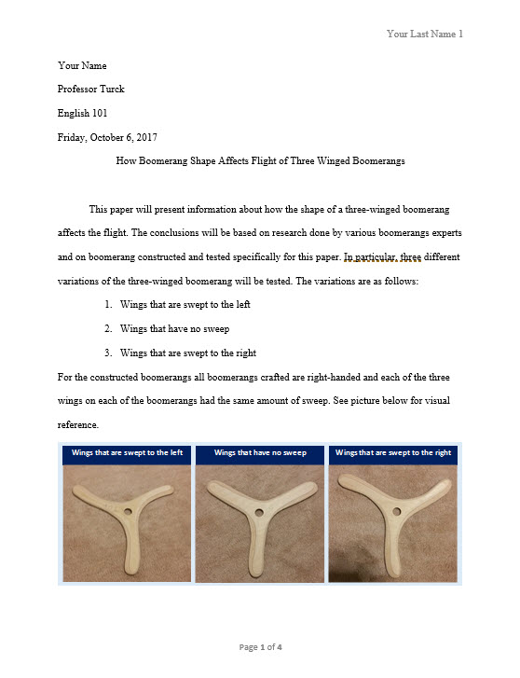
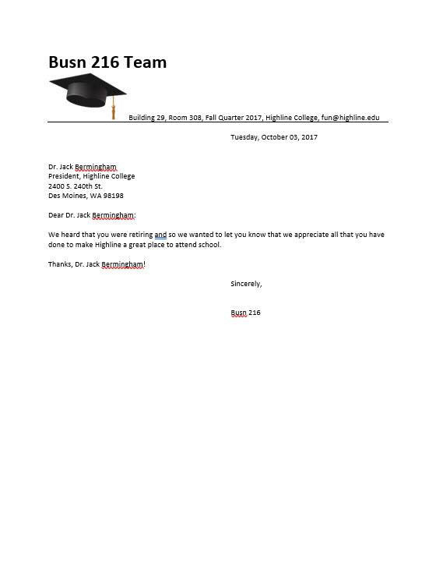
Examples in Word
Research Paper
Business Letter

Slide 6
PowerPoint
Create Presentations

Slide 7
Excel
Two Main Tasks in Excel:
  Calculations
  Data Analysis

Slide 8
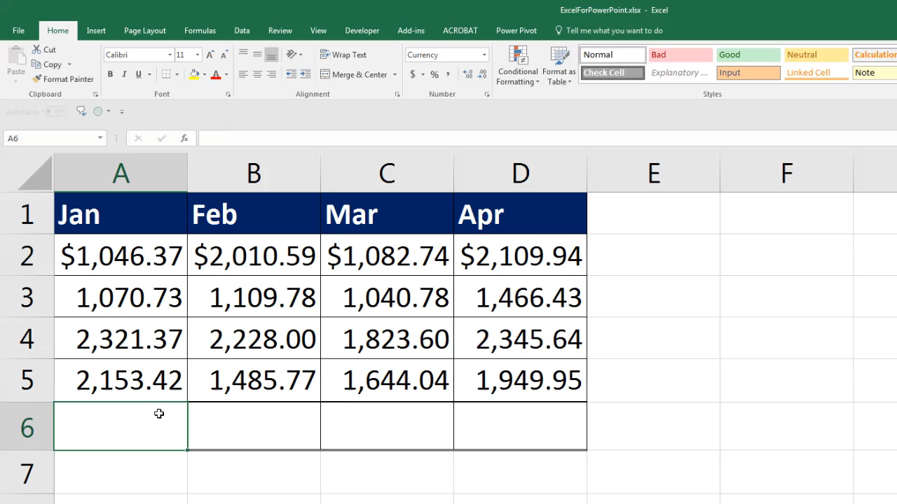
Video About Excel SUM Function

Slide 9

Video about Power Query

Slide 10
Access
Access is a Database
All databases do two things:
  Store Raw Data
  Create Useful Information From Raw Data

