Slide 1
Safari
by: Your Name

Slide 2
Safari Kenya
Famous for its classic savanna safaris, Kenya is a country of dramatic extremes and classic contrasts.
The wildlife safaris have been the top tourist attractions in Kenya for decades.
While in Kenya you can also visit the Mount Kilimanjaro, and Serengeti National park in Tanzania.

Slide 3
Top Tourist Attractions in Kenya
Top 5 Attractions
  Masai Mara National Reserve
  Amboseli National Park
  Lake Nakuru
  Tsavo National park
  Lamu Island
More Tourist Attractions
  Hell’s Gate National park
  Samburu National Reserve
  Mount Kenya
  Malindi
  Nairobi National Park
Notes:
The “Great Migration” takes place every year from July to October when millions of wildebeest and zebra migrate from the Serengeti in Tanzania to Masai Mara in Kenya.

Slide 4

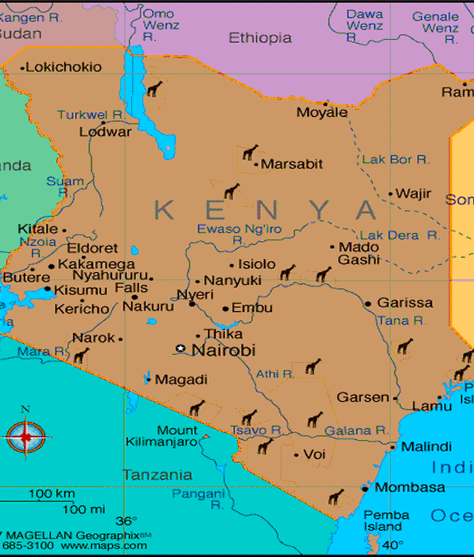
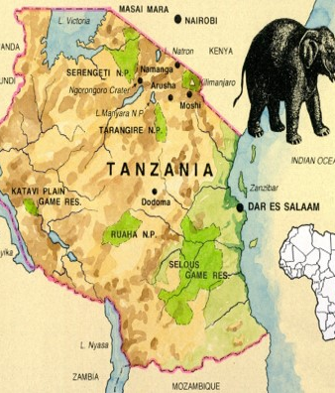
Map of Kenya and Tanzania
Both countries are in East Africa with coastline on the Indian Ocean
From Nairobi, the capital, visit Masai Mara Reserve, Amboseli National Park and Mt. Kilimanjaro, Tanzania.

Slide 5
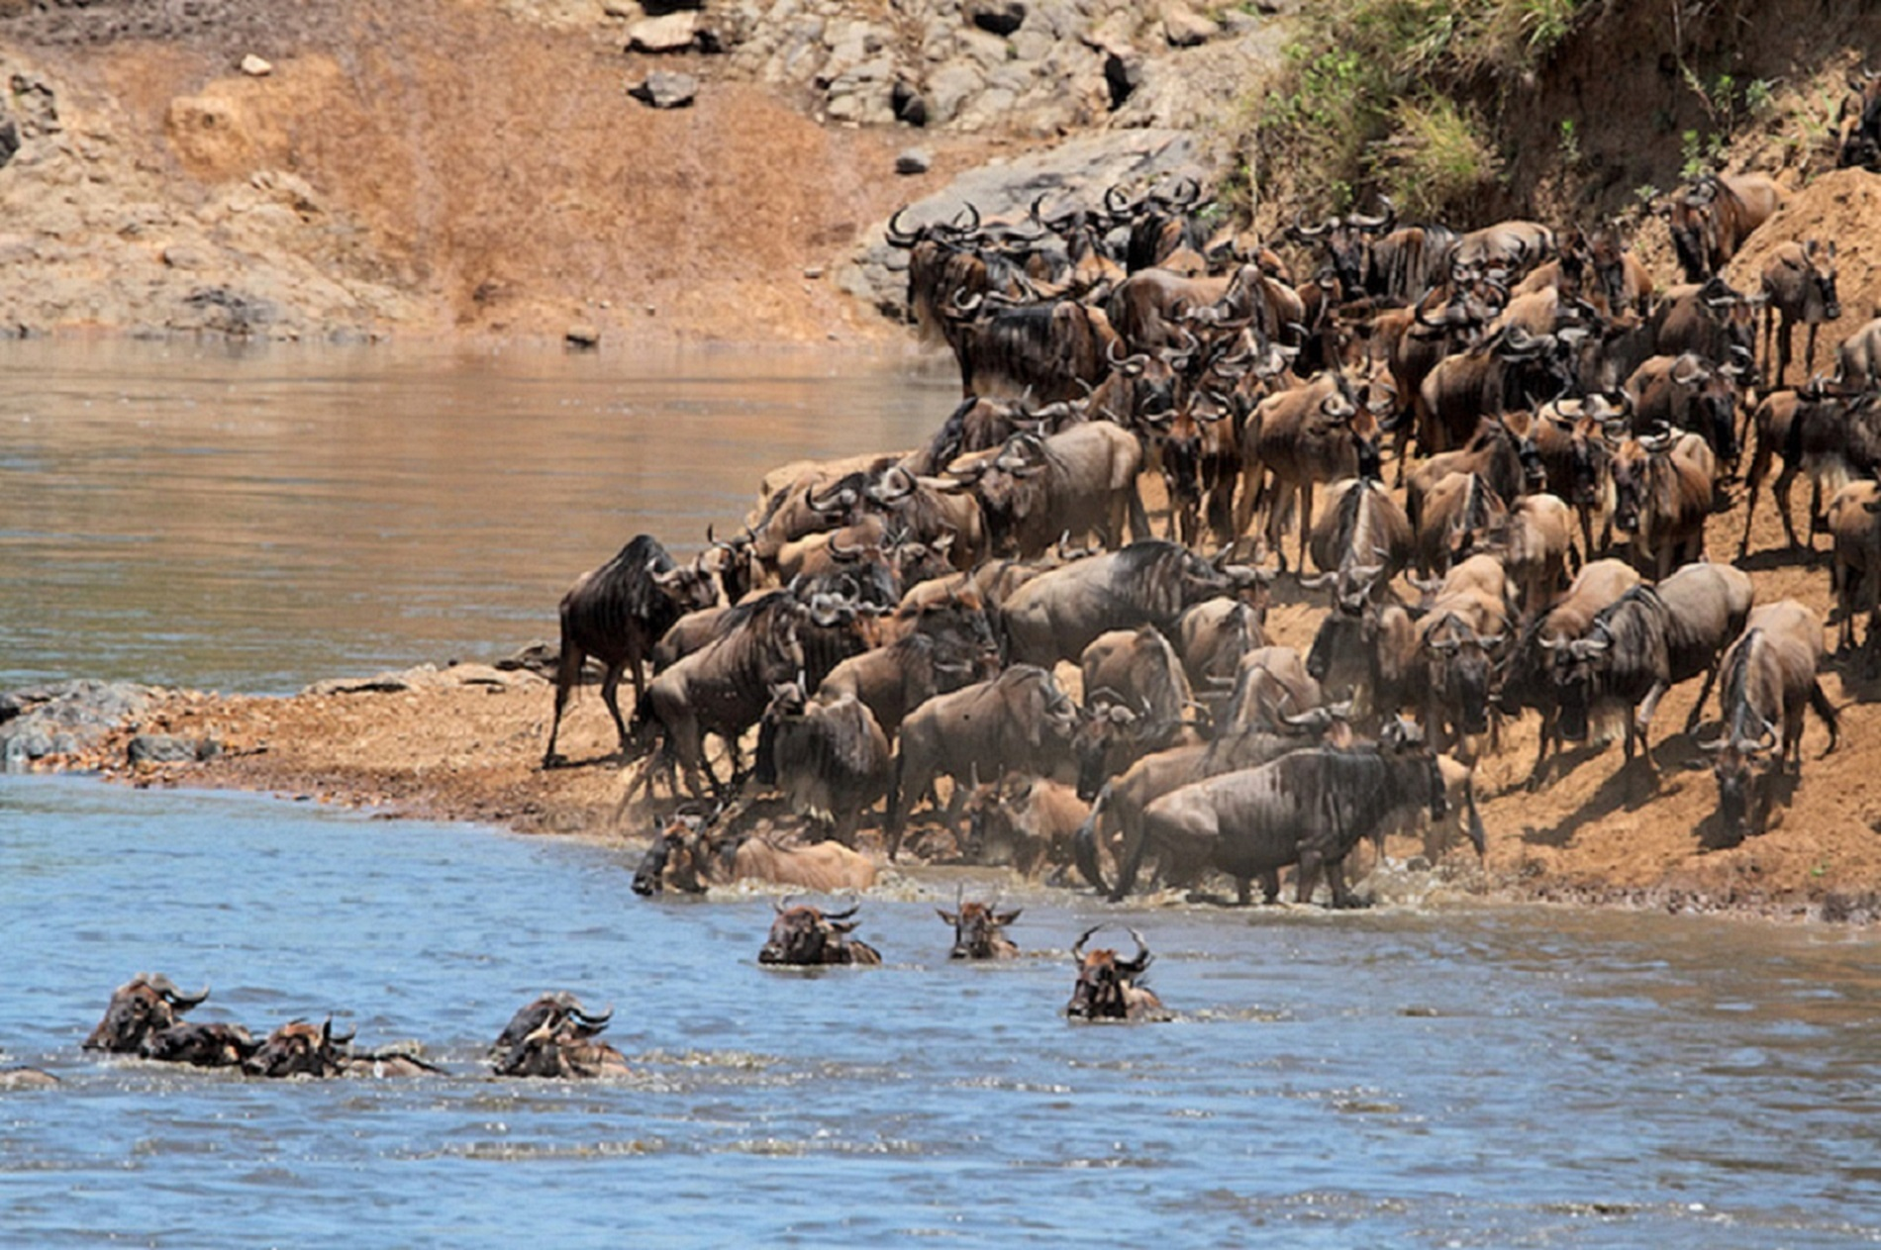
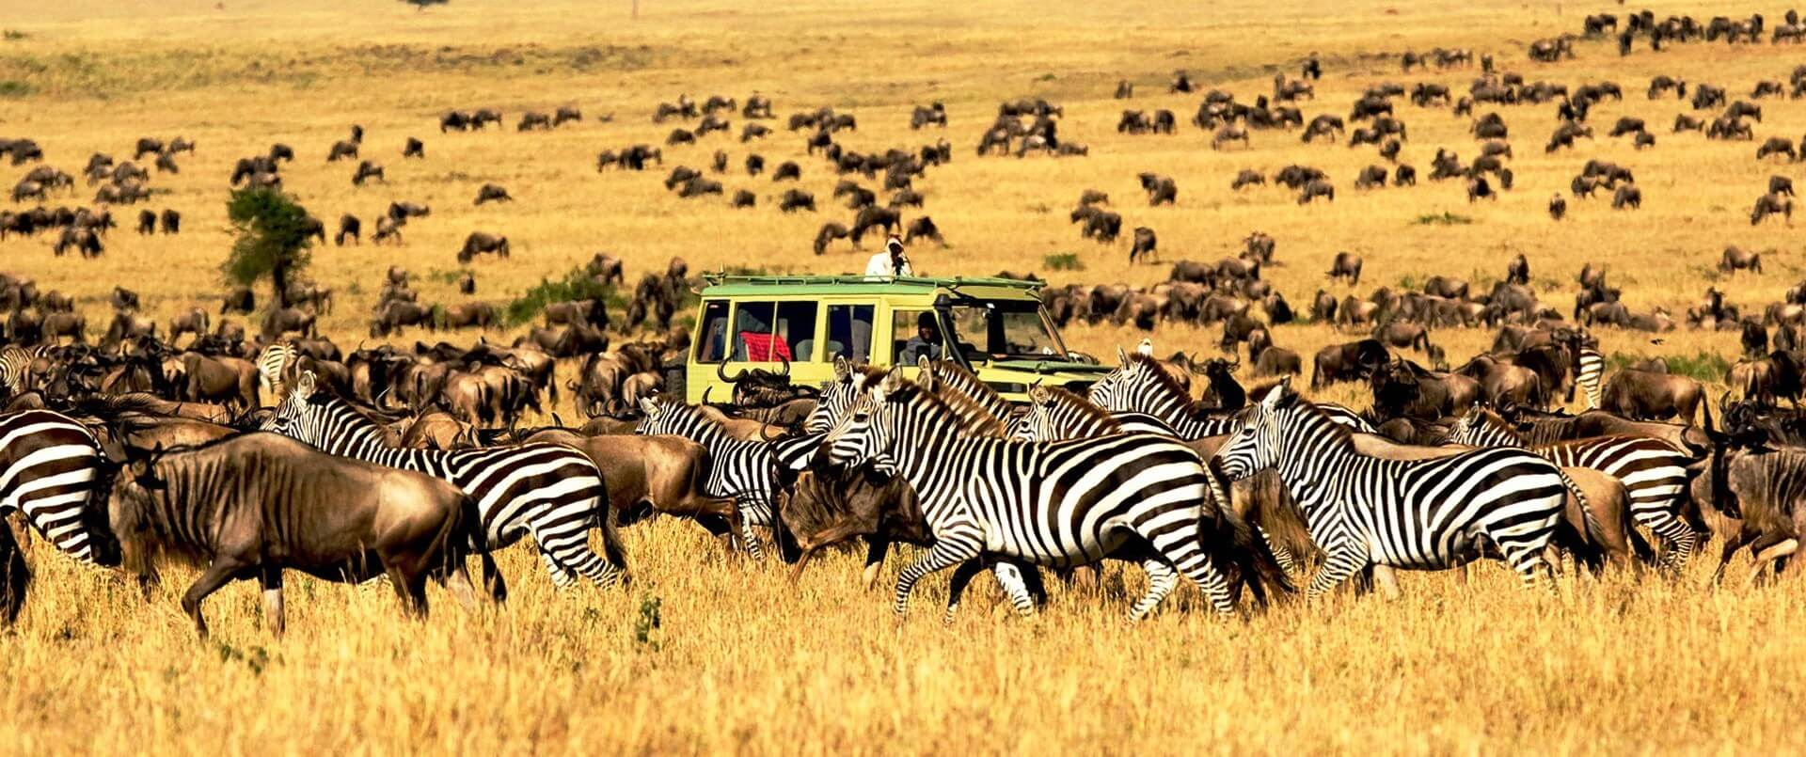
The Great Migration
Masai Mara National Reserve
Serengeti National Park

Slide 6

Safari: Kenya and Tanzania Great Wildebeest Migration

Slide 7
Thinking of Safari?
Karibu Africa!

