Slide 1
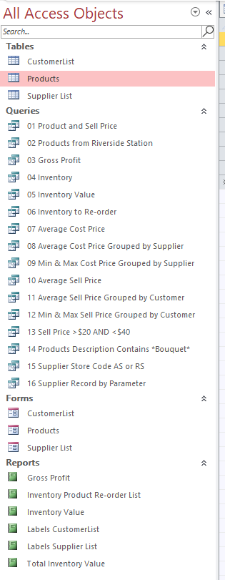
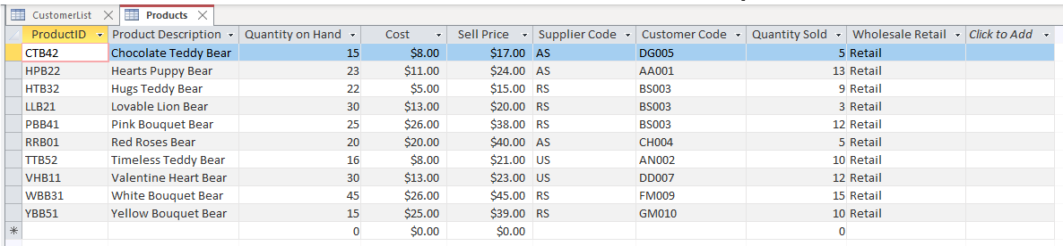
Access
Busn 216
M365 Video #12

Slide 2
Access
Access = Database
Define Database: = Database is a collection of related tables and is organized in a way that allows access, retrieval and use of that data.
What Access does:
  Stores raw data
    Store data in small parts:
    Instead of storing “925 10th St., Youngtown, AZ 85031-5358” as one piece of data, store it as 4 pieces of data:
  Creates useful information from raw data to help make decisions
    Raw Data ➔ Useful Information

Slide 3
Examples of Databases
Highline:
Google:
Highline stores raw data about:
  Students
    ID, Name, e-mail, grades, DOB, Address
  Instructors
    ID, Name, e-mail, Address
  Useful information Highline might create:
    GPA for business students
    List of student names and e-mails for a class
    Graduation List
Google stores raw data about every click you ever make:
  What you typed into search engine
  What you clicked on
  How you misspelled words
Useful information Google might create:
  What ad to display
  Most frequent links clicked on after the word “Seattle” is typed
  Correct spelling or phrase for a mistyped search request

Slide 4
Store Raw Data ➔ Useful Information
Excel
Access
Proper Data Set in Excel
  Field names in first row
    Field names say what sort of data can go in the column
  Records in subsequent rows
    Record = row = collection of bits of raw data = set of related data
Data Analysis in Excel:
  Create useful information from raw data to help make decisions
  We used:
    Formulas like SUMIFS
    Sort, Filter, PivotTables, Excel Tables, Relationships & Data Model & Power Query
Proper Table (Data Set) in Access
  Field names in first row
    Add Data Type and Field Properties so that bad raw data does not enter the table
      Note: In Excel, we saw an example of "Data Type" in Power Query
  Each record must have unique identifier (Primary Key)
    In order to prevent duplicate records
    Examples: Student ID, Invoice Number, Product ID
    In Excel, we saw an example of "Primary Key" when we created Relationships between tables for our PivotTable reports.
  Records in subsequent rows
    Record = row = collection of bits of raw data = set of related data
Data Analysis in Access:
  We will use: Queries and Reports
    In Excel, we saw an example of "Queries" in Power Query
  We will create relationships between tables so that we can create useful information from more than one table at a time.
    In Excel, we saw an example of “Relationships" when we create Relationships between tables for our PivotTable reports.

Slide 5
Access or Excel for: Raw Data ➔ Useful Information?
Access
Excel
Create more robust data validation (data types and field properties) to prevent bad data from getting into the tables.
Easier to build relationships between tables.
  Although we have Relationships and the Data Model, those are used for PivotTables
Complex queries can be easier to create in Access than in Excel.
Queries automatically update when raw data changes.
If you have Queries that you run often, it may be easier to do in Access.
  Power Query (Get and Transform) can do some querying in Excel
Simple queries such as sorting, filtering and PivotTables are easier to do in Excel.
“On The Fly” Data Analysis can be easier in Excel.
Most people know how to use Excel, at least a little bit.
Some Data Modeling done with Power Query and Excel’s Data Model can be:
  Easier to accomplish than Access
  Can hold more data more efficiently than with Access
  Busn 218 & BI 348 will explore theses topics in more detail
The combination of the two is good:
  Store data in Access
  Send raw data to Excel as needed

Slide 6
Four Important Objects In An Access Database:
Tables (Heart of any database)
Forms (User interface)
Queries (Ask a question of the database)
Reports (Useful information created from database)

Slide 7
Some Of The Differences Between Access & The Other MS Programs:
While in Access, you can only have one database open at a time
  To view multiple databases, you can use Windows Explorer to open another database while you have another one open.
Save:
  When you enter raw data into database, Access saves the data automatically
  Use the Save button only when you are creating or changing the structure of:
    Tables
    Forms
    Queries
    Reports
Undo/Redo
  Only works when you are working on:
    A record before it is saved (moved on to next record)
    Creating or changing an object (Table, Form, Query, Report)

Slide 8
Two Views For Each Object
Regular View
  Table: Datasheet view
  Form: Form view
  Query: Datasheet view
  Report: Print Preview
Design View (“Underneath view”)
  Design view allows us to change all structural elements in the object
  Although some structural elements can be added or changed in, Regular view, Design allows you to change all elements

