Slide 1
Lessons From Capital Market History:
Return & Risk
Chapter 10

Slide 2
Topics
Calculate 1 Period Returns
Five Important Types of Financial Investments
  Risk-Free Investment
What We Can Learn From Capital Market History
  Using Past To Predict Future
  Average Returns: There Is Reward For Bearing Risk
  Variability In Returns: The Greater The Potential Reward, The Greater The Risk
Risk & Return
Arithmetic V Geometric Mean
Markets Are Only Efficient In The Long Run

Slide 3
1 Year Percent Return
Dividend Yield
Capital Gains Yield

Slide 4
Period Returns = Holding Returns = 1 Year Returns

Slide 5
Five Important Types of Financial Investments
Roger Ibbotson & Rex Sinquefield did famous study that looked at the nominal-pretax-returns for five important types of financial investments in US markets during the period 1926 - 2008:
  Large Company Stocks Portfolio based on S & P 500 Index (in terms of MV of outstanding stock)
  Small Company Stocks Portfolio based on smallest 20% of companies listed on NYSE (in terms of MV of outstanding stock)
  Long-term High Quality Corporate Bonds Portfolio (20 Years to Maturity)
  Long-term US Government Bonds Portfolio (20 Years to maturity)
  US Treasury Bills (T-bills) with one-month maturity
    Virtually free of any default risk because government can raise taxes to pay bills, especially since the time frame is one monrth.
    T-bill return is considered the “risk-free return”

Slide 6
US Capital Market History
Looking at the past can perhaps provide some insight into the future.
Using the past to predict the future can be dangerous if the past isn’t representative of what the future will bring.
  2000 to 2007 people around the world looked at past house prices to predict future house prices.
  1995 to 2000 people looked at past prices for internet stocks prices to help predict future prices.

Slide 7
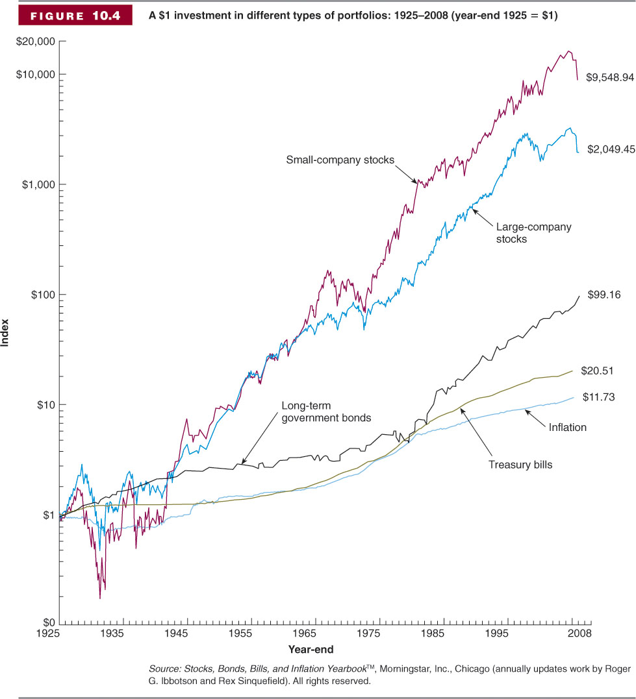
U.S. Financial Markets
The Historical Record: 1925-2008

Slide 8
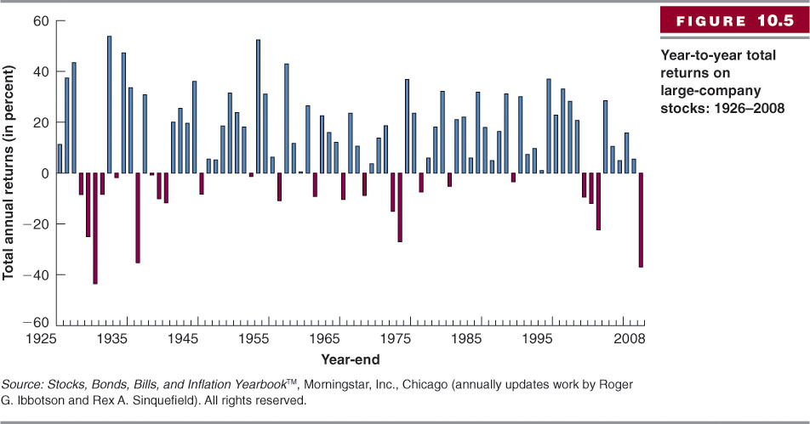
Year-to-Year Total Returns
Large-Company Stock Returns

Slide 9
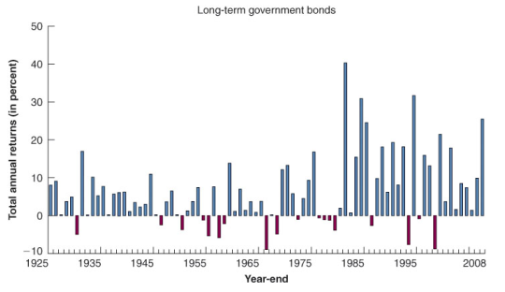
Year-to-Year Total Returns
Long-Term Government Bond Returns

Slide 10
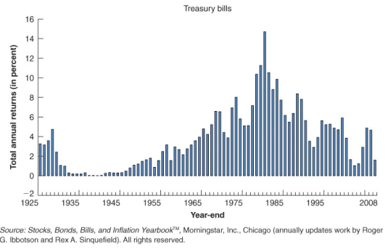
Year-to-Year Total Returns
U.S. Treasury Bill Returns

Slide 14
Arithmetic Mean = “Average”
Arithmetic Mean =
Mean =
“Average” (everyday language) =
“Typical Value” =
One Value that Can Represent All The Values =
(Add Then All Up)/Count

Slide 15
Historical Average Returns
Historical Averages For Asset Classes = Arithmetic Mean of Asset Class = (Add then all up)/Count
Reward For Risk = Risk Premium = Historical Arithmetic Mean of Asset Class – Historical Arithmetic Mean of T-Bill

Slide 16
Historical Averages, Reward For Risk, Real Rate
What We Can Learn From Capital Market History
  Lesson 1: There Is Reward For Bearing Risk
But why do some investments get more reward?
  The answer lies in “variability of returns”

Slide 17
Variability In Returns = Volatility In Returns = Risk
Variability seen with Line & Column Chart
Variability seen with X-Y scatter chart
Variability seen with Frequency Distribution
Risk Measured by calculating Standard Deviation

Slide 18
U.S. Financial Markets
The Historical Record: 1925-2008

Slide 19
Year-to-Year Total Returns
Large-Company Stock Returns

Slide 20
Year-to-Year Total Returns
Long-Term Government Bond Returns

Slide 21
Year-to-Year Total Returns
U.S. Treasury Bill Returns

Slide 22
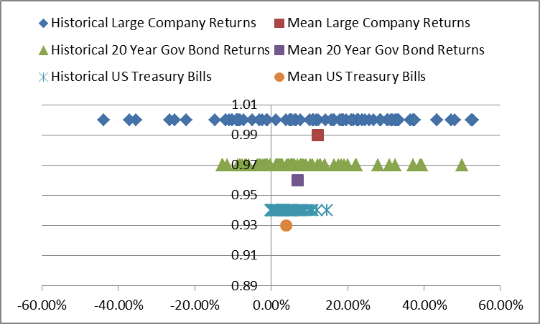
Variability seen with X-Y scatter chart
Which set of data is more spread out?
Which mean represents its data points more fairly?
If the data points are all clustered around the mean, then there is less variability, less risk that your return will be different than the mean.

Slide 23
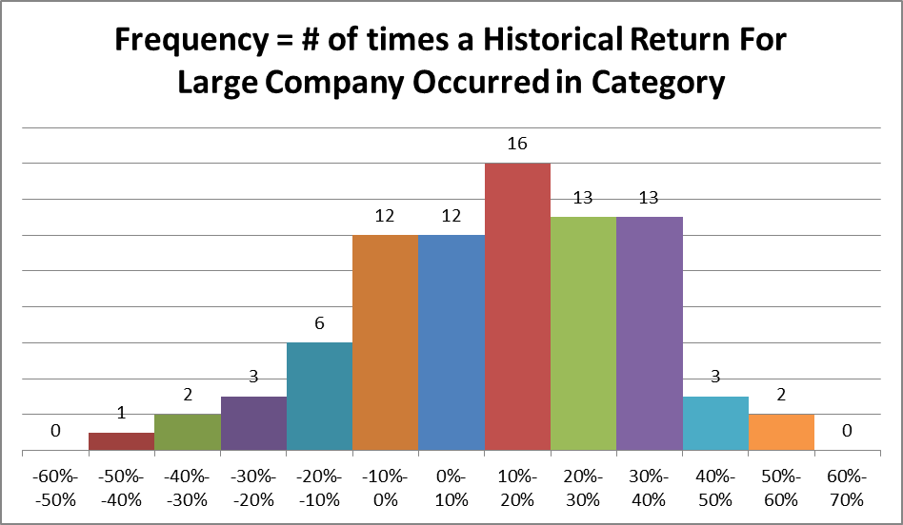
Variability seen with Frequency Distribution

Slide 24
Variability seen with Frequency Distribution

Slide 25
Which Stock Would You Prefer?
Each Has a Mean Return Of 4.1%
Why?

Slide 26
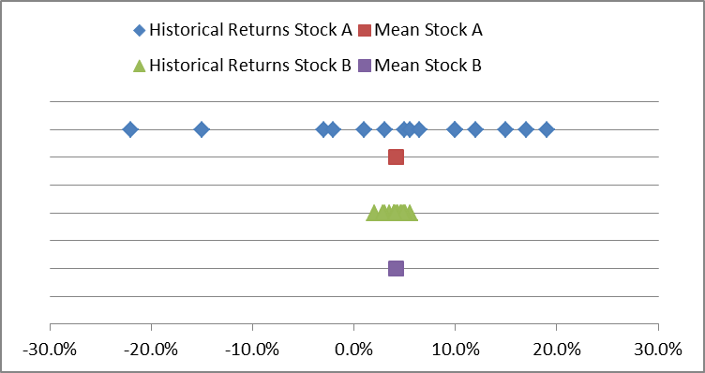
Which Stock Would You Prefer?
Each Has a Mean Return Of 4.1%
Why?

Slide 27
But Now We Need A Number To Measure The Volatility of Returns

Slide 28
Variability Measured By Calculating Standard Deviation
Risk is measured by the dispersion, spread, or volatility of returns.
Standard Deviation will be calculated number that measures variability, or volatility, or dispersion, or simply RISK

Slide 29
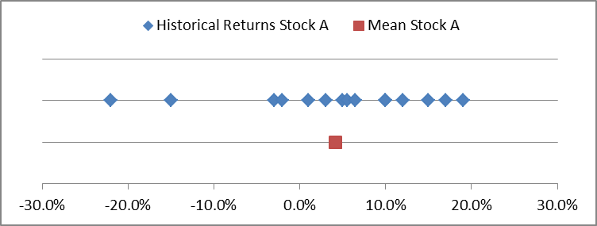
How Far Does Each Actual Return Deviate From The Mean In A Typical Year?
Deviation tells you how far each return is from the mean
Deviation = Return – Mean
If we average these deviations, it will give us an indication of the volatility of the stock.
Sum of Deviations = 0
  This means we can’t calculate the mean in the normal way.

Slide 30
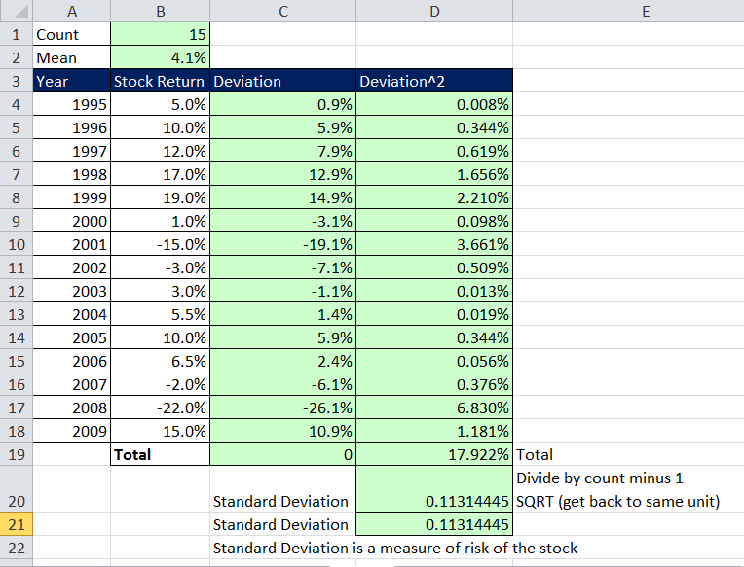
Standard Deviation Is A Numerical Measure Of Volatility Or “Risk” Of Stock

Slide 31
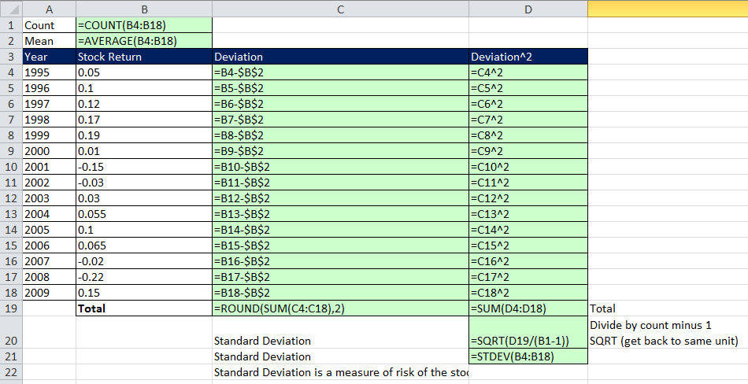
Standard Deviation Is A Numerical Measure Of Volatility Or “Risk” Of Stock

Slide 32
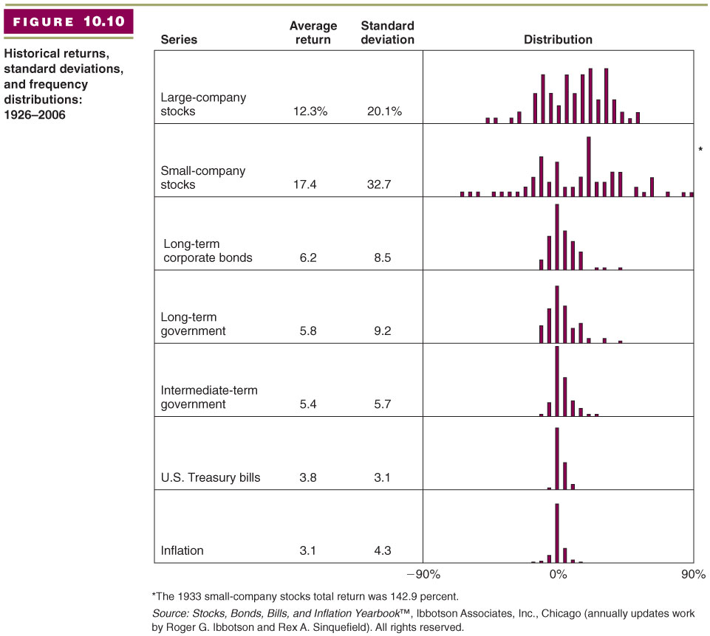
What We Can Learn From Capital Market History
Lesson 2: The Greater The Potential Reward, The Greater The Risk

Slide 33
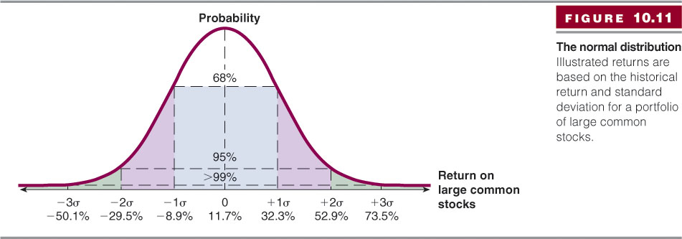
Standard Normal Curve
Do Our Historical Distributions Look Bell Shaped?

Slide 34
Risk And The Standard Normal Curve
Only Past Distributions That Fit The “Normal” Curve Can Use The Standard Normal Curve
Normal distribution:
  A symmetric frequency distribution
  The “bell-shaped curve”
  Completely described by the mean and variance
Example: Mean = 11.7%, Standard Deviation = 20.6%, the 68% of the values should lie between 11.7%-20.6% and 11.7% + 20.6% or -8.9% and 32.3%.

Slide 35
If Assume Bell Shaped

Slide 36
Risk–Return Tradeoff
(Conclusion To Chapter 10)
Two key lessons from capital market history:
  There is a reward for bearing risk
  The greater the potential reward, the greater the risk

Slide 37
Capital Market History
Average Returns: There Is Reward For Bearing Risk
Variability In Returns: The Greater The Potential Reward, The Greater The Risk

Slide 38
Mean Return & Standard Deviation
For Historical Returns we use Mean & Standard Deviation
For Projected Future Returns we use “Expected Returns” based probability theory to calculate returns and risk (standard deviation). Chapter 11

Slide 39
Arithmetic vs. Geometric Mean
Arithmetic average:
  Return earned in an average period over multiple periods
  Answers the question: “What was your return in an average year over a particular period?”
Geometric average:
  Average compound return per period over multiple periods
  Answers the question: “What was your average compound return per year over a particular period?”
Geometric average < arithmetic average unless all the returns are equal

Slide 40
Geometric Average Return: Formula
Equation 10.4
Where:
R_{i} = return in each period
T = number of periods

Slide 41
Arithmetic vs. Geometric Mean
Which is better?
The arithmetic average is overly optimistic for long horizons
The geometric average is overly pessimistic for short horizons
Depends on the planning period under consideration
  15 – 20 years or less: use arithmetic
  20 – 40 years or so: split the difference between them
  40 + years: use the geometric

Slide 42
Efficient Markets Hypothesis
Efficient Markets = new information is assimilated quickly & correctly into financial asset prices. The correctly priced assets help to efficiently allocate resources in the capitalist system.
Financial Markets are efficient in that when new information becomes available, people buying and selling stocks and bonds try to incorporate new information into their estimates of the security.
  Competition between investors means that people study companies very closely, trying to find the mispriced stock. When everyone is doing this, prices tend to be not mispriced.
  EMH implies that all investments are NPV = 0. This is because if prices are not too high or low:
    NPV (investors estimate) – MV (Price in market) = 0

Slide 43
Efficient Markets Hypothesis
Strong Efficient
  All public and private info is reflected in security price.
Semistrong Efficient
    All public info is reflected in security price.
    If true, financial statement analysis or studying current mortgage rate defaults is futile.
      People study info like this all the time.
  Weak Form Efficient
    Past Security Price info is reflected in security price.
      If true, searching for patterns in historical prices is futile.
      People do this all the time “Technical Analysis”.

Slide 44
Efficient Markets Theory As Currently Stated Is False
Herd mentality or “animal spirits” tend to make people follow certain trends in the market even when the trend is unreasonable (1990 Internet Stocks, 2000 Housing Prices). Fisher, Keynes and Minsky all wrote extensively about such behavior.
Often times Financial Market Bubbles are fueled by firms and individuals borrowing money to buy up assets, the increased demand for assets increases the price of the assets, the increased value of the assets allows people to borrow more because they have more collateral. In essence, “easy credit” can contribute to assets price increases that do not reflect the underlying fundamentals of the asset.
  Examples: Depression and the 2007-2010 Housing Crisis.
  2007-2010 Housing Crisis: housing prices where well above the present value of future rent cash flows.

Slide 45
Efficient Markets Theory As Currently Stated Is False
The idea that markets always price financial assets correctly has been proven false a number of times in history.
  Example: Public information about default rates on houses was available in the years 2005 - 2007, and yet prices on mortgage back securities did not adjust downward until late 2007. As a result of the overpriced financial assets, people continued to take out loans and buy houses. This is an example of how resources are inefficiently allocated when prices are not correct based on inefficient markets. The result: many people got seriously hurt when the prices finally did adjust (late).
  AOL was priced high at the height of the Internet Bubble in the late 1990s.
  If markets are efficient, how come AOL stock was valued so high for so long? How come mortgage backed securities with loans from 2004 – 2007 had a price at all?

Slide 46
Efficient Markets Are Only Efficient In The Long Run
In the long run, markets tend to be efficient (eventually, internet stocks and mortgage back securities did fall).

