Slide 1
Highline Class, Busn 210
Business Statistics using Excel
Section 10: Simple Linear Regression

Slide 2
Topics
Decisions Based on Relationship Between Two or More Variables
Regression Analysis
Scatter Chart
Types of Relationships
Scatter Chart and Ybar and X Bar Lines
Covariance and Correlation
Simple Liner Regression Model
Assumptions about Error in Model
Simple Liner Regression Equation
Estimated Simple Linear Regression Equation
Calculating Slope & Y-Intercept using the Least Squares Method
Experimental Region
How to Interpret Slope and Y-Intercept
Prediction with Estimated Simple Liner Regression Equation
Residuals
Coefficient of Determination or R Squared
SST = SSR + SSE
Standard Error
Data Analysis Regression feature
Testing Significance of Slope and Y-Intercept (Inference)
Multicollinearity
Categorical Variable
Inference in Vary Large Samples

Slide 3
Decisions Based on Relationship Between Two or More Variables
Managerial decisions are often based on the relationship between two or more variables
Predict/Estimate Sales (Y) based on:
Advertising Expenditures (x₁)
Predict/Estimate Bike Price (Y) based on:
Bike Weight (x₁)
Predict/Estimate Annual Amount Spent on Credit Card (Y) based on:
Household Annual Income (x₁)
Education (x₂).
Predict/Estimate Stroke (Y) based on:
Age (x₁)
Blood Pressure (x₂)
Smoking (x₃)

Slide 4
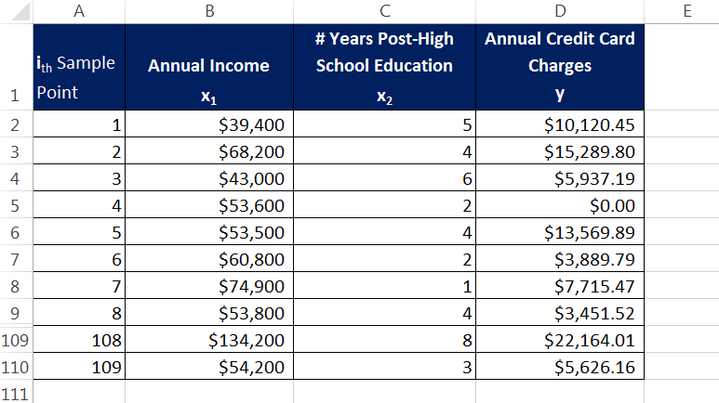
X – Y Data
Independent Variable = x
Predictor variable
Dependent Variable = y = f(x)
Variable that is predicted or estimated
Response variable

Slide 5
Regression Analysis
Regression Analysis
A statistical procedure used to develop an equation showing how two or more variables are related.
Allows us to Build Model/Equation to help Estimate and Predict.
The entire process will take us from:
Taking an initial look at data to see if there is a relationship.
Creating an equation to help us estimate/predict.
Assessing whether equation fits the sample data.
Use Statistical Inference to see if there is a significant relationship.
Predict with the equation.
Regression Analysis does not prove a cause and effect relationship, but rather it helps us to create a model (equation) that can help us to estimate or make predictions.
Simple Regression
Regression analysis involving one independent variable (x) and one dependent variable (y).
Linear Regression
Regression analysis in which relationships between the independent variables and the dependent variable are approximated by a straight line.
Simple Linear Regression
Relationship between one independent variable and one dependent variable that is approximated by a straight line, with slope and intercept.
Multiple Linear Regression (not covered in this class)
Regression analysis involving two or more independent variables to create straight line model/equation.
Curvilinear Relationships (not covered in this class)
Relationships that are not linear.

Slide 6
Scatter Chart to “See” If There Is a Relationship
Graphical method to investigate if there is a relationship between 2 quantitative variables
Excel Charting:
Independent Variable = x
Horizontal Axis
Left most column in data set
Dependent Variable = y = f(x)
Vertical Axis
Column to right of x data column
Always label the x and y axes.
Use an informative chart title.
Goal of chart: Visually, we are “looking” to see if there is a relationship pattern.
For our Sales (x) Ad Expense (y) data we “see” a direct relationship.
To get estimated line & equation and r^2, right-click markers in chart and click on “Add Trendline”. Then click dialog button for “Linear” and the checkboxes for “Display equation on chart” & “Display R^2 on chart”. Learn about equation & r^2 later…

Slide 7
Types of Relationships
Investigate if there is a relationship: With the Scatter Chart, you look to see if there is a relationship.
Looks like “As x increases, y increases”. Direct or Positive Relationship
Looks like “As x increases, y decreases”. Inverse or Indirect or Negative Relationship
Looks like No Relationship

Slide 8
Baseball Data Scatter Charts

Slide 9
Covariance and Correlation: Numerical Measures to Investigate if There is a Relationship
These numerical measures will be more precise that the “Positive”, “Negative” “No Relationship” (also “Little Relationship”) categories that the Scatter Chart gave us.
Numerical measures to investigate if there is a relationship between two quantitative variables.

Slide 10
Scatter Chart and Ybar and X Bar Lines
Scatter Charts are graphical means to find a relationship between 2 quantitative variables.
We need a numerical measure that is more precise than our Scatter Chart.
To understand how the numerical measure can do this, we plot a Ybar line and Xbar line on our chart.

Slide 11
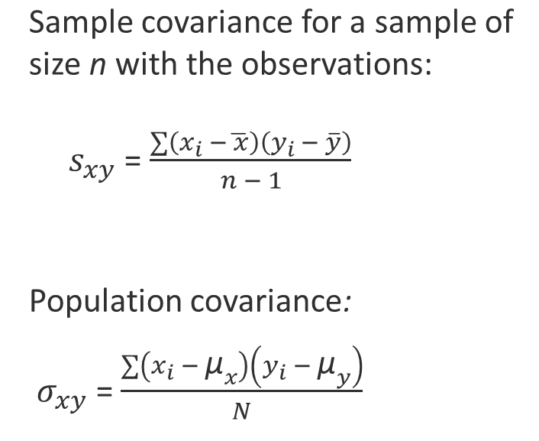
Covariance
Measure of the linear relationship between two quantitative variables.
Positive values indicate a positive relationship; negative, a negative relationship.
Close to zero means there is not much of a relationship.
The magnitude of covariance is difficult to interpret.
Covariance has problems with units (like feet compared to inches).
We can standardize covariance by dividing it by s_{x}*s_{y} to get Coefficient of Correlation.
In Excel use COVARIANCE.S function for sample data:
Y data first, x data second

Slide 13
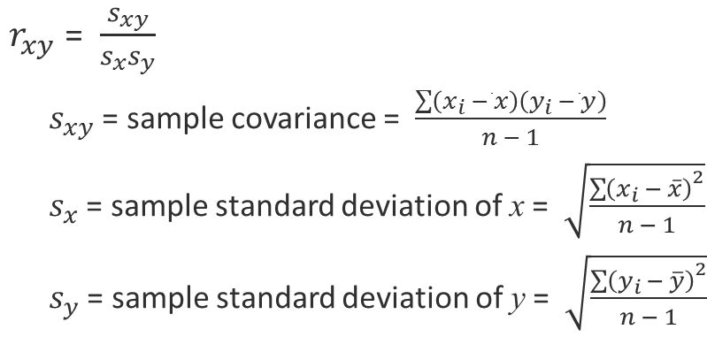
Coefficient of Correlation (r_{xy})
Measure the strength and direction of the linear relationship between two quantitative variables.
A relative measure of strength of association (relationship) between 2 variables or a measure of strength per unit of standard deviation, s_{x} * s_{y} .
Solves Covariance “units”/ magnitude problem.
In Excel use CORREL or PEARSON functions.
Investigate if there is a relationship: We will have a number answer that indicates the strength and direction:
Always a number between -1 and 1.
0 = No correlation
Near 0.5 of -0.5 = moderate correlation
Near -1 or 1 = strong correlation
Does not have problems with units like Covariance does.
Can only be used for one independent variable to measure a linear relationship
As opposed to Coefficient of Determination (“r squared” or “Goodness of Fit Test”), which can be used for 1 or more independent variables and for linear or non-liner relationships
Note: Because the Correlation Coefficient measure the strength and direction of a LINEAR relationship, not nonlinear relationships. If you get a correlation measure near zero, it may be true that there is a very weak linear relationship, but that does not say that there is not some other sort of non-linear relationship.

Slide 15
Ad Expenditures / Sales Example: Covariance and Correlation in Excel
Covariance and Correlation look very strong.

Slide 16
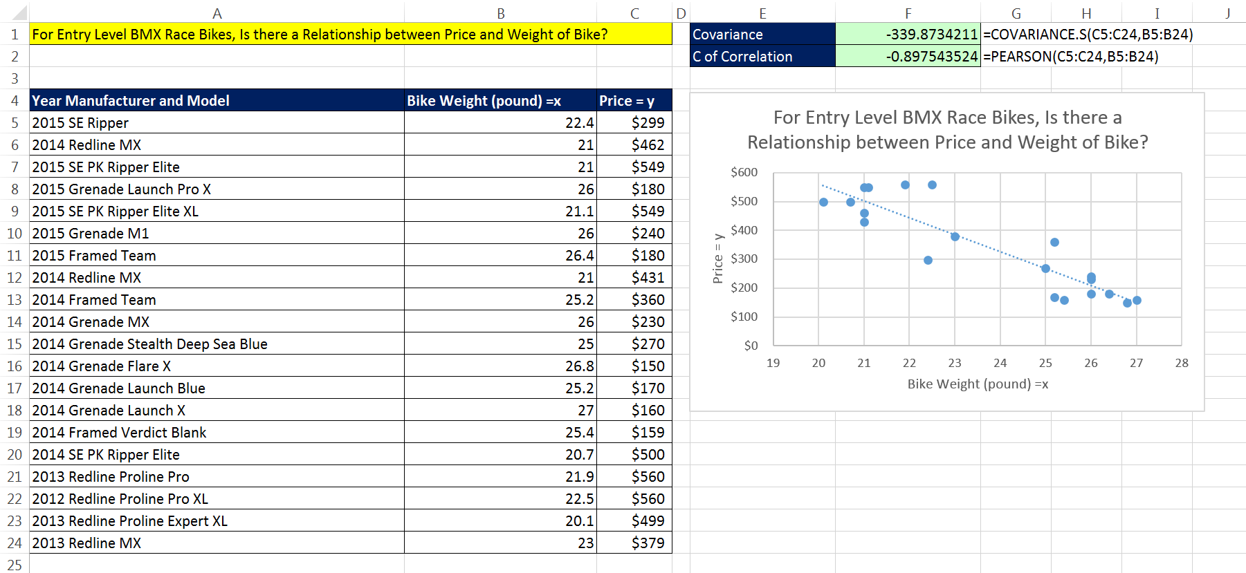
Analyst Wants to See if There is a Relationship Between BMX Racing Bike Weight and Price.
Negative/Inverse Relationship: As Bike Weight increases, Price decreases.
Covariance & Correlation are negative & strong.

Slide 17
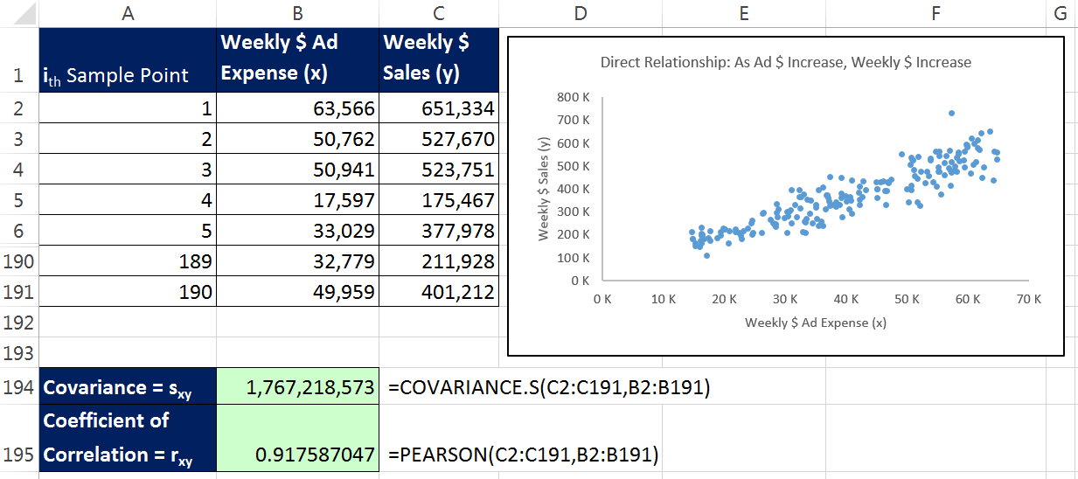
Ad Expenditures / Sales Example: Chart, Covariance and Correlation Indicate a Relationship
Now that we see that there is a relationship between the two variables, “Weekly Ad Expense” and “Weekly Sales”, through our Scatter Chart, Covariance & Correlation:
We choose the simple linear regression to create an equation that will allow use to predict and estimate sales based on advertising expenditures.

Slide 18
Overview: Simple Linear Regression
Algebra:
f(x) = y = m*x + b
Statistics:
Y_{hat} = ŷ = b₁*x + b₀ (sample statistics)
y = β₁x + β₀ (population parameters)
Slope = m = b₁ = β₁ = “For every one unit of x, how much does y change?”
Intercept = b = b₀ = β₀ = “At what point does line cross y-axis?” or “what is y, when x = 0?”
The equation describes a straight line.

Slide 19
Simple Liner Regression Model with Population Parameters
Simple Linear Regression Model:
y = β₁x + β₀ + ε
y = Predicted value
β₁ = Slope β₁ = “Beta sub 1”
x = Value you put into the equation to try and predict the y value.
β₀ = Y-Intercept β₀ = “Beta sub 0”
ε = Error Value = random variable that accounts for the variability in y that cannot be explained by the liner relationship between x and y. ε = “Epsilon”

Slide 20
Because Not All Sample Points Are On The Estimated Line We Will Get Some Error (ε)

Slide 21
Assumptions About The Error Value (ε) Necessary for the “Least Squares Method” of calculating b₁ and b₀.
The assumption of bell shape for errors, indicates that right on the line, the mean of the error value at any particular x is zero. E(ε) = 0.
This means that we can use the slope and intercept (β₁ & β₀) as constants.
Total population can be thought of as having sub-populations.
For each x value there is a range of possible y values (sub-population).
The Bell Shaped distribution is an assumption about the possibility of getting a y value above or below the line for a given x value.
The error (ε) variation will be constant
E(y|x) = β₁x + β₀
Describes the line down the middle, where ε = 0.
Is the mean of all the y values and sits exactly on the line.

Slide 22
Simple Liner Regression Equation with Population Parameters
Simple Linear Regression Equation:
E(y|x) = β₁x + β₀
E(y|x) = Expected Value or Mean of all the y values at a particular x value.
E(y|x) = β₁x + β₀ describes s straight line down the middle, where ε = 0.

Slide 23
Sample Slope and Y-Intercept
Because population parameters for slope & intercept are not usually known, we estimate them using sample data in order to calculate sample statistics for slope and y-intercept.

Slide 24
Estimated Simple Linear Regression Equation with Sample Statistics
Estimated Simple Linear Regression Equation:
y_{hat} = $\hat{y}$ = b₁x + b₀ $\hat{y}$ = “y hat”
b₁ = Slope = a sample statistic that estimates the population parameter β₁ = slope of estimated regression line.
b₀ = y-intercept = a sample statistic that estimates the population parameter β₀ = y-intercept of estimates regression line.
$\hat{y}$ gives us two possible interpretations:
$\hat{y}$ = Point estimator of E(y|x) = Estimates mean of all y values for a given x in population. or
$\hat{y}$ = Can Predict individual y value for a particular business situation.
Graph of the estimated simple linear regression equation is called “estimated regression line”.

Slide 25
Estimation Process for Simple Linear Regression

Slide 26
Overview: Least Squares Method to Derive Formula for b₁ & b₀
**For proof of formulas, see downloadable pdf file.

Slide 27
Formulas for estimated Slope (b₁) Y-intercept (b₀)
The formulas used to estimate b₁ and b₀ can be derived using Differential Calculus in what is called the “Least Squares Method”.
**For proof of formulas, see downloadable pdf file.

Slide 28
Ad Expenditures / Sales Example: Calculate Slope and Y-intercept

Slide 29
Experimental Region
We are not sure if the relationship is linear outside our x sample data range.
It is best to make predictions over the range of the min and max of the sample x data.
This range is called the “Experimental Region”
When you make predictions outside the Experimental Region, it is called “Extrapolation”
The y-intercept is often estimated using Extrapolation
We do not have empirical evidence that the relationship holds outside the experimental region; an estimate created outside the experimental region is an unreliable estimate.

Slide 30
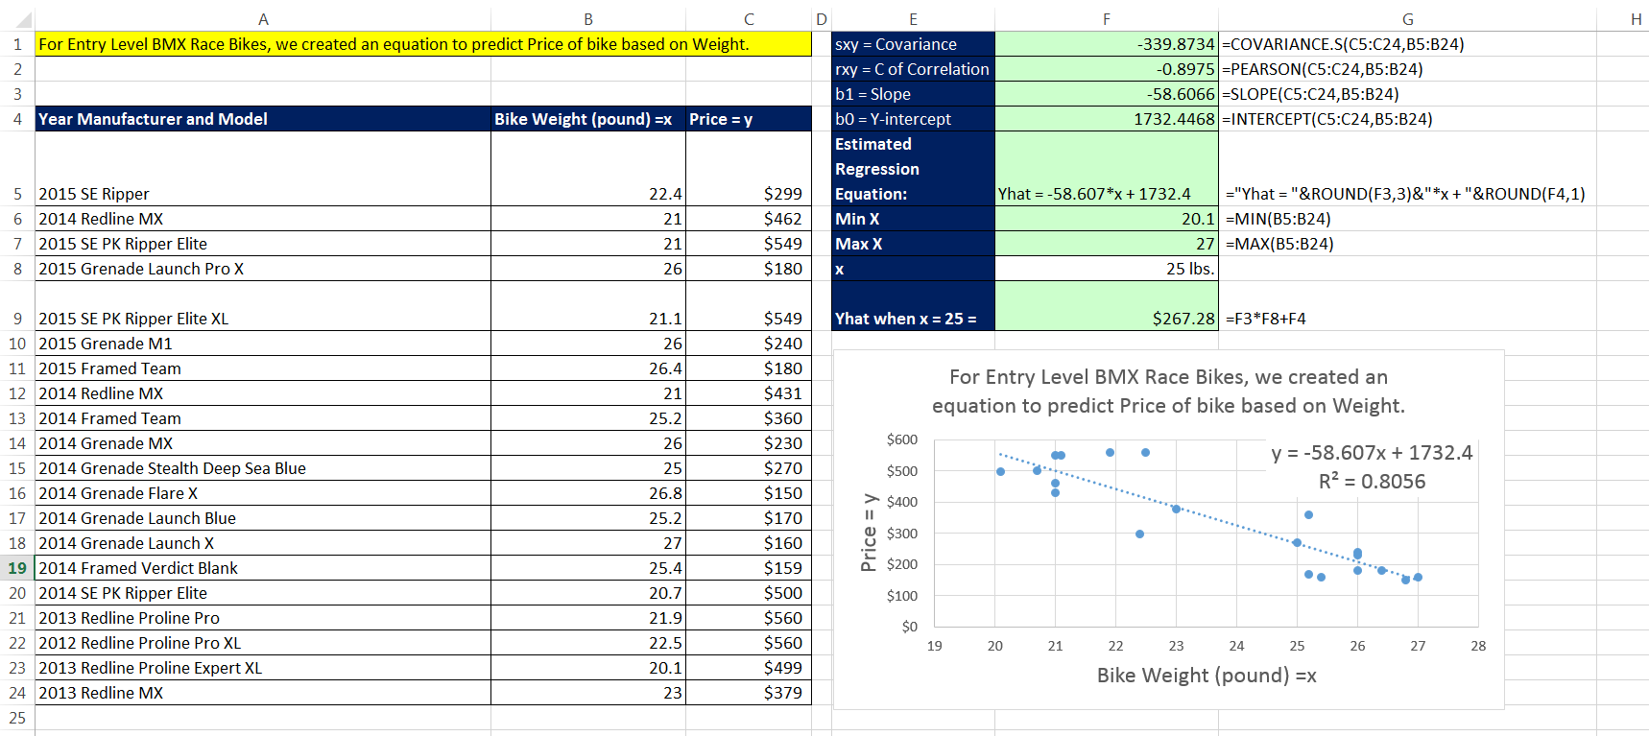
Bike Weight/ Bike Price Example: Calculate Slope and Y-intercept from Sample Data, Make a Prediction
Can we expect that a bike can have a price of $1,732.40 (x = 0)?
The y-intercept was estimated using Extrapolation
The range for these entry level racing bikes is about 20 to 27 lbs.
There are specialized pro BMX racing bikes that weigh less than 20 lbs., but they can cost upwards of $3,000.
Our equation would predict that a bike weighing 17 lbs. would be $736.14…
It is best to not use equation outside our range of min & max x sample values, our Experimental Region.

Slide 31
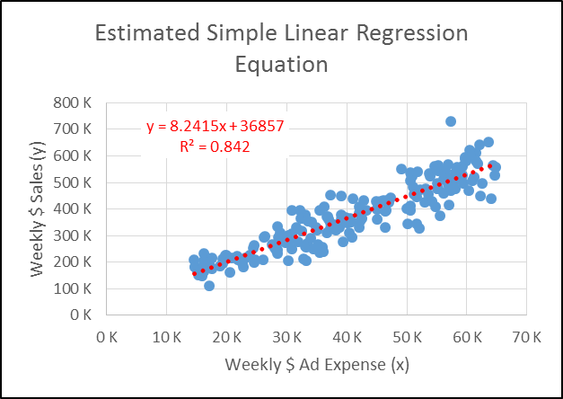
How to Interpret Slope and Y-Intercept
Slope
What is the correct interpretation of slope?
For every $1 increase in Ad Expense, the equation predicts that Weekly Sales will increase by $8.24.
Y-Intercept
What is the correct interpretation of the y-intercept?
When x = 0, the equation predicts that the Weekly Sales will be $20,406. Because 0 is not in our Experimental Region, extrapolating what the sales will be at x = 0 yields an unreliable estimate.
We still can use it to make predictions over the Experimental Region.

Slide 32
Prediction with Estimated Simple Liner Regression Equation
ŷ = 8.24 * x + 36857.04
Manager plans to spend $43,000 on ads next week.
X = 43,000
ŷ = 8.24 * 43000 + 36857.04
ŷ = $391,243.63
Our prediction of $391,243.63 is reasonable because our model is based on sample evidence and we predicted using an x value that is within the Experimental Region.

Slide 33
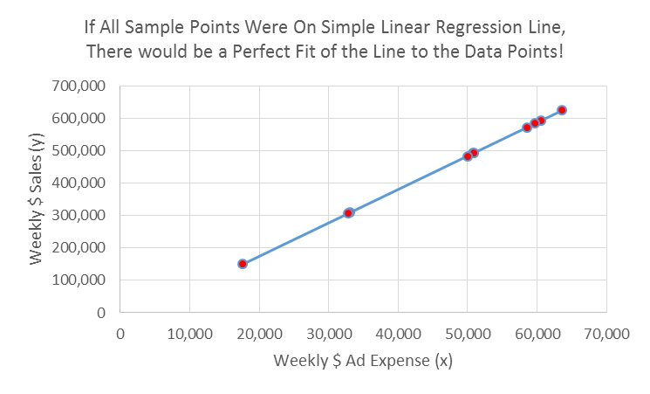
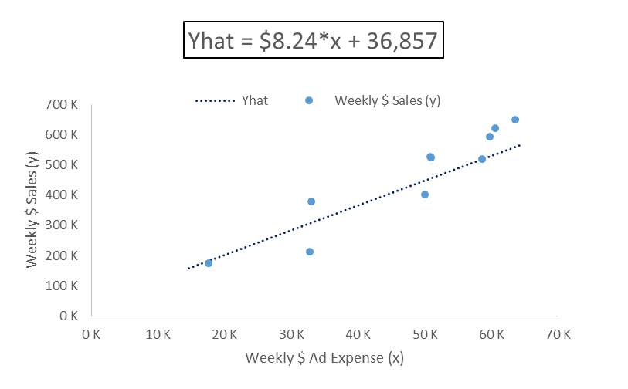
Does the Equation Predict Perfectly?
We need to examine something called Residuals.

Slide 34
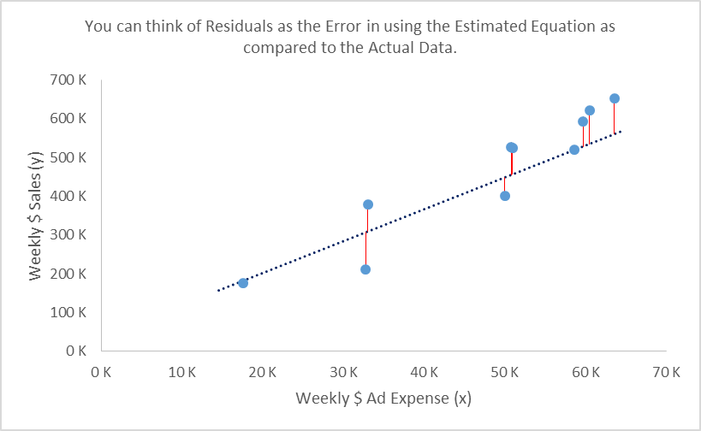
Residuals = Y₁ – ŷ = Particular Y value – Predicted Y Value
Sometimes the Equation Underpredicts
Vertical lines on chart represnet residuals or “Errors in using Predicted Value as compared to Actual Y Value.
Sometimes the Equation Overpredicts

Slide 35
Residuals = $(y_{i} −{\hat{y}}_{i})$
Predicted Values = ${\hat{y}}_{i}=b_{1}x_{i}+b_{0}$
Calculate predicted values using Estimated Equation at each $x_{i}$
FORECAST function in Excel can be used for predicted values. All it needs is an x value and the known y and x values and it will calculate the predicted value using the Estimated Regression Equation Slope and Intercept.
Residuals = $(Y_{i} −{\hat{y}}_{i})$
Particualr value – Predicted value
Distance that “Original Y Sample Value” is above or below the Estimated Line
Vertical lines on chart represnet residuals
Note 1:
Sum of Y_{i} values = Sum of predicted values (all ŷ_{i} )
Note 2:
Sum of residuals = 0
Note 3:
Residuals Squared are minimized becasue we calculated predicted values with b₁ & b₀

Slide 36
Ybar Line vs. Estimated Simple Linear Equation Line for Making Predictions
Ybar Model
Yhat Model
These errors are called “Deviations”
These errors are called “Residuals”
A Lot of Error when Making Predictions
Much Less Error.
Manager Now Has a Better Model For Predicting As Compared to a Ybar Model.

Slide 37
How Well Does Estimated Equation/Line Fit the Sample Data?
The measure we will use is called:
Coefficient of Determination or R Squared.
It is a measure of Goodness of Fit.

Slide 38
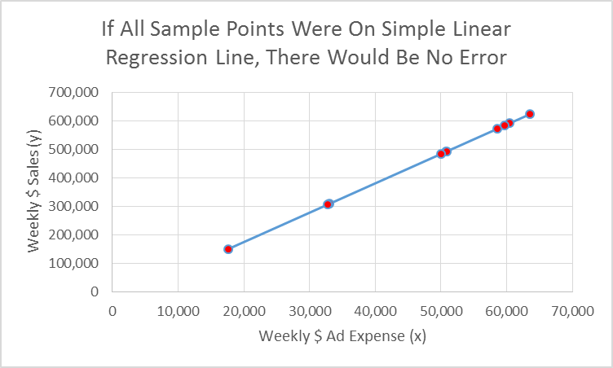
If All Sample Points Fell on Estimated Line, There Would Be No Errors

Slide 39
Error in Predicting Y Using Equation

Slide 40
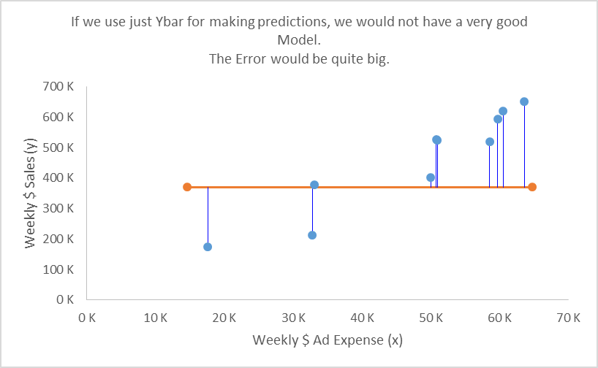
Total Error if we used just Y_{bar}

Slide 41
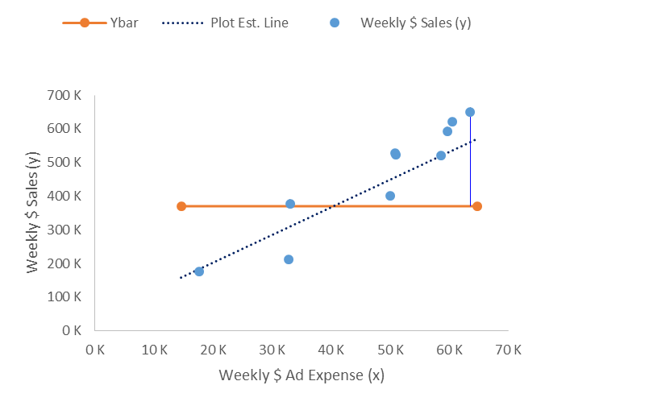
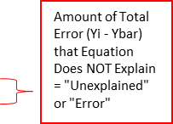
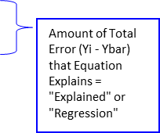
Two Parts in Total Error

Slide 42
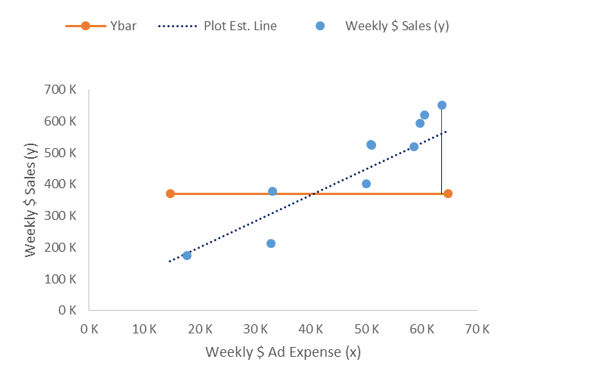
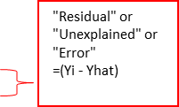
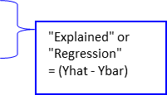
Total Error = Explained +Unexplained Total Error = Regression +Error

Slide 43
Comparing “Regression” or “Error” to “Total” to measure “Goodness of Fit”…
If we would like to compare the total “Regression” or “Error” to the “Total Error”, the problem is:
If we want to add up all “Total Error” or all “Unexplained” or all “Regression”:
We would get zero!!!!
No problem: We square each before adding!!!!

Slide 44
Squaring “Regression” or “Error” to “Total” to measure “Goodness of Fit” Helps with the Zeros.

Slide 45
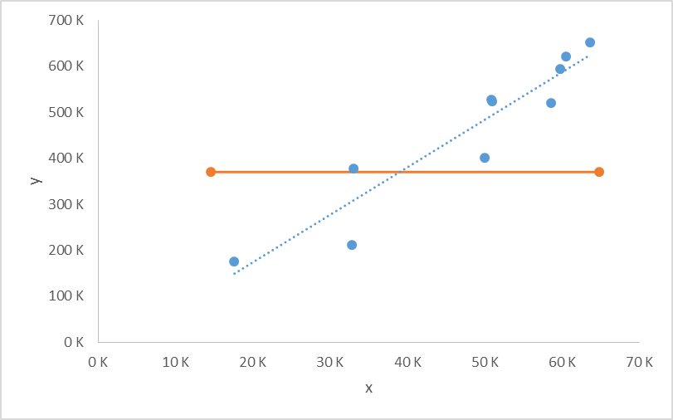
Squaring & then Summing “Total”, “Regression” & “Error”
$$SST= \sum_{i=1}^{n}{{\left(Y_{i} −\overline{Y}\right)}^{2}}$$
$$SSR= \sum_{i=1}^{n}{{\left({\hat{Y}}_{i} −\overline{Y}\right)}^{2}}$$
$$SSE= \sum_{i=1}^{n}{{\left(Y_{i} − {\hat{Y}}_{i}\right)}^{2}}$$
Sum of Squares Total.
Measure of error involved in using Y_{bar} to make a prediction.
How well sample points cluster around Y_{bar} line.
Sum of Squares due to Regression.
Measure of how far Predicted Value is away from Y_{bar.}
Amount of SST that is explained by the Estimated Regression Equation/Line.
Explained part of SST.
If all Sample Points fall on Estimated Line, SSR = SST.
Sum of Squares due to Error.
Measure of how far away Particular Value is away from Predicted Value.
Amount of SST that is unexplained by the Estimated Regression Equation/Line.
Unexplained part of SST.
How well sample points cluster around $\hat{Y}$ line
If all Sample Points fall on Estimated Line, SSE = 0.
If you have residuals already calculated, you can use the Excel function SUMSQ.

Slide 46
How to Think About SST and SSE
SST
SSE
SST = Measure of Total Error in using Ybar Line as Compared to Sample Data Points.
SSE = Total Amount of Error in using Estimated Simple Linear Equation Line as Compared to Sample Data Points.

Slide 47
How to Think About SSR
SSR = Total Amount that Estimated Simple Linear Equation Explains Over Ybar Line.
Measure of How Much Better Using Yhat is for Making Predictions than using Ybar.

Slide 48
Relationship Between SST, SSR and SSE
$$SST= \sum_{i=1}^{n}{{\left(Y_{i} −\overline{Y}\right)}^{2}}$$
$$SSR= \sum_{i=1}^{n}{{\left({\hat{Y}}_{i} −\overline{Y}\right)}^{2}}$$
$$SSE= \sum_{i=1}^{n}{{\left(Y_{i} − {\hat{Y}}_{i}\right)}^{2}}$$
SST = SSR + SSE
Because SST = SSR + SSE, we can compare the parts to the whole.
SSR/SST = Proportion of SST that Estimated Regression Equation/Line Explains.
SSE/SST = Proportion of SST that is NOT Explained by the Estimated Regression Equation/Line.

Slide 49
Coefficient of Determination
Coefficient of Determination = $r^{2}$ = $\frac{SSR}{SST}$ = 1 - $\frac{SSE}{SST}$ = ${r_{xy}}^{2}$
r^2 results in a number between 0 and 1
r^2can be thought of as:
The closer to 1, the better the fit of the Estimated Equation to the X-Y Sample Data Points.
r^2 = 1
all X-Y sample markers fall on the Estimated Regression Line.
SST = SSR
SSE = 0
Measure of Goodness of fit of Estimated Regression Equation/Line to the X-Y Sample Data Points.
The proportion of the Sum of Squared Total that can be explained by using the Estimated Regression Equation.
The proportion of the variability in the dependent variable (y) that is explained by the Estimated Regression Equation/Line.
In Excel the RSQ function can be used to calculate r^2 using just the sample x & y data.

Slide 50
Ad Expenditures / Sales Example: Calculate Coefficient Of Determination

Slide 51
The Closer to 1, the Better the Fit.

Slide 52
Coefficient of Determination
From page 137 in our Essentials of Business Analytics textbook (ISBN10: 1-285-18726-1):
For typical data in the social and behavioral sciences, values of r^2 as low as 0.25 are often considered useful.
For data in physical and life sciences, r^2 values of 0.60 or greater are often found, and in some cases , r^2 values greater than 0.90 can be found.
In business applications, r^2 values vary greatly, depending on the unique characteristics of each applications.

Slide 53
Compare Coefficient Of Determination & Coefficient Of Correlation
C. Of Correlation = r_{xy}
C. Of Determination = r^2
r_{xy} = (Sign of b₁)*SQRT(r^2).
Number between -1 and 1.
Measures strength and direction of liner relationship between one independent variable and one dependent variable.
Only for liner relationships.
Only for one independent variable.
r^2 = (r_{xy})^2.
Number between 0 and 1.
Measure strength and goodness of fit of relationship.
Can be used on linear or non-linear relationships.
Can be used for one or more independent variables.
Referred to as R^2 in Multiple Regression

Slide 54
Estimates for Variance & Standard Deviation of the Estimated Regression Equation
$$SSE= \sum{{\left(Y_{i} − {\hat{Y}}_{i}\right)}^{2}}=Total Residual Error$$
$MSE=$ $\frac{\sum{{\left(Y_{i} − {\hat{Y}}_{i}\right)}^{2}}}{n−2}$ = Estimate of Variance for Regression Equation
$s=$ $\sqrt{\frac{\sum{{\left(Y_{i} − {\hat{Y}}_{i}\right)}^{2}}}{n−2}}$ = Estimate of Standard Deviation for Regression Equation,
called “Standard Error of Estimate” or “Standard Error of y”.
(Measure in spread of Residuals).
If you already have the residual values calculated, you can use the Excel function STEYX to calculate Standard Error of Estimate. All it needs are the x and y sample point values.

Slide 55
Standard Error of the Estimate

Slide 56
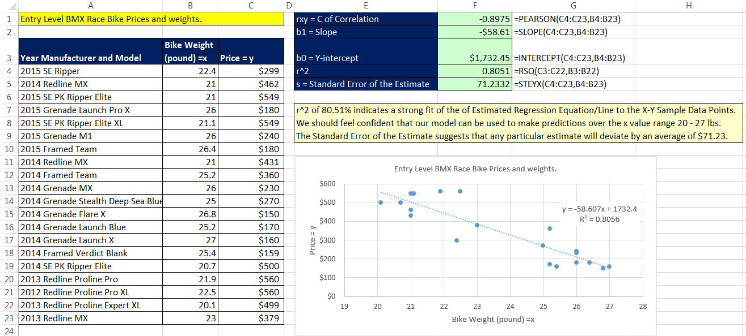
Bike Weight/ Bike Price Example: Calculate Coefficient Of Determination & Standard Error

Slide 57
“How Fairly A Statistic Represents Its Data Points”.
Measuring How Fairly The “Mean” Represents Its Data Points with “Standard Deviation”
Measuring How Fairly the “Estimated Regression Equation” Represents Its Data Points with “Standard Deviation of the Estimated Line” or “Standard Error of the Estimate”
$$\sqrt{\frac{\sum{{(y_{i}−\overline{y})}^{2}}}{n−1}}$$
$$\sqrt{\frac{\sum{{\left(Y_{i} − {\hat{Y}}_{i}\right)}^{2}}}{n−2}}$$

Slide 58
Data Analysis, Regression feature Step 1: Dialog Box

Slide 59
Degrees of Freedom
Degrees of freedom represents the number of independent units of information in a calculation.
In general, Degrees of Freedom = df = n - # of estimated parameters.
Both of these would become:
$$s_{Mean}=\sqrt{\frac{\sum{{(y_{i}−\overline{y})}^{2}}}{df}}$$
$$s_{Regression Line}=\sqrt{\frac{\sum{{\left(Y_{i} − {\hat{Y}}_{i}\right)}^{2}}}{df}}$$

Slide 60
Data Analysis, Regression feature Step 2: Output

Slide 61
What Regression Output Means

Slide 62
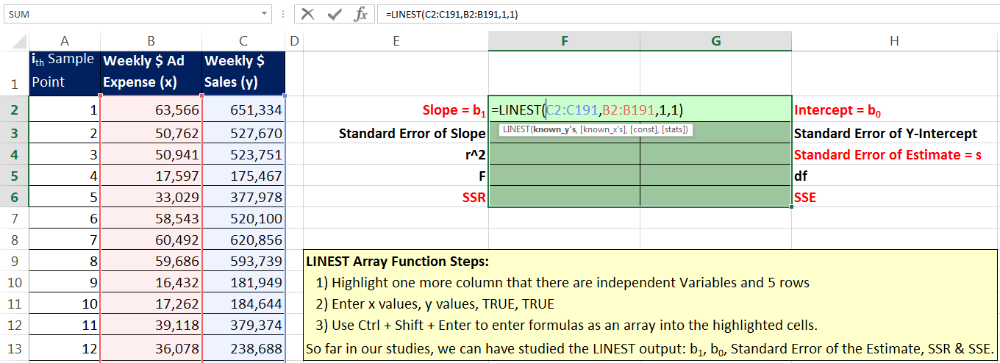
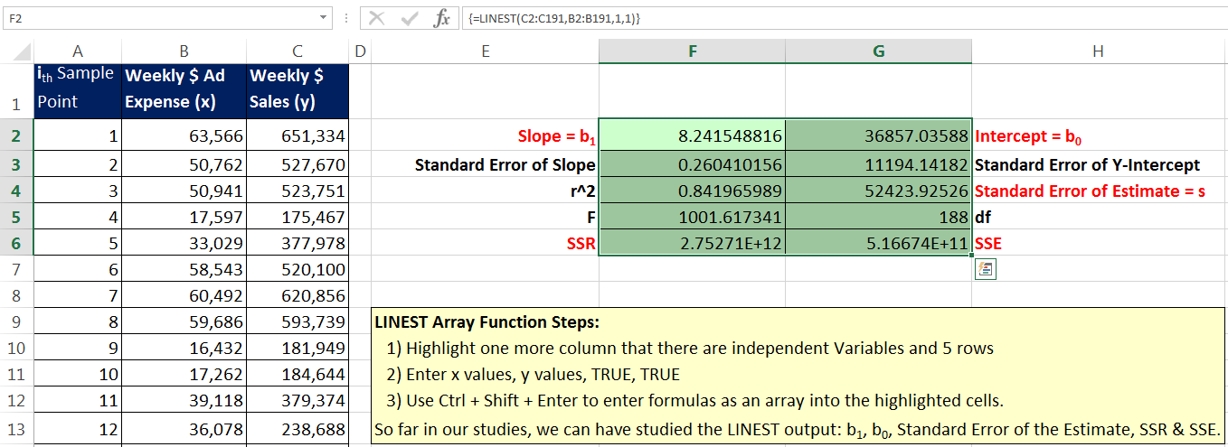
LINEST Array Function to deliver 10 statistics for Linear Regression
Highlight one more column than there are independent variables and 5 rows.
Remember to verify that curly brackets are present after you used Ctrl + Shift + Enter.
Enter Array Function with keystrokes
Ctrl + Shift + Enter.

Slide 63
Inference and Regression
In Regression Analysis, we took a sample and estimated the parameters for slope and y-intercept.
Our sample statistics for slope and y-intercept are our point estimates of the population parameters, slope and y-intercept.
Now we need to test to see whether or not our point estimates are reasonable or not.
However:
Before we can test the reasonableness of the slope and y-intercept, we must check to see if the assumptions necessary to use the Least Squares Regression Model are valid

Slide 64
Conditions Necessary for Valid Inference with the Least Squares Model
For any given combination of values of the independent variables x₁, x₂,…, x_{q}, the population of potential error terms ε must be:
Normally Distributed (Bell Shaped)
Has a mean of zero
Has a constant variance
The values of ε are statistically independent
In general, this is a concern only when we collect data from single entity over time, like in a time series
We can visually test assumptions by examining Residual Plots

Slide 65
Implication of Assumptions
ε Normally Distributed (Bell Shaped)
Implication: Because y is a linear function of ε, y is normally distributed random variable for all values of x.
ε has a mean of zero, E(ε) = 0
Implication: The slopes and intercepts are constants and we can use the line to estimate or predict
Has a constant variance
Implication: variance is same for all x
The values of ε are statistically independent
Linear model can be used without an adjustment for seasonality or other cyclical patterns

Slide 66
Visually Testing Assumptions: Plot Residuals Against X Values
Markers above Zero Line indicate a Positive Residual, which is a Sample Point that is above the Predicted Value.
The equation under estimated as compared to the actual Sample Point.
Markers below Zero Line indicate a Negative Residual, which is a Sample Point that is below the Predicted Value.
The equation over estimated as compared to the actual Sample Point.
If assumptions are met we should see consistent markers above and below the Zero Line with a higher frequency near the Zero Line. This plot does not supply evidence that would support rejecting the assumptions.

Slide 67
You can manually plot Residuals Against x or use Data Analysis, Regression feature
Manual
Data Analysis, Regression feature

Slide 68
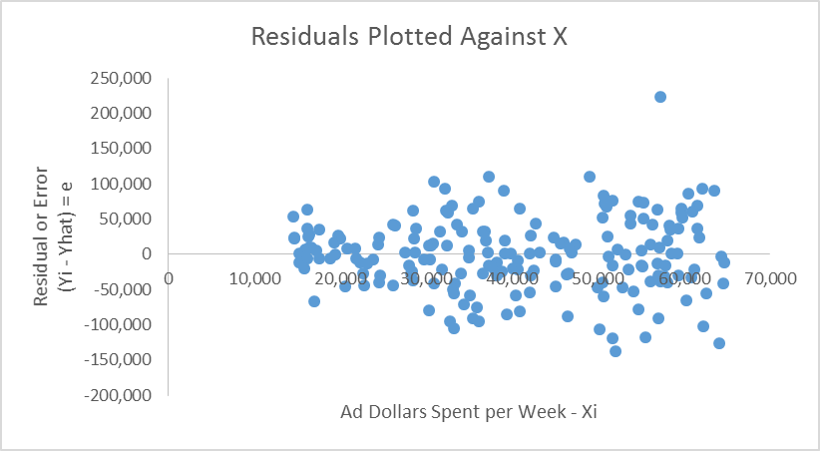
Visually Testing Assumptions: Plot Residuals Against X Values
ε term (and thus dependent variable y) is Normally Distributed.
If this assumption is met we should see:
The frequency of values near Zero Line should be greater than frequency of values away from Zero Line.
E(ε) = 0, has a mean of zero.
If this assumption is met we should see:
For a given x value the center of the spread of the errors should be near the Zero Line.
About same number of values above and below the Zero Line.
Has a constant variance.
If this assumption is met we should see:
Errors are symmetrically distributed above and below and along the Zero Line across the x values.
Spread of errors looks similar for each x.
This plot does NOT provide evidence of a violation of the conditions necessary for valid inference in regression.
The implication of 1) bell shaped errors, 2) mean = 0 & 3) constant variance is that the point estimates are unbiased (do not tend to underpredict or overpredict), for any given combination of values of the independent variables x₁, x₂,…, x_{q} .

Slide 69
If assumptions are met, point estimates tend to not underpredict or overpredict (unbiased estimate)

Slide 70
Inference in Regression is Generally Valid Unless You See Marked Violations Such as These:
These plots provide strong evidence of a violation of the conditions necessary for valid inference in regression.
Not consistent Variance
Equation does not reflect relationship between x & y
Skewness indicates ε Not Normal Distributed
“Collect data from single entity over time”. Time on horizontal axis. Residuals not Independent.
* From Essentials of Business Analytics textbook ISBN10: 1-285-18726-1

Slide 71
You Can Also Plot Predicted Values Against X Values To Check Assumptions About ε (Manual Method Only)

Slide 72
If Residual Plots Show Assumptions Are Met:
We can run Hypothesis test to check reasonableness of regression parameters β₀, β₁, β₂, . . . , β_{q .}
We can create Confidence Intervals for our predicted values of our dependent variable.
Hypothesis Testing (Busn 210)
A Statistical procedure that uses sample evidence & probability theory to determine whether a statement about the values of a parameter are reasonable (reliable) or not.
Confidence Intervals (Busn 210)
From sample data we calculate a lower & upper limit to make probability statement about how sure we are that the population parameter will lie between the lower and upper limit.
95% Confidence Intervals mean that if we constructed 100 similar intervals, about 95 would contain the population parameter and 5 would not.

Slide 73
The Logical Element to Test in Linear Regression: Slope
If the slope is zero, there is probably NOT a relationship
If the slope is NOT zero, there is probably a relationship

Slide 74
Hypothesis Test to Check if Slope/s Are Equal to Zero
If slope/s are ALL equal to zero, then:
E(y|x₁,x₂,…x_{q}) = β₀ + β₁x₁ + β₂x₂ + ∙ ∙ ∙ + β_{q}x_{q} becomes:
E(y|x₁,x₂,…x_{q}) = β₀ + 0*x₁ + 0*x₂ + ∙ ∙ ∙ + 0*x_{q} becomes:
E(y|x₁,x₂,…x_{q}) = β₀
Not a linear function of x₁, x₂,…, x_{q}
For our Hypothesis Test, our goal is to “Reject” the hypothesis “ALL Slope/s = 0”.
If ALL Slope/s = 0”, then model would be no better than the Y_{bar} line for making predictions.

Slide 75
Steps For Hypothesis Testing
State The Null and Alternative Hypotheses.
Null Hypothesis = H₀ = All Slope/s = 0
Alternative Hypothesis = H_{a} = All Slope/s <> 0
“At Least One Slope is NOT Equal to Zero”
Set Level of Significance = “alpha”.
Alpha = risk of rejecting H₀ when it is TRUE.
Alpha determines the hurdle for whether or not the test statistic just represents sample error or there is a true “statistically significant” difference (past the hurdle).
Alpha is used to compare against p-value. P-value <= Alpha, we Reject H₀ and accept H_{a}
Alpha is often 0.05 or 0.01.
When testing the slope, when we get a statistically significant difference, it will mean:
It is reasonable to assume that at least one of the slopes is not zero.
It is reasonable to assume that there is a statistically significant relationship.
Rejection Rule:
“If p-value is less than our alpha, we reject H₀ and accept Ha , otherwise, we fail to reject H₀ .”

Slide 76
Steps For Hypothesis Testing
From Sample Data calculate the Test Statistic and then calculate the p-value of the Test Statistic.
Use F Test Statistic (and F Distribution) for Testing Overall Significance:
F Test Statistic is:
$F= \frac{SSR/q}{SSE/(n −q −1)}$ = $\frac{SSR/(df Regression)}{SSE/(df Error)}$ = $\frac{MSR}{MSE}$
p-value:
= F.DIST.RT(F Test Statistic, q , n-q-1)
Use t Test Statistic (and t Distribution) for testing individual Slope and Y-Intercept:
t Test Statistic for Slope:
t = $\frac{b_{1}}{\frac{s}{\sqrt{\sum{{\left(x_{i}−\overline{x}\right)}^{2}}}}}$
t Test Statistic for Y-Intercept:
t = $\frac{b_{0}}{\text{s}\text{∗}\sqrt{\sum{(}x_{i}^{2})/(n∗\sum{{\left(x_{i}−\overline{x}\right)}^{2})}} }$
p-value for t Test Statistic:
=T.DIST.2T(ABS(t Test Statistic), n-q-1)
Data Analysis Regression Output provides F & t Test Statistics, & p-values.
The key is: If p-value is less than Alpha, Reject H₀ and Accept H_{a}

Slide 77
Steps For Hypothesis Testing
From the sample evidence makes reasonable statements about the population parameter.
If we reject H₀ and accept Ha we will say:
“The sample evidence suggests that at least one slope is not equal to zero. It is reasonable to assume that there is a significant relationship at the given level of significance.”
“xi and y are related and a linear relationship explains a statistically significant portion of the variability in y over the Experimental Region.”
If we fail to reject H₀ we will say:
“The sample evidence suggests that all slope/s are equal to zero. It is reasonable to assume that there is NOT a significant relationship at the given level of significance.”

Slide 78
F Distribution for Hypothesis Test

Slide 79
F Test Statistic for Hypothesis Test
Use the F Distribution
F Test Statistic is:
$F= \frac{SSR/q}{SSE/(n −q −1)}$ = $\frac{SSR/(df Regression)}{SSE/(df Error)}$ = $\frac{MSR}{MSE}$
SSR = Sum of squares due to regression (explained variation)
SSE = Sum of squares due to error (unexplained variation)
q = the number of independent variables in the regression model
n = the number of observations in the sample
SSR/q = MSR = Mean Square Regression = test statistic that measures variability in the dependent variable y that is explained by the independent variables (x₁, x₂… x_{q})
SSE/(n-q-1) = MSE = Mean Square Error = measure of variability that is not explained by x₁, x₂… x_{q} .
df = degrees of freedom = term used in Excel ANOVA output.
The larger the F value, the stronger the evidence that there is an overall regression relationship.
P-value = Probability of getting the F Test Statistic or greater in the F Distribution.
The smaller the p-value the stronger the evidence that there is an overall regression relationship (stronger the evidence against the Null that all slopes are zero).
If p-value is smaller than alpha, we reject H₀ .
Data Analysis Regression Output provides F and p-value

Slide 80
Formulas for testing individual estimates of parameters:
Sum of Squares of Error (Residuals) = SSE =$\sum{{\left(y_{i}−{\hat{y}}_{i}\right)}^{2}}=\sum{{\left(y_{i}−b_{0}−b_{1}x_{i}\right)}^{2}}$
Estimate of Variance of Estimated Regression Line: s ² = MSE = SSE/(n − 2)
Estimate of Standard Deviation of Estimated Regression Line = Standard Error Of The Estimate = s = SQRT(MSE)
Estimated Standard Deviation of a particular slope = $s_{b_{1}}=\frac{s}{\sqrt{\sum{{\left(x_{i}−\overline{x}\right)}^{2}}}}$
Confidence interval for β₁ is = $b_{1}±t_{α/2}s_{b_{1}}$, where t_{α/2} is the t value providing an area of α/2 in the upper tail of a t distribution with n - 2 degrees of freedom.
Estimated Standard Deviation of y-intercept = $s_{b_{0}}=$ s*$\sqrt{\sum{(}x_{i}^{2})/(n∗\sum{{\left(x_{i}−\overline{x}\right)}^{2})}}$
Confidence interval for β₀ is = $b_{0}±t_{α/2}s_{b_{0}}$, where t_{α/2} is the t value providing an area of α/2 in the upper tail of a t distribution with n - 2 degrees of freedom.

Slide 81
Testing Individual Regression Parameters
If F Test Statistic indicates that at least one of the slope/s are not zero, then we can test if there is a statistically significant relationship between the dependent variable y and each of the independent variables by testing each slope.
We use the t Distribution (Bell Shaped Probability Distribution from Busn 210)
We use t Test Statistic to test whether the slope is zero:
t = $\frac{b_{1}}{s_{b_{1}}}$
b₁ = slope
$s_{b_{1}}$ = estimated standard error of slope
t = # of standard deviations.
If t is past our hurdle, we reject H₀ and accept H_{a}.
H₀ : Slope = 0
H_{a} : Slope <> 0
Alpha of 0.5 or 0.01 are often used. Alpha determines the hurdle or is used to compare against p-value.
This is a two-tail test.
If t is past hurdle in either direction, reject H₀ and accept H_{a}. It seems reasonable that the slope is not zero.
If the p-value is less than alpha, it seems reasonable that the slope is not zero. The smaller the p-value, the stronger the evidence that the slope is not zero and the more evidence we have that a relationship exists between y and x.
In Simple Linear Regression, t test and F test will yield same p-value.

Slide 82
t Distribution for Hypothesis Test

Slide 83
Hypothesis Test For Weekly Ad Expense and Sales Example:
First we look at the residual plot to see if the assumptions of the Least Squares Method are met. It appears that the assumptions are met. The plot does NOT provide evidence of a violation of the conditions necessary for valid inference in regression.
Because the p-value for the F Test Statistic is less than 0.01, we reject H₀ and accept H_{a}. It is reasonable to assume that the slope is not zero and that there is a significant relationship between x and y. A linear relationship explains a statistically significant portion of the variability in y over the Experimental Region.
Similarly, p-value for Y-Intercept is less than 0.01 and so we conclude it is not zero. However, the Y-Intercept value is not in our Experimental Region.

Slide 84
What the F Statistic Hypothesis Test Looks Like

Slide 85
Confidence Intervals to Test if Slope β₁ & Y-Intercept β₀ Are Equal to 0
Excel Data Analysis, Regression tool calculates upper and lower limit for a Confidence Interval
Interval does not contain 0: conclude Y-Intercept (β0) is not zero (when all x are set to zero).
Interval does not contain 0: conclude Slope (β1) is not zero (there is a linear relationship)
Found an overall regression relationship at both alpha = 0.05 & alpha = 0.01

Slide 86
Nonsignificant Variables: Reassess Whole Model/Equation
Slope
Intercept
If Slope not significant (Do not reject H₀ : Slope = 0)
If practical experience suggests that the nonsignificant x (independent variable) has a relationship with the y variable, consider leaving the x in the model/equation.
Business example: # of deliveries for a truck route had insignificant slope, but was clearly related to total time.
If the model/equation adequately explains the y variable without the nonsignificant x independent variable, try rerunning the regression process without the nonsignificant x variable, but be aware that the calculations for the remaining variables may change.
Key is that you may have to run the regression tool in Excel a number of times over various variables to try and get the best slopes and y-intercept for the equation.
If Y-intercept not significant
The decision to include or not include the calculated y-intercept may require special consideration because setting “Constant is Zero” in Data Analysis Regression tool will set the equation intercept equal to zero and may dramatically change the slope values.
Business example when you might want the equation to go through the origin (x=0,y=0): labor hours = x and Output = y.

Slide 87
Multicollinearity
Multicollinearity
Correlation among the independent variables when performing multiple regression.
In Multiple Regression when you have more than one x, each x should be related to the y value, but in general, no two x values should be related to each other.
For example, if we have y = time for truck deliveries in a day, x1 = number of miles, x2 = amount of gas, because number of miles is related to gas, the resulting multiple regression process may have problems.
Use PEARSON or CORREL to analyze any 2 x variables
Rule of thumb: if absolute value is greater than 0.7, there is potential problem.
Problems with correlation among the independent variables is that it increases the variances & standard errors of the estimated parameters (β₀, β₁, β₂, . . . , β_{q} ) and predicted values of y, and so inference based on these estimates is not as precise than it should be.
For example, if t test or confidence intervals lead us to reject a variable as nonsignificant, it may be because there is too much variation and thus the interval is too wide (or t stat not past hurdle).
We may incorrectly conclude that the variable is not significantly different from zero when the independent variable actually has a strong relationship with the dependent variable.
If inference is a primary goal, we should avoid variables that are highly correlated.
If two variables are highly correlated, consider removing one.
If predicting is primary goal, multicollinearity is not necessarily a concern.
Note: If any statistic (b₀, b₁, b₂, . . . , b_{q} ) or p-value changes significantly when a new x variable is added or removed, we must suspect that multicollinearity is at play.
Checking correlation between pairs of variables does not always uncover multicollinearity.
Variable might be correlated with multiple other variables. To check: 1) treat x1 as dependent and the rest of the x as independent and run ANOVA table to see if R^2 is big to see if there strong relationship. R^2 > 0.5, rule of thumb that there might be multicollinearity.

Slide 88
Inference and Very Large Samples
When sample size is large:
Estimates of Variance and Standard Error (# Standard Deviations) are calculated with sample size in the denominator. As sample size increases, Estimates of Variance and Standard Error decrease.
Law of Large Numbers (Large Sample Size) says that as sample size gets bigger, statistic approaches parameter. As statistic approaches parameter, variation between the two decreases. As the variation between the two decreases, Estimates of Variance and Standard Error decrease.
As Estimates of Variance and Standard Error decrease, the intervals used in inference (Hypothesis Testing and Confidences Intervals) decrease, p-values get smaller, and almost all relationships will seem significant (meaningful and specious).
You can’t really tell from the small p-value if the relationship is meaningful or specious (deceptively attractive)
Multicollinearity can still be an issue.

Slide 89
Small Sample Size
Maybe be hard to test assumptions for inference in regression, like with a Residual Plot (because not enough sample points).
Assessing multicollinearity is difficult.

