Slide 1
Making Capital Investment Decisions
Chapter 9

Slide 2
Topics
Relevant Cash Flows For A Project
Cash Flows From Accounting Numbers
MACRS Tax Law for Depreciation
Sensitivity Analysis to Show Range Of NPV (Because the Future is Unknown)

Slide 3
Relevant Cash Flows For A Project
Incremental Cash Flows = difference between future cash flows with a project & without the project.
Any cash flow that exists regardless of whether or not a project is undertaken in not relevant.
Incremental Cash Flows = Aftertax Incremental Cash Flows
Sunk Costs not relevant
Opportunity Costs are relevant
Side Effects/Erosion are relevant
Change in Net Working Capital is relevant
Financing Costs are dealt with as a managerial variable and are not considered with the projects cash flows (Cash Flow To/From Creditors or Stockholders.

Slide 4
Relevant Cash Flows
Include only cash flows that will only occur if the project is accepted
Incremental cash flows
The stand-alone principle allows us to analyze each project in isolation from the firm simply by focusing on incremental cash flows

Slide 5
Relevant Cash Flows:
Incremental Cash Flow for a Project
  Corporate cash flow with the project
  Minus
  Corporate cash flow without the project

Slide 6
Relevant Cash Flows
“Sunk” Costs ………………………… N
Opportunity Costs …………………... Y
Side Effects/Erosion……..…………… Y
Net Working Capital………………….. Y
Financing Costs….………..…………. N
Tax Effects ………………………..….. Y

Slide 7
Stand-along Principal
The assumption that evaluation of a project may be based on the project’s incremental cash flows, and is evaluated separately from other projects.
The project has its own:
  Future revenues and costs
  Assets
  Cash flows
Evaluate the project on its own merits.

Slide 8
Relevant Cash Flows For A Project
Sunk Costs
  A cost that we have already paid or have already incurred the liability to pay.
  Sunk costs cannot be changed as a result of accepting or rejecting the project.
  Sunk Costs are not considered in an investment decision.
  We already paid for the consultant on the new product line. Isn’t that a relevant cost for the project? No, because it is already paid for and does not change regardless of whether we accept or reject the project.

Slide 9
Relevant Cash Flows For A Project
Opportunity Costs
  Give up a benefit.
  The most valuable alternative that is given up if a particular project is undertaken.
  If you give up a job to go to school, you must add lost wages to the cost of the school.
  If you use land that is already paid for, to create an organic farm, what other use for the land did you give up?
    At minimum, an opportunity cost is what you could have sold it for.

Slide 10
Relevant Cash Flows For A Project
Erosion (Cannibalism)
  The cash flows of a new project that come at the expense of other projects.
    Think of new product line that takes away from sales of an existing product line.
    Cash Flow relevant only when it would not otherwise be lost: existing product line or competition.

Slide 11
Relevant Cash Flows For A Project
NWC
  Short-term NWC (cash, inventory, AR, AP) that project will need.
  Firm supplies NWC at beginning of project and recovers it at end of project (like a loan).
Financing Costs
  Interest and Dividends are not analyzed as part of the project. They are analyzed separately.
  They are not cash flow from or to assets.
  They are cash flows from or to creditors or stockholders (chapter 2)

Slide 12
Cash Flows From Accounting Numbers
Pro Forma Financial Statements:
  Projected Financial Statements estimating the unknown future.
Operating Cash Flow:
OCF = EBIT + Depr – Taxes
  OCF = NI + Depr if no interest expense
Cash Flow From Assets:
    CFFA = OCF – NCS –ΔNWC
    NCS = Net capital spending

Slide 13
Tax Shield Method (Good For Cost Savings Projects):
OCF = (Sales – VC – FC)*(1-T) + Depr*T
  VC = Variable Costs (costs that increase as you sell more)
  FC = Fixed Costs (costs that do not change as you sell more)
  T = Marginal Tax Rate

Slide 14
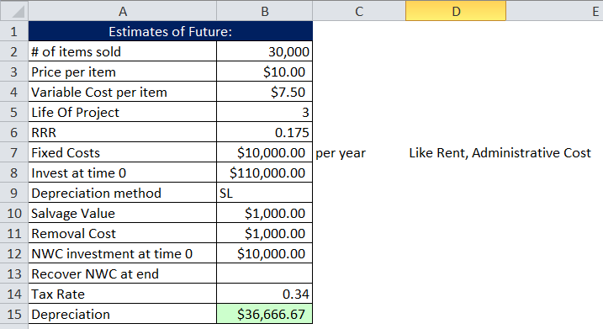
Example 1: NPV calculation From Pro Forma Data

Slide 15
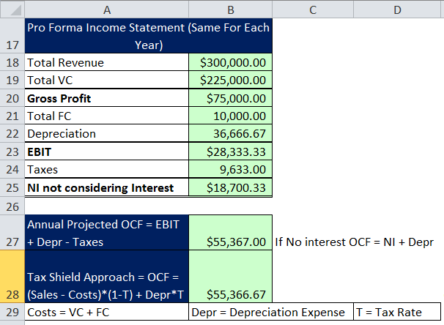
Example 1: NPV calculation From Pro Forma Data

Slide 16
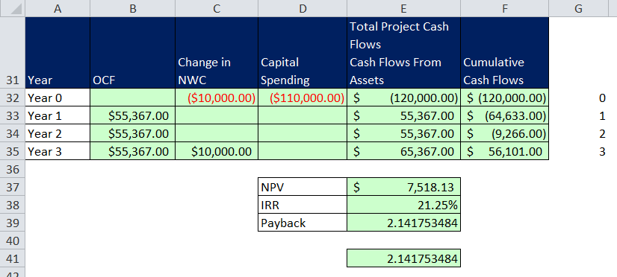
Example 1: NPV calculation From Pro Forma Data

Slide 17
Accrual Accounting V Cash Flow:
Revenues and Expenses Can Be Recorded Without Cash Movement.

Slide 18
Accrual Accounting Must Be Undone to Get At Cash Flows

Slide 19
Undo Accrual Accounting

Slide 20
NWC and OCF
*NWC = Net Working Capital, OCF = Operating Cash Flows
Usually there are differences between accrual accounting sales and expenses and actual cash sales and expenses.
Because of this we must make adjustments to our OCF.
  Revenues may have to much or too little recorded on the Income Statement.
    If the Accounts Receivable (AR) account (on Balance Sheet) goes up during the year, we have non-cash revenue on the Income Statement. We must subtract out the non-cash revenue to reflect the true cash flow – subtract the increase in AR from OCF.
    If the AR goes down during the year, we received cash in that has no associated revenue recorded on the Income Statement. We must add in decrease (positive number) in AR to OCF to reflect the true cash flow.

Slide 21
NWC and OCF
*NWC = Net Working Capital, OCF = Operating Cash Flows
Expenses may have to much or too little recorded on the Income Statement.
  If the Inventory account (on Balance Sheet) goes up during the year, we have spent more cash on inventory than we have sold. We must subtract the increase in Inventory from the OCF to reflect the true cash flow.
  If Inventory goes down during year, we have recorded too much expense on Income Statement, we must add the decrease (positive number) to OCF.
  If the Accounts Payable (AP) account (on Balance Sheet) goes up during the year, we have non-cash expense on the Income Statement. We must add back the non-cash expense to reflect the true cash flow: add the increase in AP to OCF.
  If the AP goes down during the year, we have cash paid out cash that has no associated expense on the Income Statement. We must subtract the decrease in AP from OCF.

Slide 22
Rule for how CA & CL affect OCF
*CA = Current Assets, CL = Current Liabilities
Increase in CA ➔ Subtract from OCF
Decrease in CA ➔ Add to OCF
Increase in CL ➔ Add to OCF
Increase in CL ➔ Add to OCF

Slide 23
NWC and OCF
Remember from chapter 2:
  NWC = Net Working Capital (Short term assets and liabilities)
  CA = Current Assets
  CL = Current Liabilities
  Change NWC = End NWC – Beg NWC
  Change NWC = (End CA – End CL) – (Beg CA – Beg CL)

Slide 24
Formula for Total Project Cash Flow
Total Project Cash Flow = EBIT + Depreciation – Taxes – Change NWC – Capital Spending
OCF = EBIT + Depreciation – Taxes – (End NWC – Beg NWC) – Capital Spending
Or
OCF = EBIT + Depreciation – Taxes – (Change in CA) + (Change in CL) – Capital Spending
OCF = EBIT + Depreciation – Taxes – (End CA – Beg CA) + (End CL – Beg CL) – Capital Spending

Slide 25
Depreciation & Cash Flow Analysis
Because Depreciation is a non-cash expense that has cash flow implications, we must use the IRS rules for depreciation, Not GAAP Rules.
Modified Accelerated Cost Recovery System (MACRS).
  We will look at somewhat simplified MACRS tables
  MACRS does not consider the life of asset or salvage value that GAAP does.
Calculate Depreciation to find tax cash flow implication.
Calculate Book Value (BV) to find tax implication for sale of asset at end of life.
  MV (Sale Price) > BV ➔ Pay Tax (Cash Out)
  MV (Sale Price) < BV ➔ Tax Saving (Cash In)

Slide 26
MACRS

Slide 27
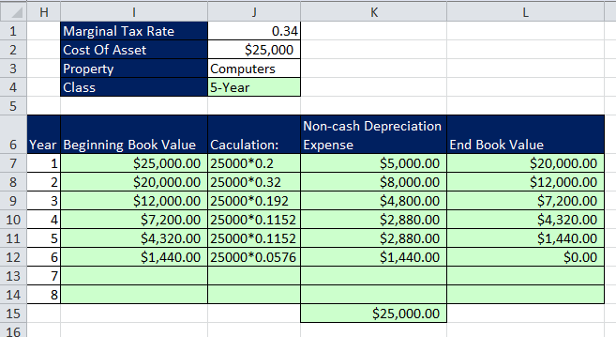
MACRS Example

Slide 28
Tax Effect on Sale Of Asset
Net Cash Flow from Sale Of Asset =
SP - (SP-BV)*(T)
Where:
SP = MV = Selling Price
BV = Book Value
T = Marginal tax rate

Slide 29
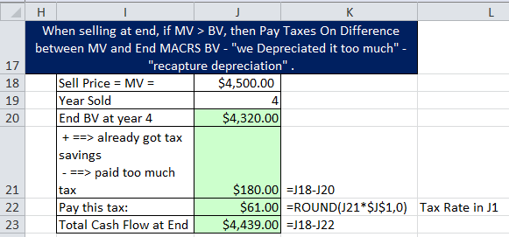
MACRS Example continue

Slide 30
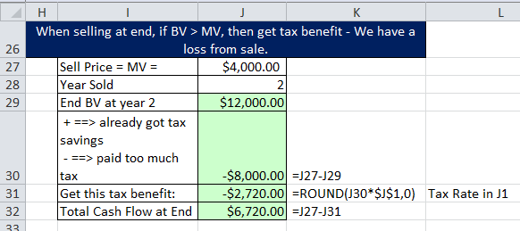
MACRS Example continue

Slide 31
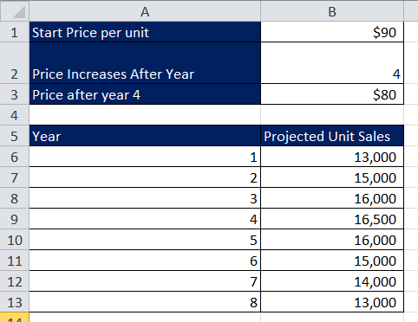
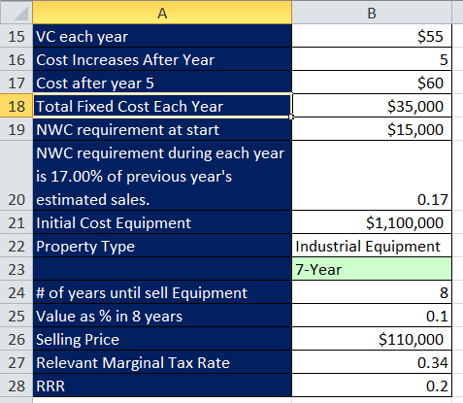
Comprehensive Example of Pro Forma Financial Statements and NPV see video
Assumptions:

Slide 32
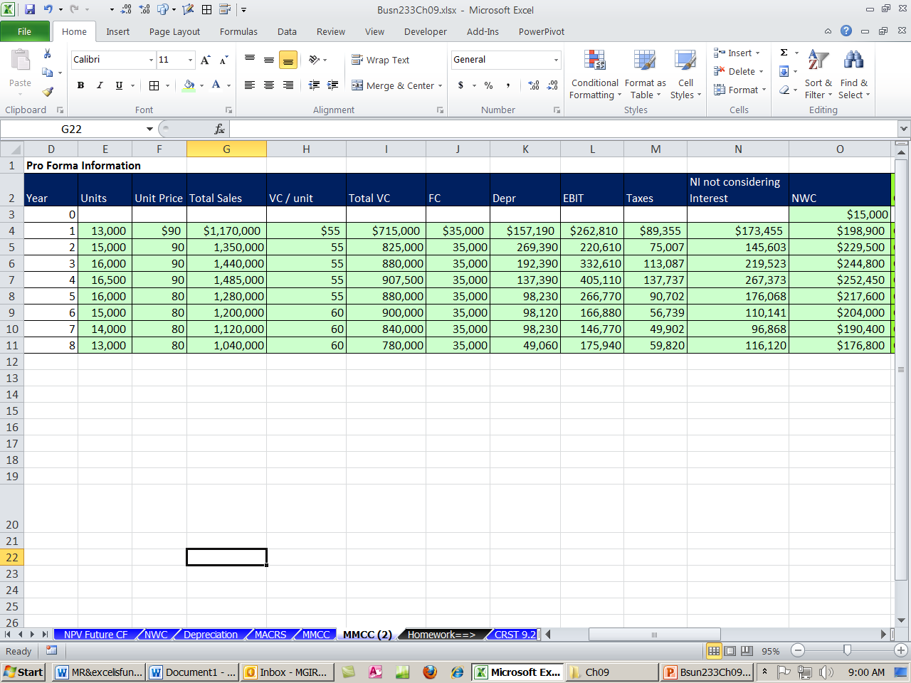
Comprehensive Example Pro Forma:

Slide 33
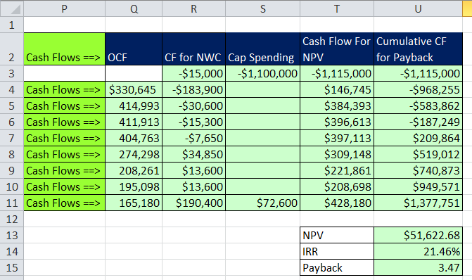
Comprehensive Example Cash Flows:

Slide 34
Estimates About Unknown Future
We can only estimate what might happen in the future.
The actual Future Cash Flows are NOT known.
Forecasting Risk:
  The possibility that errors in projected cash flows will lead to incorrect decisions.
    Think of: GM buying Hummer, Warner letting AOL buy it, B of A buying Countywide
  Sensitivity of NPV to changes in cash flow estimates
    The more sensitive, the greater the forecasting risk

Slide 35
Positive NPV
If we find positive NPV projects, we must be skeptical.
Finding Positive NPV projects in competitive markets is hard to do.

Slide 36
If We Find Positive NPV Projects, We Should Be Able To Point To Why:
Is it a better product (iPod)?
Totally new product (Wii)?
Do we have a great marketing plan (MrExcel.com free online videos)
Can we manage supply and demand more effectively (Wal-Mart)
Do we control the market (Microsoft)
Can we leverage the long-tail of the internet (Amazon)?

Slide 37
+NPV Projects Indicate We Should Take A Closer Look.
Scenario Analysis (Easy to do in Excel)
  Change assumptions (formula inputs) to create:
    Pessimistic case (Price & Units up, Costs down)
    Base Case
    Optimistic Case (Price & Units down, Costs up)
  Change a number of variables to gage what will happen on the up or down side.
  This gives a range of values you can look at.
  You can run multiple scenarios:
    If cases look good, maybe the project will be good.
    If cases look bad, maybe forecast risk is high and we should investigate further.

Slide 38
Problems with Scenario Analysis
Considers only a few possible out-comes
Assumes perfectly correlated inputs
  All “bad” values occur together and all “good” values occur together
Focuses on stand-alone risk, although subjective adjustments can be made

Slide 39
+NPV Projects Indicate We Should Take A Closer Look.
  Sensitivity Analysis (Easy to do in Excel)
  Investigation of what happens to NPV when only one variable is changed
  If the NPV is very sensitive to a particular variable, it means we better take a closer look at our estimates for that variable.
  If variable is sensitive (small change in variable means big change in NPV – “steeper the plotted line”), then the forecast risk associated with that variable is high.
  Line steepness can be measured by Slope (SLOPE function in Excel)
    =SLOPE(y-values (vertical),x-values (horizontal))

Slide 40
Sensitivity Analysis:
Strengths
  Provides indication of stand-alone risk.
  Identifies dangerous variables.
  Gives some breakeven information.
Weaknesses
  Does not reflect diversification.
  Says nothing about the likelihood of change in a variable
  Ignores relationships among variables.

Slide 41
Disadvantages of Sensitivity and Scenario Analysis
Neither provides a decision rule.
  No indication whether a project’s expected return is sufficient to compensate for its risk.
Ignores diversification.
  Measures only stand-alone risk, which may not be the most relevant risk in capital budgeting.

Slide 42
Managerial Options
So far our analysis has been static, but as projects move forward, elements can always be changed such as:
  Lower or raise price
  Change marketing
  Change manufacturing process
Managerial Options (Real Options)
  Opportunities that managers can exploit if certain things happen in the future.
  NPV will tend to be underestimated when we ignore options.
  No reliable way to estimate $ figures for these sorts of options.

Slide 43
Managerial Options
Contingency Planning
  Planning what to do if some event occurs in the future (like sales are below break even).
Option to expand
  If things go well (think of iPod, Wii).
Option to abandon
  If things go badly (Think of Hummer and AOL).
Option to wait
  Maybe after the recession would be a better time to launch the new product.
Strategic option
  Think: manufacturer tries their hand at retailing to see if it is a good idea. The info gained is difficult to translate into a $ figure in order to do DCF analysis.

Slide 44
Capital Rationing
Capital rationing occurs when a firm or division has limited resources
  Soft rationing – the limited resources are temporary, often self-imposed
  Hard rationing – capital will never be available for this project
The profitability index is a useful tool when faced with soft rationing

