Slide 1
Net Present Value And Other Investment Criteria
Chapter 8

Slide 2
Topics
First Look at Capital Budgeting
Investment Criteria:
  Net Present Value √
  Payback Rule ≈
  Accounting Rates Of Return ≈
  Internal Rate Of Return ≈
  The Profitability Index ≈

Slide 3
Financial Management
Goal Of Financial Management:
  Increasing the value of the equity
Capital Budgeting:
  Acquire long-term assets
  Because long-term assets:
    Determine the nature of the firm
    Are hard decisions to reverse
      They are the most important decisions for the financial manager
  Selecting Assets
    Which assets to invest in?
    There are many options.
    Which do we pick?

Slide 4
Good Decision Criteria For Capital Budgeting
We need to ask ourselves the following questions when evaluating decision criteria
  Does the decision rule adjust for the time value of money?
  Does the decision rule adjust for risk?
  Does the decision rule provide information on whether we are creating value for the firm?

Slide 5
Net Present Value = NPV
The difference between the market value and it’s cost = Value Added.
Example:
  Point of View = Asset Buyer
  If:
    Cost = -$200,000
    Market Value (Present Value Future Cash Flows) = $201,036
  NPV = $201,036 - $200,000 = $1,036
We examine a potential investment in light of its likely effect on the price of the firm’s shares
  NPV/(# of shares outstanding)

Slide 6
NPV
If there is a market for assets similar to the one we are considering investing in, we use that market and our decision making is simplified
When we cannot observe a market price for at least a roughly comparable investment, capital budgeting is made difficult… then we use:
  Discounted Cash Flow Valuation (DCF) to get our NPV
  DCF gives us an estimate of market value.

Slide 7
Synonyms
Discounted Cash Flow Valuation (DCF)
Net Present Value (NPV)

Slide 8
Synonyms
Investment = Project = Asset

Slide 9
Rules for DCF or NPV
The first step is to estimate the expected future cash flows (Chapter 9)
The second step is to estimate the required return for projects (investments) of this risk level (Chapter 10, 11)
The third step is to find the present value of the cash flows and subtract the initial investment (Chapter 8)

Slide 10
Net Present Value (NPV) =
Discounted Cash Flow Valuation (DCF)
Discount Rate = Market Rate = Required Rate Of Return = RRR
Period Discount Rate

Slide 11
NPV/DCF Example 1 & 2:
Should you invest in a short term project that will cost us $200,000 to launch and will yield these cash flows (Required Rate of Return= 15%):

Slide 12
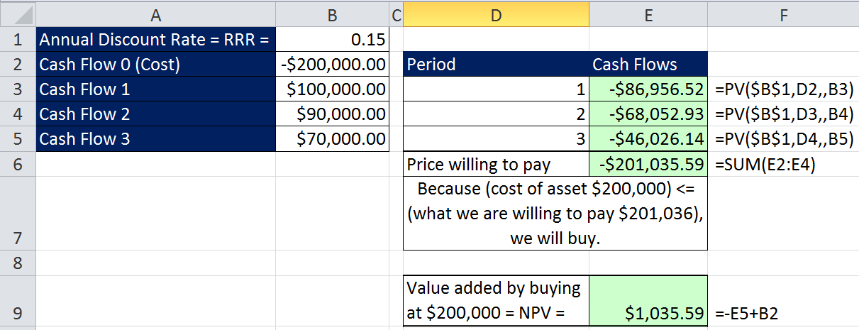
NPV/DCF Method Used In Earlier Chapters
Example 1:

Slide 13
NPV Excel Function & Formula
NPV Function:
=NPV(rate,value1,value2…)
  rate = Period RRR (Discount) = i/n.
  value1 = Range of cells with cash flows.
  Cash flows must happen at the end of each period.
    Cash flows start at time 1.
    Never include cash flows at time 0 (zero).
  Cash flows do not have to be equal in amount.
  Time between each cash flow must be the same.
NPV Formula when cost is at time 0:
=NPV(rate,value1,value2…) - Cost

Slide 14
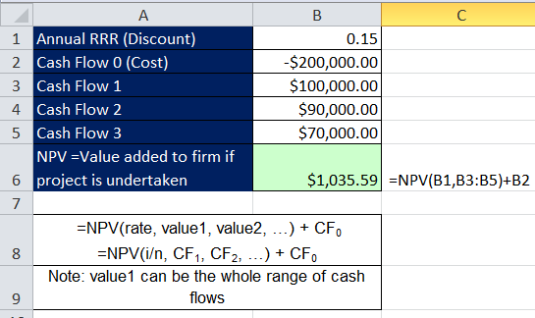
NPV/DCF Method Used This Chapter
Example 2:

Slide 15
Net Present Value (NPV) =
Discounted Cash Flow Valuation (DCF)
The process of valuing an investment (project) by discounting its future cash flows
Decision Rule:
  NPV > 0 ➔ Accept Project
  NPV < 0 ➔ Reject Project
  NPV = 0 ➔ Indifferent (RRR = IRR)
There are no
guarantees that
our estimates
are correct
Create
value for
stockholder
Search for
capital budget
projects
That yield
positive NPV
value added

Slide 16
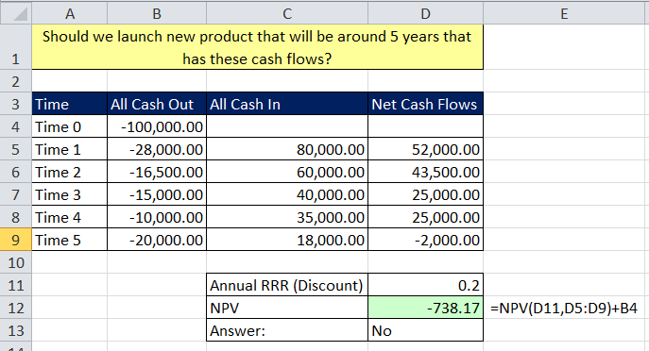
NPV / DCF Example 3:

Slide 17
Profile of NPV at Different Rates

Slide 18
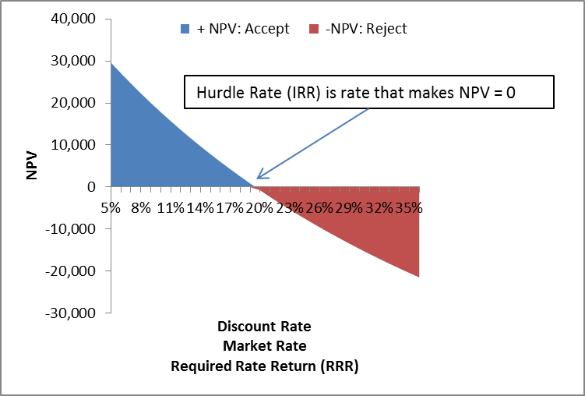
Profile of NPV at Different Rates

Slide 19
We Have Just Talked About NPV
Investment Criteria:
  Net Present Value √
  Payback Rule ≈
  Accounting Rates Of Return ≈
  Internal Rate Of Return ≈
  The Profitability Index ≈
Let’s look at one example and compare all these methods

Slide 20
Data For Example 4
You are looking at a new project and you have estimated these numbers:
Notes:
This example will be used for each of the decision rules so that the students can compare the different rules and see that conflicts can arise. This illustrates the importance of recognizing which decision rules provide the best information for making decisions that will increase owner wealth.

Slide 21
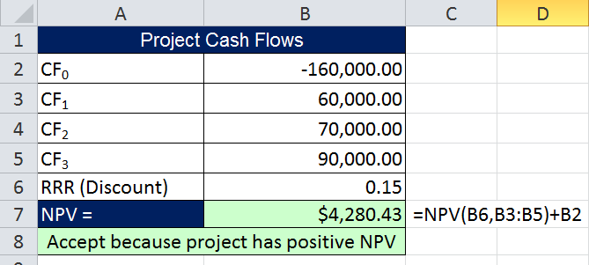
Example 4:
Computing NPV for The Project:

Slide 22
Advantages of NPV Rule
Rule adjusts for the time value of money
Rule adjusts for risk (RRR - Discount Rate)
Rule provides information on whether we are creating value for the firm

Slide 23
Payback Rule
Payback Period
  The amount of time required for an investment to generate cash flows to recover its initial costs
Computation
  Estimate the cash flows
  Determine # of years Required to get “paid back”.
  Subtract the future cash flows from the initial cost until the initial investment has been recovered
Accept
Investment
Payback
Period
Pre-specified
# of
Years
<

Slide 24
Data For Example 5
You are looking at a new project and you have estimated these numbers:
Notes:
This example will be used for each of the decision rules so that the students can compare the different rules and see that conflicts can arise. This illustrates the importance of recognizing which decision rules provide the best information for making decisions that will increase owner wealth.

Slide 25
Example 5:
Computing Payback For The Project
Assume we will accept the project if it pays back within two years.
  Year 1: 160,000 – 60,000 = 100,00 still to recover
  Year 2: 100,000 – 70,000 = 30,000 still to recover
Do we accept or reject the project?
Reject. The project did not pay back within 2 years.
Notes:
The payback period is year 3 if you assume that the cash flows occur at the end of the year as we do with all of the other decision rules.
If we assume that the cash flows occur evenly throughout the year, then the project pays back in 2.34 years.

Slide 26
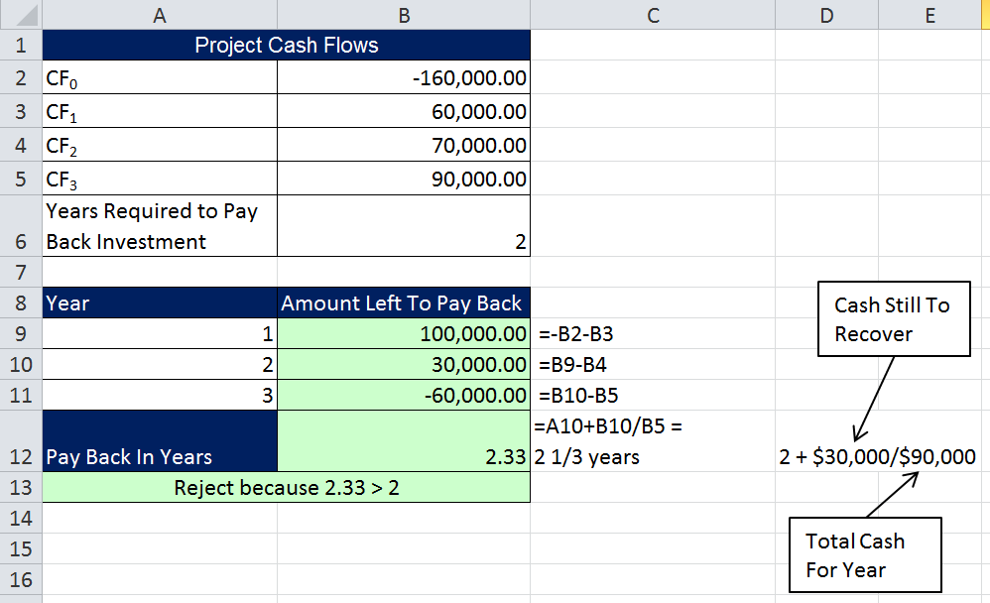
Example 5 continued:

Slide 27
Decision Criteria Test - Payback
Does the payback rule account for the time value of money?
Does the payback rule account for the risk of the cash flows?
Does the payback rule provide an indication about the increase in value?
Should we consider the payback rule for our primary decision criteria?
Notes:
The answer to all of these questions is no.

Slide 28
Advantages & Disadvantages of Payback
Advantages
  Easy to understand
  Cost to do this analysis is minimal – good for small investment decisions
  Adjusts for uncertainty of later cash flows (gets rid of them)
  Biased towards liquidity (tends to favor investments that free up cash for other uses more quickly)
Disadvantages
  Ignores the time value of money
  Fails to consider risk differences
    Risky or very risky projects are treated the same
  Requires an arbitrary cutoff point
  Ignores cash flows beyond the cutoff date
  Biased against long-term projects, such as research and development, and new projects
  Does not guarantee a single answer
  Does not ask the right question: Does it increase equity value?
  You have to estimate the cash flows any way, so why not take the extra time to calculate NPV?

Slide 29
Problems with Payback Rule:

Slide 30
Average Accounting Return = AAR
There are many different definitions for Average Accounting Return.
Here is one:
Here is another:
  Calculate (Return On Assets = ROA) for each year and then average the ROAs.
Notes:
The example in the book uses straight line depreciation to a zero salvage; that is why you can take the initial investment and divide by 2. If you use MACRS, you need to compute the BV in each period and take the average in the standard way.

Slide 31
Average Accounting Return = AAR
Steps in calculating AAR:
Estimate All Revenue and Expenses over the life of the asset.
Calculate the Net Income for each year.
Estimate Book Value over life of asset.
    Note that the average book value depends on how the asset is depreciated.
Decide on target cutoff AAR rate
Decision Rule:
Accept the project if the calculated AAR > cutoff AAR rate.
31

Slide 32
Average Book Value =
When Straight Line Depreciation is used:
(Cost + Salvage)/2
When a Non- Straight Line Depreciation is used:
(BV₀ + BV₁ +…BV_{t})/(t+1)

Slide 33
Data For Example 6
You are looking at a new project and you have estimated these numbers:
Notes:
This example will be used for each of the decision rules so that the students can compare the different rules and see that conflicts can arise. This illustrates the importance of recognizing which decision rules provide the best information for making decisions that will increase owner wealth.

Slide 34
Computing AAR For The Project
Example 6:
Notes:
Students may ask where you came up with the 25%, point out that this is one of the drawbacks of this rule. There is no good theory for determining what the return should be. We generally just use some rule of thumb.

Slide 35
Decision Criteria Test - AAR
Does the AAR rule account for the time value of money?
Does the AAR rule account for the risk of the cash flows?
Does the AAR rule provide an indication about the increase in value?
Should we consider the AAR rule for our primary decision criteria?
Notes:
The answer to all of these questions is no. In fact, this rule is even worse than the payback rule in that it doesn’t even use cash flows for the analysis. It uses net income and book value.

Slide 36
Advantages and Disadvantages of AAR
Advantages
  Easy to calculate
  Needed information will usually be available
Disadvantages
  Not a true rate of return; time value of money is ignored
  Uses an arbitrary benchmark cutoff rate
  Based on accounting net income and book values, not cash flows and market values

Slide 37
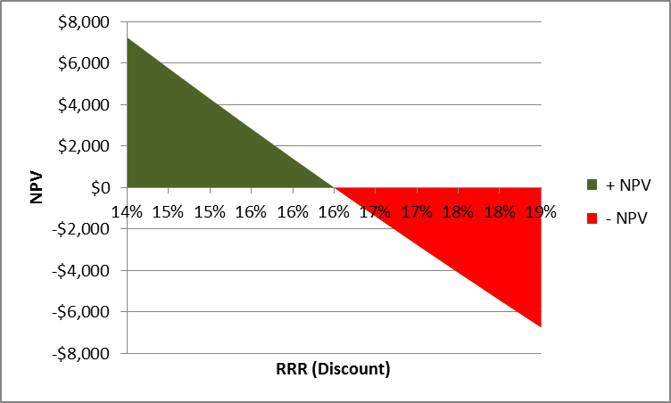
NPV Profile
37

Slide 38
Solve For Rate
Remember:
  Chapter 5 (Annuities and Multiple Cash Flows)
  Chapter 6 (Bonds)
    We learned that we can solve for rate.
    For Annuities or Bonds we were able to look at cash flows and determine the rate.
  Chapter 8 (Multiple Cash Flows for Buying Assets)
    Just as YTM was “internal rate” of cash flows for bonds, IRR will be “internal rate” of cash flows for capital budgeting.
    We solve for the rate at which the NPV is zero and that becomes the hurdle rate between + NPV and – NPV.
38

Slide 39
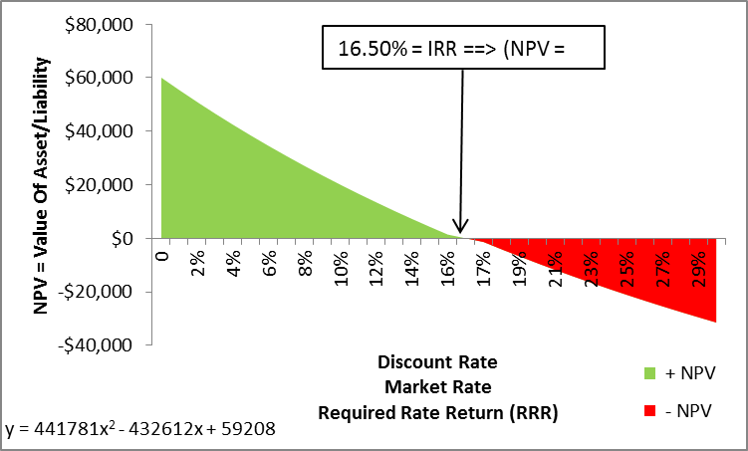
IRR = Internal Rate of Return
To Understand What IRR means, build a NPV Profile and look for the rate at which NPV = $0
This tells you the rate of return for the cash flows from the project.
0)
39

Slide 40
IRR = Internal Rate of Return
IRR = Rate at Which NPV = $0
0)
All RRR above IRR, subtract value (-NPV)
All RRR below IRR, add value (+NPV)

Slide 41
IRR = Internal Rate of Return =“Break Even Rate”
Definition: Rate that makes the NPV = $0
Decision Rule:
Most important alternative to NPV.
It is often used in practice and is intuitively appealing.
Calculation based entirely on the estimated cash flows and is independent of interest rates found elsewhere
Formula inputs are cash flows only!
Accept
Investment
IRR
RRR
>

Slide 42
IRR Excel Function
IRR Function:
=IRR(values,guess)
  values = range of cells with cash flows. Cash out is negative, cash in is positive. Range of values must contain at least one positive and one negative value.
  Guess is not required. But if you get a #NUM! error, try different guesses – ones you think might be close.
  Cash flows must happen at the end of each period.
  Cash flows start at time 0.
  Cash flows do not have to be equal in amount.
  Time between each cash flow must be the same.
  IRR gives you the period rate. If you give it annual cash flows, it gives you annual rate, if you give it monthly cash flows, it gives you monthly rate.
  **Don’t use IRR for investments that have non-conventional cash flows (cash flow other than time 0 is negative) or the investments are mutually exclusive alternatives and initial cash flows are substantially different or timing are substantially different.
42

Slide 43
Data For Example 7
You are looking at a new project and you have estimated these numbers:
Notes:
This example will be used for each of the decision rules so that the students can compare the different rules and see that conflicts can arise. This illustrates the importance of recognizing which decision rules provide the best information for making decisions that will increase owner wealth.

Slide 44
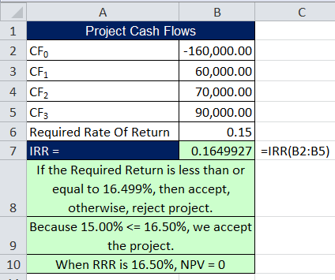
Computing IRR For The Project
Example 7:
Formula Inputs are cash flows – that’s it!
If you do not have Excel or a financial calculator, then this becomes a trial and error process.
Notes:
Many of the financial calculators will compute the IRR as soon as it is pressed; others require that you press compute.

Slide 45
Trial And Error Process: Build Profile And “Zero In On” the IRR.
45

Slide 46
Decision Criteria Test - IRR
Does the IRR rule account for the time value of money?
Does the IRR rule account for the risk of the cash flows?
Does the IRR rule provide an indication about the increase in value?
Should we consider the IRR rule for our primary decision criteria?
  No! Because of two circumstances…
Notes:
The answer to all of these questions is yes, although it is not always as obvious.
The IRR rule accounts for time value because it is finding the rate of return that equates all of the cash flows on a time value basis.
The IRR rule accounts for the risk of the cash flows because you compare it to the required return, which is determined by the risk of the project.
The IRR rule provides an indication of value because we will always increase value if we can earn a return greater than our required return.
We should consider the IRR rule as our primary decision criteria, but as we will see, it has some problems that the NPV does not have. That is why we end up choosing the NPV as our ultimate decision rule.

Slide 47
Advantages of IRR
Knowing a return is intuitively appealing.
It is a simple way to communicate the value of a project to someone who doesn’t know all the estimation details.
If the IRR is high enough, you may not need to estimate a required return, which is often a difficult task.
In the working world, many people use IRR.
Notes:
You should point out, however, that if you get a very large IRR that you should go back and look at your cash flow estimation again. In competitive markets, extremely high IRRs should be rare.

Slide 48
Summary of Decisions For The Project
Summary
Net Present Value | Accept
Payback Period | Reject
Average Accounting Return | Reject
Internal Rate of Return | Accept
Notes:
So what should we do – we have two rules that indicate to accept and two that indicate to reject.

Slide 49
Define
Mutually Exclusive
Independent
A situation were taking one project prevents you from taking another project.
  Ex: With the land, you can build a farm or a factory, not both.
Not Both.
Taking one project does not affect the taking of another project.
  Ex: If you buy machine A, you can also buy machine B, or not.
  Ex: Cash flows from Project A do not affect cash flows for Project B.
  Projects that are Not Mutually Exclusive are said to be Independent.

Slide 50
NPV & IRR
NPV and IRR will generally give us the same decision if:
  Conventional Cash Flows =
    Cash flow time 0 is negative.
    Remaining cash flows are positive.
  Projects (investments) Are Independent:
    The decision to accept/reject this project does not affect the decision to accept/reject any other project.
    Independent = “not mutually exclusive”.
OK to use IRR or NPV
Both give same answer.

Slide 51
DO NOT Use IRR, Instead Use NPV
DO NOT use IRR for projects that have non-conventional cash flows
DO NOT use IRR for projects that are mutually exclusive.
NOT OK to use IRR
Use NPV instead

Slide 52
IRR and Nonconventional Cash Flows
When the cash flows change sign more than once, there is more than one IRR
When you solve for IRR you are solving for the root of an equation and when you cross the x-axis more than once, there will be more than one return that solves the equation
If you have more than one IRR, which one do you use to make your decision?

Slide 53
Example 8: Non-conventional Cash Flows: You Will Get Two Answers. Which Is Correct?
53

Slide 54
Summary of Decision Rules
The NPV is positive at a required return of 15%, so you should Accept.
If you use Excel, you would get an IRR of 14% which would tell you to Reject.
You need to recognize that there are non-conventional cash flows and use NPV for decision rule.

Slide 55
IRR and Mutually Exclusive Projects
So far we have only asked the question: “Should we invest our $ in Project A?”
But what if we ask: “Should we invest our $ in Project A or B?”
Mutually exclusive projects
  If you choose one, you can’t choose the other
  Example: You can choose Investment A or B, but not both.

Slide 56
Example 9: Mutually Exclusive Projects
The required return for both projects is 10%.
Which project should you accept and why?
Notes:
As long as we do not have limited capital, we should choose project A. Students will often argue that you should choose B because then you can invest the additional $100 in another good project, say C. The point is that if we do not have limited capital, we can invest in A and C and still be better off.
If we have limited capital, then we will need to examine what combinations of projects with A provide the highest NPV and what combinations of projects with B provide the highest NPV. You then go with the set that will create the most value. If you have limited capital and a large number of mutually exclusive projects, then you will want to set up a computer program to determine the best combination of projects within the budget constraints.
The important point is that we DO NOT use IRR to choose between projects regardless of whether or not we have limited capital.

Slide 57
Example 9: NPV and IRR Can Give Different Answers.
For These Cash Flows, When RRR = 10%, We Get Different Answers.
Total cash flows are larger, but payback more slowly, so higher NPV at low RRR
At RRR = 10%, we use NPV as criteria and accept B.
57

Slide 58
Example 9: NPV and IRR
NPV Profile shows that NPV depends on RRR.
IRR is the same no matter what the RRR is.
Bigger cash flows in early years means they are less affected by large RRR (cash flows closer to time zero are less affected by discounting (less time to compound)) Payback is quicker, so higher NPV at high RRR.
At RRR = 17%, we use NPV as criteria and accept A.
58

Slide 59
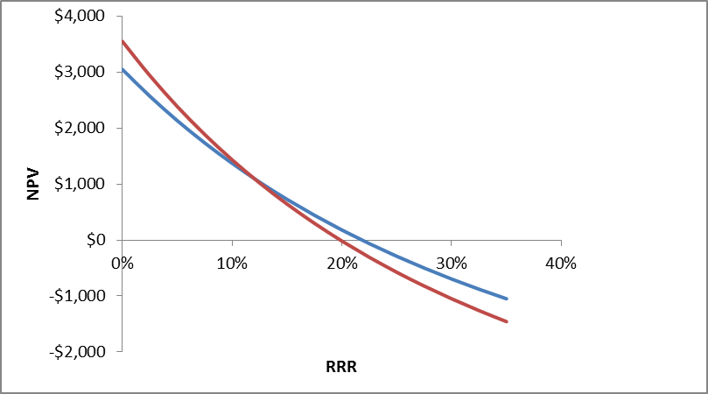
Example 9: NPV Profile shows that NPV depends on RRR.
ME – Don’t Use IRR, use NPV.
NPV B > NPV A,
When Discount
Rate < 12%
Ranking conflict:
IRR & NPV give
different answers
NPV A > NPV B,
When Discount
Rate > 12%
No ranking conflict:
IRR and NPV
give same answer
NPV B
NPV A
59

Slide 60
Conflicts Between NPV and IRR
NPV directly measures the increase in value to the firm
Whenever there is a conflict between NPV and another decision rule, you should always use NPV
IRR is unreliable in the following situations
  Non-conventional cash flows
  Mutually exclusive projects

Slide 61
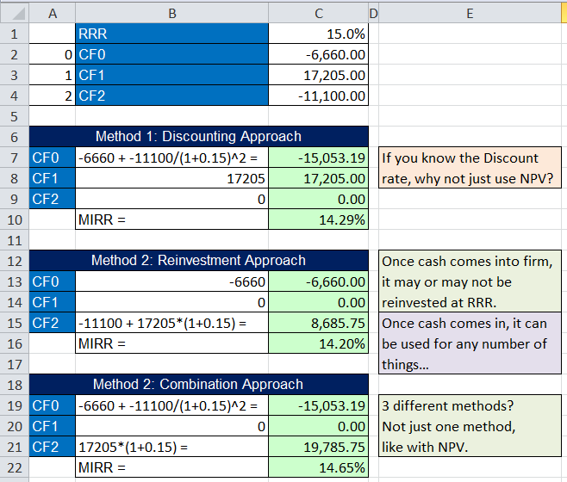
Modified Internal Rate of Return (MIRR)
Example 10:

Slide 62
Modified Internal Rate of Return (MIRR)
3 different methods
Controversial:
  Not one way to calculate MIRR (different results that with large values and long time frames can lead to large differences).
  Is it really a rate if it comes from modified cash flows?
  Why not just use NPV?
  If you use a discount rate to get modified cash flows, you can not get a true IRR.
  Cash reinvested may be unrealistic because, who knows if the rate that you are using for discounting is the same rate that would be applied to a cash flow that might be used for any number of things.

Slide 63
Profitability Index (Benefit Cost Ratio)
PI Formula= PVFCF/Initial Cost
  PI > 1, accept project
  PI < 1, reject project
Measures the benefit per unit cost, based on the time value of money
A profitability index of 1.1 implies that for every $1 of investment, we create an additional $0.10 in value
  Use this PI Formula = PVFCF/Initial Cost – 1
This measure can be very useful in situations where we have limited capital (can’t do all projects, then select greater PI)

Slide 64
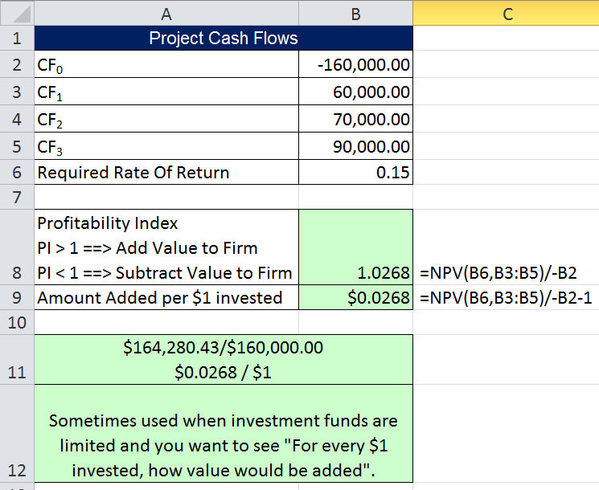
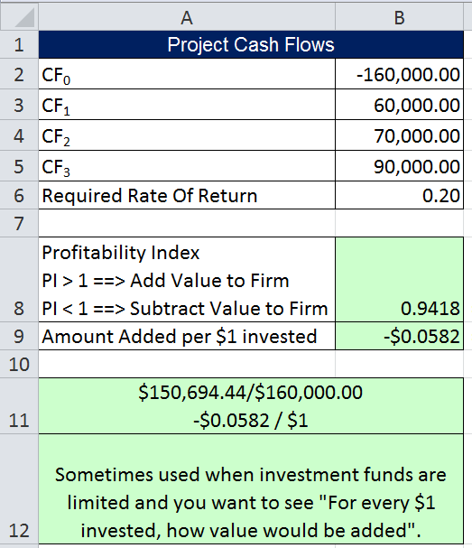
PI
Example 11:

Slide 65
Advantages and Disadvantages of Profitability Index
Advantages
  Closely related to NPV, generally leading to identical decisions
  Easy to understand and communicate
  May be useful when available investment funds are limited
Disadvantages
  May lead to incorrect decisions in comparisons of mutually exclusive investments
  Scale is not revealed
  10/5 = 1000/500

Slide 66
Capital Budgeting In Practice
We should consider several investment criteria when making decisions
NPV and IRR are the most commonly used primary investment criteria
Payback is a commonly used secondary investment criteria
Why so many? Because they are all only estimates!
The financial manager acts in the stockholder’s best interest by identifying and taking positive NPV projects
Notes:
Even though payback and AAR should not be used to make the final decision, we should consider the project very carefully if they suggest rejection. There may be more risk than we have considered or we may want to pay additional attention to our cash flow estimations. Sensitivity and scenario analysis can be used to help us evaluate our cash flows.
The fact that payback is commonly used as a secondary criteria may be because short paybacks allow firms to have funds sooner to invest in other projects without going to the capital markets

Slide 67
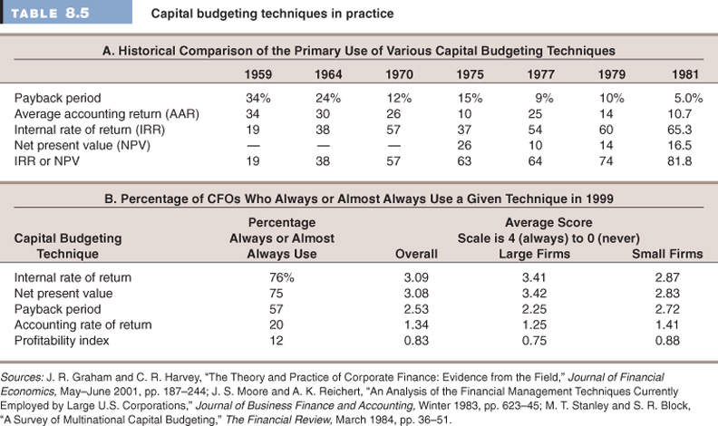

Slide 68
Quick Quiz
Consider an investment that costs $150,000 and has a cash inflow of $38,500 every year for 6 years and in 7th year the cash flow is $2,000. The required return is 15% and required payback is 3 years.
  What is the payback period?
  What is the NPV?
  What is the IRR?
  Should we accept the project?
What decision rule should be the primary decision method?
When is the IRR rule unreliable?
Notes:
Payback period = 4 years
NPV = -2758.72
IRR = 7.93%

Slide 69
Following slides are from Author.

Slide 70
Multiple IRRs
Descartes Rule of Signs
Polynomial of degree n→n roots
  When you solve for IRR you are solving for the root of an equation
  One positive ?? real root per sign change
  Remaining are imaginary (i² = -1)

Slide 71
Two Reasons NPV Profiles Cross
Size (scale) differences.
  Smaller project frees up funds sooner for investment.
  The higher the opportunity cost, the more valuable these funds, so high discount rate favors small projects.
Timing differences.
  Project with faster payback provides more CF in early years for reinvestment.
  If discount rate is high, early CF especially good

Slide 72
Reinvestment Rate Assumption
IRR assumes reinvestment at IRR
NPV assumes reinvestment at the firm’s weighted average cost of capital (opportunity cost of capital)
  More realistic
  NPV method is best
NPV should be used to choose between mutually exclusive projects

