Slide 1
Connection Between Dividends and Stock Values,
Equity Markets
Chapter 7

Slide 2
Topics
Stock Value, Dividends And Dividend Growth
Some Features Of Common And Preferred Stocks
Different Ways Corporate Directors Are Elected To Office
Stock Markets

Slide 3
Valuation of Stocks and Bonds
Stock cash flows are less certain than that of bond cash flows because:
  Bond cash flows are fixed and defined by contract
  Whereas stock cash flows are:
    Dividends: residual and determined by the Board of Director’s vote
    Proceeds from sale of stock: Not guaranteed
Difficulties in Stock Valuation:
  Dividend cash flows are not known in advance
  Life of stock is essentially forever
  No easy way to observe the rate of return required for a stock

Slide 4
Common Stock Valuation ➔ Cash Flows to Stockholders
If you buy a share of stock, you can receive cash in two ways
  The company pays dividends
  You sell your shares, either to another investor in the market or back to the company
For stocks with cash flows that are easily determined, the price of the stock is the present value of these expected cash flows

Slide 5
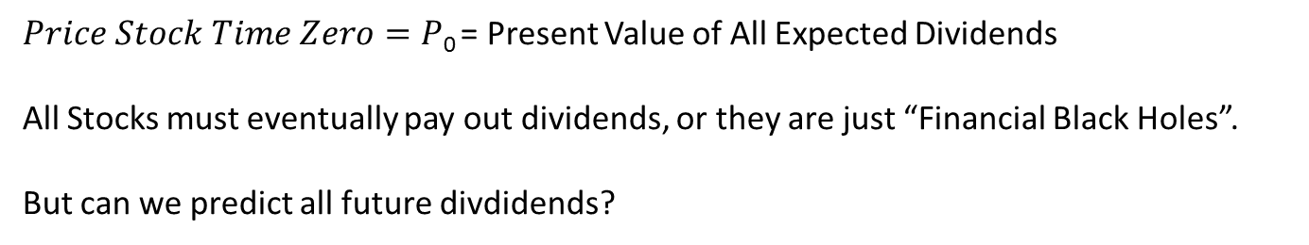
Stock Price Present Value Of Future Cash Flows
Essentially Zero (Discounted Over Long time.

Slide 6
Math Notation For Present Value Of All Future Dividends:

Slide 7
Estimating Dividends: Special Cases
Constant dividend (Preferred Stock)
  The firm will pay a constant dividend forever
  This is like preferred stock
  The price is computed using the perpetuity formula
Constant dividend growth
  The firm will increase the dividend by a constant percent every period
  For most corporation this is an explicit goal.
Supernormal growth
  Dividend growth is not consistent initially, but settles down to constant growth eventually

Slide 8
Preferred Stock = Dividend With Zero Growth
An annuity in which the cash flow continues forever
  Equal cash flow goes on forever (like most preferred stock pays dividend)
“Capitalization of Income”
As x gets large,
(1+i/n)
Approaches
zero

Slide 9
Constant Dividend (Zero Growth; Perpetuity)

Slide 10
Preferred Stock Valuation (Example 1)
If you buy preferred stock that pays out a contractual yearly dividend of $5.50 and the appropriate discount rate is 12%, what is the stock worth? (What is the present value of this perpetuity?)
  $5.5/.12 = $45.83

Slide 11
Example 1.1
Suppose stock is expected to pay a $0.50 dividend every quarter and the required return is 10% with quarterly compounding. What is the price?

Slide 12
Dividend Growth Model
Dividends are expected to grow at a constant percent per period.
P₀ = D₁ /(1+R) + D₂ /(1+R)² + D₃ /(1+R)³ + …
P₀ = D₀(1+g)/(1+R) + D₀(1+g)²/(1+R)² + D₀(1+g)³/(1+R)³ + …
With a little algebra, this reduces to:

Slide 13
Dividend Growth Model Math:
^
D₀(1+g)
D₁
P₀ =
=
R - g
R - g

Slide 14
Dividend Growth Model (Example 2)
Suppose Big D, Inc. just paid a dividend of $.50. It is expected to increase its dividend by 2% per year. If the market requires a return of 15% on assets of this risk, how much should the stock be selling for?
P₀ = D₀(1+g)/(R-g)
P₀ = $0.50(1+.02) / (.15 - .02) = $3.92

Slide 15
Dividend Growth Model (Example 3)
Suppose TB Pirates, Inc. is expected to pay a $2 dividend in one year. If the dividend is expected to grow at 5% per year and the required return is 20%, what is the price?
P₀ = D₁/(R-g)
P₀ = $2 / (.2 - .05) = $13.33
Why isn’t the $2 in the numerator multiplied by (1.05) in this example?

Slide 16
Stock Price Sensitivity to Dividend Growth, g (Example 3)
Notes:
As the growth rate approaches the required return, the stock price increases dramatically.

Slide 17
Stock Price Sensitivity to Required Return, R (Example 3)
Notes:
As the required return approaches the growth rate, the price increases dramatically. This graph is a mirror image of the previous one.

Slide 18
XYZ Company (Example 4)
XYZ Company is expected to pay a dividend of $5 next period and dividends are expected to grow at 5% per year. The required return is 15%.
What is the current price?
P₀ = D₁/(R-g)
P₀ = $5 / (.15 - .05) = $50
  If the stock is selling for $51, do we buy?
  If the stock is selling for $49, do we buy?

Slide 19
XYZ Company (Example 5)
What is the price expected to be in year 4 for XYZ Company stock?
P₄ = D₁(1 + g)⁴ / (R – g) = D₅ / (R – g)
P₄ = $5(1+.05)⁴ / (.15 - .05) = $60.78
or
Next slide…
Notes:
Point out that the formula is completely general. The dividend in the numerator is always for one period later than the price we are computing. This is because we are computing a Present Value, so we have to start with a future cash flow. This is very important when discussing supernormal growth.
We know the dividend in one year is expected to be $4 and it will grow at 6% per year for four more years. So, D₅ = 4(1.06)(1.06)(1.06)(1.06) = 4(1.06)⁴

Slide 20
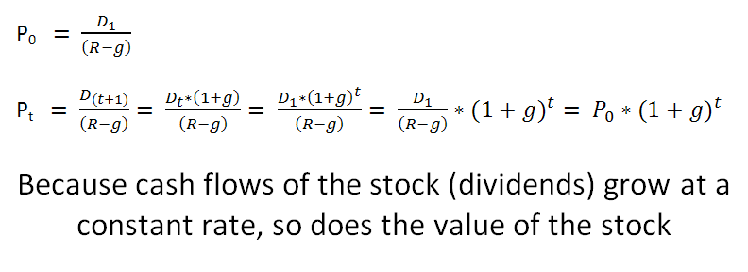
Notice in Example 5:

Slide 21
XYZ Company (Example 5)
What is the price expected to be in year 4?
P₄ = P₀(1+g)⁴
P₄ = $50(1+0.05)⁴ = $60.78
Notes:
Point out that the formula is completely general. The dividend in the numerator is always for one period later than the price we are computing. This is because we are computing a Present Value, so we have to start with a future cash flow. This is very important when discussing supernormal growth.
We know the dividend in one year is expected to be $4 and it will grow at 6% per year for four more years. So, D₅ = 4(1.06)(1.06)(1.06)(1.06) = 4(1.06)⁴

Slide 22
Solve for Implied Return
Dividend Yield (% Gained From Dividend Cash Flow)
Capital Gain Yield (% that stock grows)
Stock Return Has Two Components
More about R in chapters 10 & 11

Slide 23
XYZ Company (Example 6)
Continuing the XYZ Company Example:
What is the implied return given the change in price during the four year period?
R = D₁/P₀ + g
$5/$50 + 0.05 = 0.10 + 0.05 ➔ 10% + 5% = 15%
10% = Dividend Yield
5% Capital Gains Yield
Notes:
Point out that the formula is completely general. The dividend in the numerator is always for one period later than the price we are computing. This is because we are computing a Present Value, so we have to start with a future cash flow. This is very important when discussing supernormal growth.
We know the dividend in one year is expected to be $4 and it will grow at 6% per year for four more years. So, D₅ = 4(1.06)(1.06)(1.06)(1.06) = 4(1.06)⁴

Slide 24
Bond Vocabulary:
Current Yield =
Annual Interest Payment/Closing Price
  Not equal to YTM (unless bond sells for par); it does not include the capital gain from discounted face value (principal)
  Premium Bond
    CY >YTM
  Discount Bond
    CY <YTM
  In all cases ➔(Current Yield) + (Expected one-period capital gain/loss yield of the bond) must be equal to the YTM

Slide 25
Yield
Dividend Yield and Current Yield are similar because both only show the % gain from the Dividend/Interest Payment – Capital Gain not included.

Slide 26
Constant Growth Model Assumptions
Dividend expected to grow at g forever
Stock price expected to grow at g forever
Expected dividend yield is constant
Expected capital gains yield is constant and equal to g
Expected total return, R, must be > g
Expected total return (R):
  = expected dividend yield (DY)
  + expected growth rate (g)
  = dividend yield + g

Slide 27
Non-constant Growth Problem (Example 7)
Suppose a firm is expected to increase dividends by 20% in one year and by 15% in two years. After that dividends will increase at a rate of 5% per year indefinitely. If the last dividend was $1 and the required return is 20%, what is the price of the stock?
Remember that we have to find the PV of all expected future cash flows.

Slide 28
Non-constant Growth – (Example 7) Solution
Compute the dividends until growth levels off
  D₁ = $1(1.2) = $1.20
  D₂ = $ 1.20(1.15) = $1.38
  D₃ = $ 1.38(1.05) = $1.449
Find the expected future price
  P₂ = D₃ / (R – g) = $ 1.449 / (.2 - .05) = $ 9.66
Find the present value of the expected future cash flows
  P₀ = $ 1.20 / (1.2) + ($ 1.38 + $ 9.66) / (1.2)² = $ 8.67

Slide 29
Non-constant growth followed by constant growth:
0
r_{s}=20%
1
2
3
g = 20%
g = 15%
g = 5%
D₀ = 1.00 1.20 1.38 1.449
1.0000
0.9583
^
$1.449
6.7083
P₂ =
= $9.66
0.20 – 0.05
8.6667 = P₀
Notes:
18

Slide 30
Non-constant + Constant growth
Notes:
6

Slide 31
Other Methods Of Stock Valuations You Might See In An Advanced Accounting/Finance Class
Pro Forma Financial Statements
Present Value Of Free Cash Flows
Residual Income Method
Many more…

Slide 33
Stocks and Bonds:
Like bonds, stocks bring capital (money) into the corporation so that it can invest in profitable projects
  Bondholders are creditors
    They have a fixed claim to cash flow
  Stockholders are owners
    They have a residual claim to cash flow
Assets = Liabilities + Equity

Slide 34
Differences Between Debt and Equity
Debt
  Not an ownership interest
  Creditors do not have voting rights
  Interest is considered a cost of doing business and is tax deductible
  Creditors have legal recourse if interest or principal payments are missed
  Excess debt can lead to financial distress and bankruptcy
Equity
  Ownership interest
  Common stockholders vote for the board of directors and other issues
  Dividends are not considered a cost of doing business and are not tax deductible
  Dividends are not a liability of the firm and stockholders have no legal recourse if dividends are not paid
  An all equity firm can not go bankrupt

Slide 35
Common Stock
Buy 1 stock
  Get to vote for Directors of corporation, who in turn decide what managers to hire.
    Generally: 1 stock = 1 vote for each Director position on the Board of Directors.
  Get dividends (payouts to stockholder) when Board of Directors declares dividend.
  Claim to remaining assets in bankruptcy after creditors and preferred stockholders get their share.

Slide 36
Features of Common Stock
Voting Rights
  Stockholders elect directors
  Cumulative voting
    Directors are elected all at once (helps shareholders with a small number of shares)
  Straight voting
    Directors elected 1 at a time (# shares > 50%, you can vote in all Directors)
  Proxy voting
    Letting someone else vote for you

Slide 37
Cumulative Voting Vs. Straight Voting

Slide 38
Voting
Cumulative voting – when the directors are all elected at once. Total votes that each shareholder may cast equals the number of shares times the number of directors to be elected. In general, if N directors are to be elected, it takes 1 / (N+1) percent of the stock + 1 share to assure a deciding vote for one directorship. Good for getting minority shareholder representation on the board.
Straight (majority) voting – the directors are elected one at a time, and every share gets one vote. Good for freezing out minority shareholders.
Staggered elections – directors’ terms are rotated so they aren’t elected at the same time. This makes it harder for a minority to elect a director and complicates takeovers.
Proxy voting – grant of authority by a shareholder to someone else to vote his or her shares. A proxy fight is a struggle between management and outsiders for control of the board, waged by soliciting shareholders’ proxies.

Slide 39
Features of Common Stock
Classes of stock
  Many Different Types of Stock (Different contracts)
  Google
    Founders want company to “Not Be Evil” and so they created a type of stock that gives them more voting rights. In this way they can control the direction of the firm and attempt to not “be evil”.

Slide 40
Features of Common Stock
Other Rights present in many Com. Stocks:
  Share proportionally in declared dividends
  Share proportionally in remaining assets during liquidation
  Preemptive right
    Right of first refusal to buy new stock issue to maintain proportional ownership if desired
  Vote on issues such as Mergers

Slide 41
Dividend Characteristics
Dividends are not a liability of the firm until a dividend has been declared by the Board
  Consequently, a firm cannot go bankrupt for not declaring dividends
Dividends and Taxes
  Dividend payments are not considered a business expense, therefore, they are not tax deductible
  Dividends received by individuals are taxed as ordinary income
  Dividends received by corporations have a minimum 70%* exclusion from taxable income
  *IRS tax law provide up to 100% exclusion as the % ownership increases (as % increase, the corp. just outright owns the company…)
Notes:
Dividend exclusion: If corporation A owns less than 20% of corporation B stock, then 30% of the dividends received from corporation B are taxable. If A owns between 20% and 80% of B, then 20% of the dividends received are taxable. If A owns more than 80%, a consolidated statement can be filed and dividends received from B are essentially untaxed.

Slide 42
Features of Preferred Stock
Dividends:
  Stated dividend that must be paid before dividends can be paid to common stockholders.
  Dividends are not a liability of the firm and preferred dividends can be deferred indefinitely.
  Most preferred dividends are cumulative – any missed preferred dividends have to be paid before common dividends can be paid (arrearage).
Preferred stock generally does not carry voting rights.
  In some cases, if dividends are not paid, Preferred Stockholders are granted voting rights
In liquidation, they are only paid the “stated value” of the Preferred Stock.
Preferred Stock  ½ Debt + ½ Equity.
Notes:
Point out that there are a lot of features of preferred stock that are similar to debt. In fact, many new issues have sinking funds that effectively convert what was a perpetual security into an equity security with a definite maturity. However, for tax purposes, preferred stock is equity and dividends are not a tax deductible expense.

Slide 43
Financial Markets
Primary Markets
  Original sale of equity or debt
  Corporation issues security (gets capital (cash))
Secondary Markets
  After original sale of equity or debt
  You sell/buy security

Slide 44
Dealers vs. Brokers
Dealer
Broker
  Think “Used car dealer”.
  Maintains an inventor of securities.
  Ready to buy or sell at anytime.
  Most debt is sold this way.
  Example: NASDAQ.
  Dealers buy and sell securities for themselves:
    Bid = Price dealer willing to pay
    Ask = Price dealer willing to sell
    Spread = dealer profit = Ask - Bid
  Think “Real estate broker”
  Brings buyers and sellers together
  Brokers and agents match buyers and sellers
  Most of the large firms’ equity is sold this way
  Example: NYSE

Slide 45
New York Stock Exchange NYSE
In terms of $, Largest Stock Market in world.
Prior to 2006:
  1,366 exchange members that own “seats” on the exchange and collectively were owners.
  Record price for seat was $4 M in 2004.
After 2006:
  NYSE became a public owned corporation: NYSE Group Inc.
    Exchange members now purchase “trading licensee” (max # = 1,500) ➔ about $45,000.
    “trading licensee” entitles you to buy and sell securities.

Slide 46
New York Stock Exchange NTSE
2007:
  NYSE and Euronext merged
    8 countries around world
      USA, Belgium, France, Ireland, Netherlands, Luxembourg, Portugal, United Kingdom
    Open 21 hours a day

Slide 47
New York Stock Exchange NTSE
Watch NYSE in action: http://www.youtube.com/watch?v=ns7kfI_apwk
Specialist
  Dealer who stands at “station” and specializes in buying or selling a certain number of stocks.
  These “Market Makers” post the bid and ask prices.
  Function as “referee”.
Commission Brokers
  Broker who represent clients and either:
    Buy / Sell from other Commission Brokers
    Buy / Sell at bid / ask price from Specialist
Floor Brokers (Help Commission Brokers)
Floor Traders (Trade on their own accounts)
SuperDOT (allows orders to be transmitted electronically)

Slide 48
NYSE Operations
Operational goal = attract order flow
NYSE Specialist:
  Assigned broker/dealer
    Each stock has one assigned specialist
    All trading in that stock occurs at the “specialist’s post”
  Trading takes place between customer orders placed with the specialists and “the crowd”
  “Crowd” = commission and floor brokers and traders

Slide 49
NASDAQ
National Association of Securities Dealers Automated Quotation
NASDAQ & OMX (merged 2007).
Large portion of technology stocks.
Computer-based quotation system where Dealers post price and # securities to trade to subscribers to NASDAQ.
  No physical location.
Multiple market makers (Dealers that buy and sell).
Three levels of information.
  Level 1 – real-time bid/ask quotes, but not who is bidding/asking or how many.
  Level 2 – real-time bid/ask quotes & who is bidding/asking & how many.
  Level 3 – Dealers can enter bid ask and other info. These are the market makers.

Slide 50
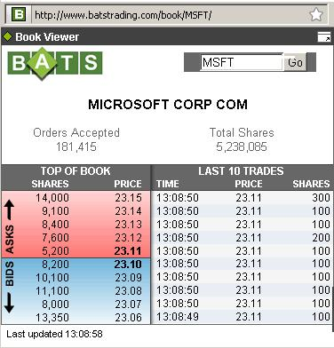
ECNs
Electronic Communications Networks provide direct trading among investors
Developed in late 1990s
ECN orders transmitted to NASDAQ
Observe live trading online at Batstrading.com

Slide 51
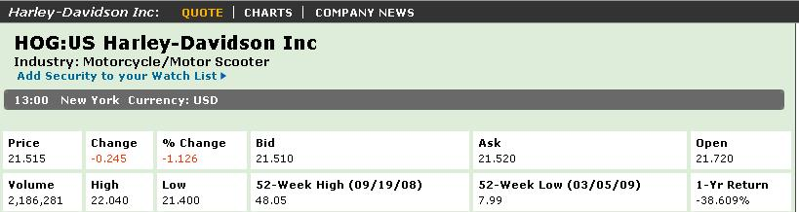
Reading Stock Quotes
What information is provided in the stock quote?

Slide 52
Constant Dividend (Zero Growth; Perpetuity)

Slide 53
Calculate FV Of Current Dividend With Constant Growth Rate

Slide 54
Calculate Current Value Of Stock With Constant Growth Rate (Dividend Growth Model)

Slide 55
Growing Perpetuity (An Asset With Cash Flows That Grow At A Constant Rate Forever)

Slide 56
Calculate FV Of P₀ (Price Of Stock At Time t)

Slide 57
Rates
Dividend Yield
Capital Gains Yield (Constant Growth Rate)
Required Rate Of Return

