Slide 1
Highline Class, BI 348
Basic Business Analytics using Excel
Import, Clean, Transform, Data

Slide 2
Topics
Excel Built-in features to Clean and Transform data such as:
Formulas
Flash Fill
Text To Columns
Power Query (Proper Data Set must be an Excel table or Filtered List)
Import data into Excel:
Import data from: text files, databases, web sites and more
Get External Data (not needed so much anymore because of Power Query)
Power Query To Import, Clean, Transform data (examples on next Topic slide)
Data Dashboard
Data Model in Excel 2013

Slide 3
Topics
Power Query To Import, Clean, Transform data Examples:
Import Multiple Text Files (.txt, .csv), Which Each Contain A Single Proper Data Set, From A Single Folder And Merge Into A Proper Data Set
Import multiple Excel files with a single sheet using Add Column and Excel.Workbook Power Query Function
Import multiple Excel workbooks with multiple sheets into a single data set (Excel.Workbook)
Import, clean and transform multiple Excel Files that do not have a proper data set from single folder into a single data set (Excel.Workbook)
Import and merge data sets from multiple sources into a single data set
Get data from the web
Unpivot a data Set
Import big data into Data Model and access data using PivotTable “Use an External Sources”
Import multiple data sets and build relationships (using Data Model) between the data sets in Excel (to simulate VLOOKUP)

Slide 4
Excel Data Cleaning and Transformational features
Formulas, in particular Text Functions
Flash Fill
Text To Columns
Good when you:
Already have data in Excel
Not importing the data from a single or multiple sources
Source data from external sources will not change
The task is quick and easy with Excel features

Slide 5
Text Functions to Transform Data
TEXT function: converts a number to text with a Custom Number Format that you specify. TEXT(number, "Custom Number Format in quotes")
RIGHT function: extracts a given number of characters from the right
LEFT function: extracts a given number of characters from the left
MID function: extracts from the middle given a starting point and the number of characters that you want
SEARCH function: tells you the starting position in a text string of text you specify. FIND is similar to SEARCH, but it is case sensitive.
TRIM function: removes spaces from a text string except for single spaces between words
REPLACE function: function replaces part of a text string with text you specify, given a starting number and the number of characters
SUBSTITUTE function: finds some text and replaces it with some different text
PROPER function: changes all capital letters or all lower case letters to all lower case except for first letter in each word
LEN function: counts characters
LOWER function: converts all letters to lower case
UPPER function: converts all letters to upper case

Slide 6
Flash Fill
Microsoft calls this feature: “Program by Example”
The way Flash Fill works:
You have to recognize a pattern in the data and then give Flash Fill one or more examples of how you want to transform the data
In a column next to the data set: type as many example as needed to “show” Flash Fill how you want it to change the data.
Example, if you have First Last name in a column and you want First name, type First name in column next to data set, hit Enter, type a second First name and when you see the “Ghost List” appear, hit Enter.
Example, if you have First Last name in a column and you want First name, type First name in column next to data set, hit Enter, and Use Ctrl + E.
If you have a complicated patrtern, you may need to give Flash Fill a few examples, before using Ctrl + E.
Flash Fill is on the Data Ribbon Tab. Or use Ctrl + E.

Slide 7
Text To Columns
Text To Columns is on the Data Ribbon Tab
Text To Columns allows you to take a column of data and split it apart based on a Delimiter or a Fixed Width.
The dialog box for Text To Columns is the same as the dialog box for importing text data.
Text to Columns is particularly good for converting ISO Dates like: 20150824 (Year, Month, Day) into Serial Number Dates
Step 3 of dialog box: choose data format YMD and hit Finish.
This feature may be becoming obsolete because of Power Query, but it still has some good uses.

Slide 8
Import Data into Excel
Import data from external sources such as:
Text files such as .txt (Tab delimited) and .cvs (Comma separated values)
Excel Workbooks
Databases such as Access and SQL Database
Web sites
Other external sources
Get External Data group in Data Ribbon Tab is less important because Power Query does all the things that it does and much more.
Power Query allows you to import, clean, transform the data and make reports and then refresh the data so who proceeds updates and creates new reports

Slide 9
Power Query
In Excel 2010 & 2013 Search Google for “Download Power Query”
Very simple download and then it automatically appears as a new Ribbon Tab.
In Excel 2016 it is the “Get and Transform” group on the Data Ribbon Tab
Get External Data group in Data Ribbon Tab is much less important because Power Query does all the things that it does and much more.
The essence of Power Query is:
Import, clean, transform data from multiple sources and place it into an Excel Table or the Data Model and build reports from the Excel Table or Data Model that can be refreshed with a single click.
The entire process from import to clean to report is memorized and when you refresh that whole path toward the final report is repeated and the final report updates.
At any time you can open the memorized query and edit it and then reload the data.

Slide 10
Example 1a: Import Multiple Text Files & Build “Quantitative Business Class Grade Analysis Dashboard
Data at Start: Four “Text” Files Exported from Database:
End Dashboard:

Slide 11
Data Dashboard
Data Dashboard
Data Visualization Tool that illustrates multiple metrics or KPIs (Key Performance Indicators) and automatically updates as new data becomes available
Effective Dashboards:
Presents timely summary data or metrics/KPIs
Metrics/KPIs should be useful for the user/decision maker
Dashboard should inform rather than overwhelm
Should call attention to unusual metrics/KPIs that require attention or are of interest

Slide 12
1: Import Multiple Text Files (.txt, .csv), Which Each Contain A Single Proper Data Set, From A Single Folder And Merge Into A Proper Data Set
Steps:
.txt or .csv files must all be in a single folder
Power Query Ribbon Tab, Get External Data group, From File dropdown, From Folder
Browse to folder
In Excel 2016: Data Ribbon Tab, Get and Transform group,
In Query Settings Task Pane, Name Query
In Extension column, Filter if necessary
Right-click Content column and click “Remove Other Columns”
From the Content column, click the Double Arrow to expand data. Button looks like:
This step should import, promote headers, and change data to proper data type.

Slide 13
1: Import Multiple Text Files (.txt, .csv), Which Each Contain A Single Proper Data Set, From A Single Folder And Merge Into A Proper Data Set
Steps:
In first column click Filter Dropdown, click Load More button if it appears, and filter out excess column Name
Check the Data Type for each column (Data Type button in “Transform” group, Home Ribbon Tab)
Home Ribbon Tab in Query Editor, Close group, Close and Load Dropdown, Close and Load button
Choose Load to: 1) Excel Table in Excel workbook or 2) Data Model (Smaller File Size)
Once we import the data into the Data Model, we can access the Data Model through the PivotTable dialog box using the “Connect to External Sources” button.

Slide 14
Example 1b: Import Multiple CSV Files With 800,000 Rows Of Data Into Data Model And Create Report
Data at Start: Four “CSV” Files with 800,000 rows of data:
End Report:

Slide 15
What is Data Model in Excel 2013?
Data Model
Behind the scenes (in-memory) Columnar Database that allows you to import large data sets (millions of rows) that would not fit in an Excel sheet
The Data Model stores the imported data, not in an Excel Sheet or Table, but in the “In-memory Columnar Database
The Columnar Database is efficient at storing large amounts of data: file size can be dramatically reduced
For Example: if you store 500,000 rows of data in the Data Model rather than an Excel sheet, the file size will be multiple times smaller.
Once we import the data into the Data Model, we can access the Data Model through the PivotTable dialog box using the “Connect to External Sources” button.
Most people use the Data Model is conjunction with the Report building tool, PowerPivot, which allows you to build relationships between tables and use the new formula DAX formula language for Model Building.
We will get an introduction to Power Pivot next week
Note: When you use Data Model, Dates cannot be grouped in the PivotTable (how to get around this in an upcoming video).

Slide 16
Synonyms For data Model / Columnar Database
PowerPivot Database
Columnar database
Data Model
Excel Data Model
PowerPivot Database stored in an Excel workbook
PowerPivot xVelocity engine
PowerPivot engine
XVelocity analytics engine
Excel 2013 PowerPivot engine = Tabular engine of SQL Server Analysis Services 2012 running in process inside Excel
VertiPaq =XVelocity = Database in memory = Columnar database.
Storage engine

Slide 18
Example 2: Import Multiple Excel Files (With One Sheet Tab Each)into Data Model And Create Histogram
Data at Start: Three Excel Files with 500,000 rows of data:
End Report:

Slide 19
2: Import Multiple Excel Files With A Single Sheet Using Add Column And Excel.Workbook Power Query Function
Steps:
.xlsx or .xlsm (or other Excel extensions) files must all be in a single folder
Power Query Ribbon Tab, Get External Data group, From File dropdown, From Folder
Browse to folder
In Excel 2016: Data Ribbon Tab, Get and Transform group,
In Query Settings Task Pane, Name Query
In Extension column, Filter if necessary
Right-click Content column and click “Remove Other Columns”
Add Column Ribbon Tab, Click “Add Custom Column”
Name column: GetExcelData
Create Power Query Formula: =Excel.Workbook([Content])
From the GetExcelData column, click this button (Expand button): Click OK.
Expand Button (Double outward pointing arrow)

Slide 20
2: Import Multiple Excel Files With A Single Sheet Using Add Column And Excel.Workbook Power Query Function
Steps:
Right-click “GetExcelData.Data” column and click “Remove Other Columns”
From the GetExcelData column, click the Expand Button (Double outward pointing arrow). Click OK.
In Upper Left Corner, click dropdown and select “Promote Headers”
In first column click Filter Dropdown, click Load More button if it appears, and filter out excess column name
Check the Data Type for each column (Data Type button in “Transform” group, Home Ribbon Tab)
Home Ribbon Tab in Query Editor, Close group, Close and Load Dropdown, Close and Load button
Choose Load to: 1) Excel Table in Excel workbook or 2) Data Model (Smaller File Size)
Once we import the data into the Data Model, we can access the Data Model through the PivotTable dialog box using the “Connect to External Sources” button.

Slide 21
Example 3: Import Multiple Excel Files with Multiple Sheet Tabs into an Excel Table (Proper Data Set)
Data at Start: Three Excel Files with a new sheet tab for each employee:
Resultant Proper Data Set:
Sheet Tab Name (Employee Name) gets populated into column

Slide 22
3: Import Multiple Excel Workbooks With Multiple Sheets Into A Single Data Set
Steps:
.xlsx or .xlsm (or other Excel extensions) files must all be in a single folder
Power Query Ribbon Tab, Get External Data group, From File dropdown, From Folder
Browse to folder
In Excel 2016: Data Ribbon Tab, Get and Transform group,
In Query Settings Task Pane, Name Query
In Extension column, Filter if necessary
Right-click Content column and click “Remove Other Columns”
Add Column Ribbon Tab, Click “Add Custom Column”
Name column: GetExcelData
Create Power Query Formula: =Excel.Workbook([Content])
From the GetExcelData column, Expand button. Click OK.

Slide 23
3: Import Multiple Excel Workbooks With Multiple Sheets Into A Single Data Set
GetExcelData.Kind column tells if the object is a sheet, table, defined name or other
From GetExcelData.Kind column, filter out everything that is not a sheet.
If you have Proper Sheet Names (and we always do in this class), from GetExcelData.Item column, Filter out anything that contains the word “Sheet”
Remove columns that are not “GetExcelData.Data” and “GetExcelData.Item”
From “GetExcelData.Data” column, click Expand Button (Double outward pointing arrow)
In Upper Left Corner, click dropdown and select “Promote Headers”
In a column that contains only a few unique records, click Filter Dropdown, click Load More button if it appears, and filter out excess column name (Field Name).
Rename columns if necessary
Check the Data Type for each column (Data Type button in “Transform” group, Home Ribbon Tab)
Home Ribbon Tab in Query Editor, Close group, Close and Load Dropdown, Close and Load button
Choose Load to: 1) Excel Table in Excel workbook or 2) Data Model (Smaller File Size)

Slide 24
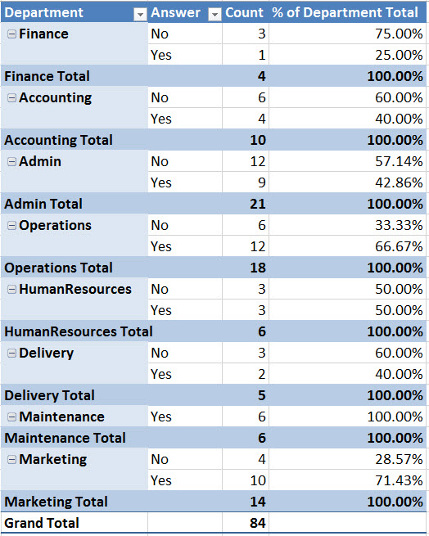
Example 4: Import Multiple Excel Files Data That Is Not In A Proper Data Set (“Bad Data”) To Determine Employee Response To Company Survey
Data at Start: Multiple “Bad Data” Excel files:
Transform Into Proper Data Set:
Report that shows % Responses by Department:

Slide 25
4: Import, Clean And Transform Multiple Excel Files That Do Not Have A Proper Data Set From Single Folder Into A Single Data Set
Steps:
.xlsx or .xlsm (or other Excel extensions) files must all be in a single folder
Power Query Ribbon Tab, Get External Data group, From File dropdown, From Folder
Browse to folder
In Excel 2016: Data Ribbon Tab, Get and Transform group,
In Query Settings Task Pane, Name Query
In Extension column, Filter if necessary
Right-click Content column and click “Remove Other Columns”
Add Column Ribbon Tab, Click “Add Custom Column”
Name column: GetExcelData
Create Power Query Formula: =Excel.Workbook([Content])
From the GetExcelData column, Expand button. Click OK.
GetExcelData.Kind column tells if the object is a sheet, table, defined name or other
From GetExcelData.Kind column, filter out everything that is not a sheet.
If you have Proper Sheet Names (and we always do in this class), from GetExcelData.Item column, Filter out anything that contains the word “Sheet”
Remove columns that are not “GetExcelData.Data” and “GetExcelData.Item”
From “GetExcelData.Data” column, click Expand Button (Double outward pointing arrow)

Slide 26
4: Import, Clean And Transform Multiple Excel Files That Do Not Have A Proper Data Set From Single Folder Into A Single Data Set
Steps:
From “GetExcelData.Data” column, click Expand Button (Double outward pointing arrow)
From first column Filter out “Null”, “Employee/Answer”, “Count”
From first column use the Text Filter option “Does Not Begin With” to filter out rows that contain “Question:”
Highlight columns with the Yes and No answers and in the Transform Ribbon Tab, Select “Unpivot Columns”.
Remove Attribute column
Rename Columns
Close and Load to Sheet
Build PivotTables using Show Vales As: “% of Column Total” and “% of Parent Total”
Paste new files in Folder and Update Query Output and PivotTable.

Slide 27
Example 5: Import Multiple Files from Multiple Sources into an Excel Table (Proper Data Set)
Data at Start: Three Different Data Sources: Access database, Excel File, .txt file:
Resultant Proper Data Set:

Slide 28
5: Import And Merge Data Sets From Multiple Sources Into A Single Data Set
Steps:
Access Database File:
Power Query Ribbon Tab, Get External Data group, From Database dropdown, From Access
Select Table, Click Edit, Edit if necessary
Close and Load To: “Only Create Connection”, Click Load
Excel File:
Power Query Ribbon Tab, Get External Data group, From File dropdown, From Excel
Select Table, Click Edit, Edit if necessary
Close and Load To: “Only Create Connection”, Click Load
“.txt” File
Power Query Ribbon Tab, Get External Data group, From File dropdown, From Text
Edit if necessary
Close and Load To: “Only Create Connection”, Click Load
Power Query Ribbon Tab, Combine group, Click Append button
Select Primary Table and Table to Append, Click OK
In Power Query Editor Home Ribbon Tab, Combine group, Click Append, and add Table
Change Data Types if Necessary
Click Close and Load to: Either: Table or Data Model

Slide 29
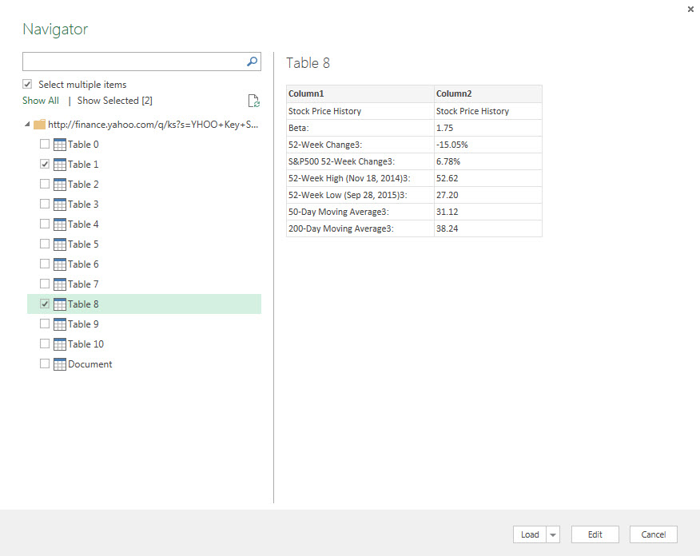
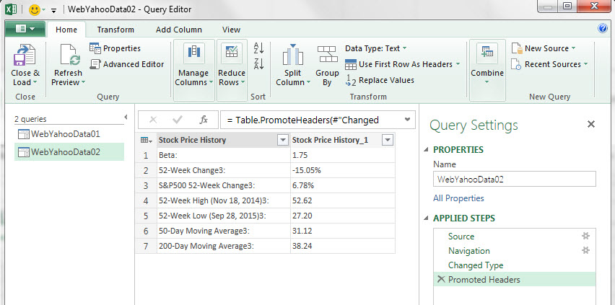
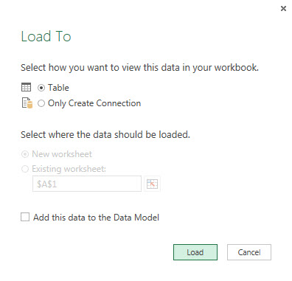
6: Get Data From The Web
Find web site that has data that you would like to have in Excel and have the ability to refresh when the web data changes, like stock market data
Power Query Ribbon Tab, Get External Data group, From Web
Paste Web address, click OK to get the Navigator window where you can select tables
Select tables with check boxes, Click Edit
In the Query Editor window, edit each table and then “Load To” “Table” (if you have multiple tables it will load each table on a new sheet).

Slide 30
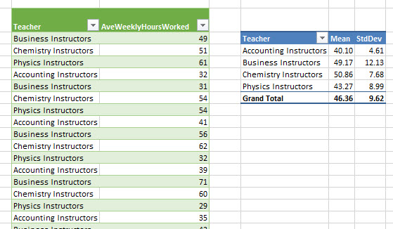
7: Unpivot A Data Set
With data set in Excel, either convert the data set to an Excel Table (Ctrl + T) or Turn on and off Filters (Ctrl + Shift + L, L).
Import Data into Power Query with “From Table”
Highlight columns, on the Transform Ribbon Tab, Any Column group, click Unpivot Columns

Slide 31
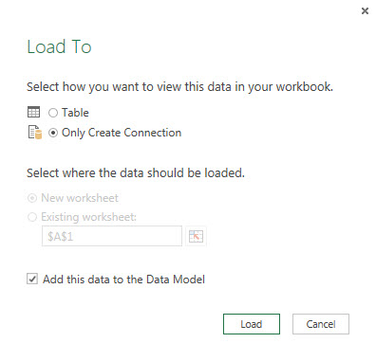
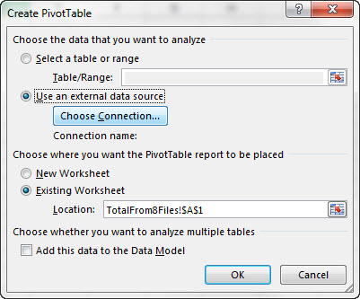
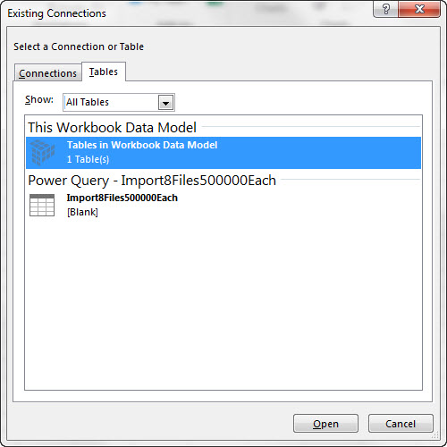
8: Import Big Data Into Data Model And Access Data Using PivotTable “Use an external data source”
Whether you are importing Big Data from text files, Access, Excel with many sheet tabs or other, after you are done with the Power Query Editor, Close and Load to “Only Create Connection” and check “Add this data to data Model”
To access the data model without Power Pivot, open the Create PivotTable dialog box, select “Use an external data source”, click “Choose Connection”, On Tables tab, select Power Query Data Source.
When web data changes, in Excel refresh query and data updates.

Slide 32
Get Two Tables into an Excel 2013 PivotTable Field List without using PowerPivot AND Replace VLOOKUP: Power Query Merge? Data Model Relationships? .
Replace VLOOKUP with Excel 2013 Data Model and Relationships:
Power Query Merge feature
Steps:
Convert both proper data sets to Excel Tables (Ctrl + T); be sure to name Excel Table (Alt, J, T, A).
In Create PivotTable dialog box check “Add this data to Data Model.
Even though we do not have PowerPivot, the Columnar Database is still in Excel 2013 by default.
In PivotTable Field List, click ALL tab to see all Excel tables in workbook.
Pulling Fields from both tables into the PivotTable will invokes the “Yellow Relationship” button.
Click “Yellow Relationship” button and add: 1) lookup table as the “Related Table” (second level drop down in dialog box) and 2) transaction table (also known as Fact Table) as the “Table” (first level drop down in dialog box).
Convert both proper data sets to Excel Tables (Ctrl + T); be sure to name Excel Table (Alt, J, T, A).
Import both tables into Power Query editor: Power Query Ribbon Tab, Excel Data group, From Table AND Load To “Create Connection Only”
Power Query Ribbon Tab, Combine group, Merge button
Then add: 1) transaction table (also known as Fact Table) to first dropdown list, and: 2) lookup table to second dropdown list
Then click related column in each table (in our case Sales Rep columns)
Click expand button at top of new column and check only the Region column.
Rename columns and load query to either Table or Data Model

