Slide 1
Busn 216
By Your Name

Slide 2
Topics
Windows Explorer
Word
PowerPoint
Excel
Access
Mail Merge

Slide 3
Windows Explorer
File Management
  Copy, Move, Delete Files
  Backup
  Create Folders

Slide 4
Word
Business Documents
  Flyer
  Research Papers
  Business Letters

Slide 5
PowerPoint
Presentations
  Text
  Images
  Video
  Paste Special links

Slide 6
Excel
Calculations
  Formulas
  PivotTables
  Excel tables
  Examples:
    Payroll
    Budgets
    Calculations with Criteria
Data Analysis
  PivotTables
  Sorting and Filtering
  Formulas
  Examples:
    Adding by Region
    Monthly Reports

Slide 7
Example:
Notes:
Notes:
1) Note 1

Slide 8
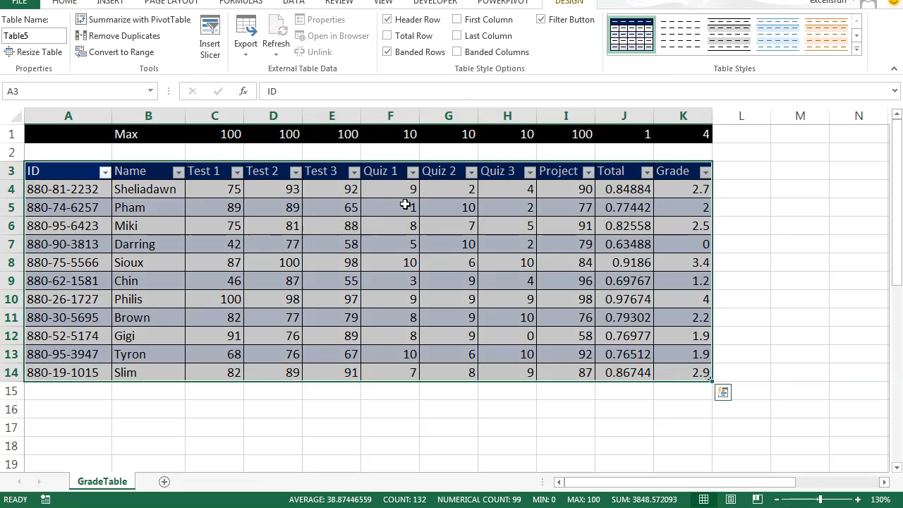

Slide 9
Access
Database:
  Stores Raw Data
    Tables
  Convert Raw Data Into Useful information
    Queries
    Reports

Slide 10
Mail Merge
Connect a document to a database
  Databases:
    Excel
    Access

