Slide 1
Seeing the Light
Lighting Calculation in Computer Graphics
Birgit Hindman
Lake Washington Technical College

Slide 2
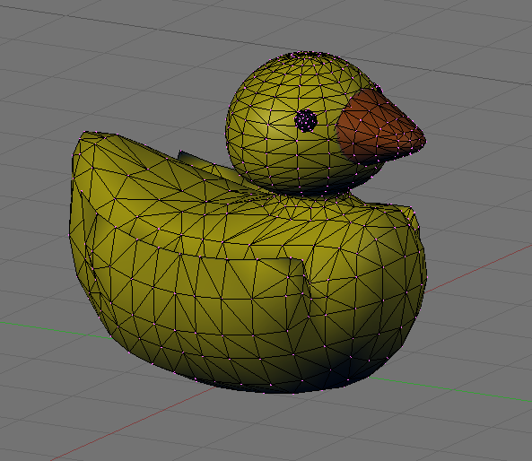
vertices

Slide 3
vertices
[0.654243, 0.330678, 0.187963]
[0.645254, 0.358022, 0.185461]
[0.646650, 0.374428, 0.185850]
[0.655751, 0.379897, 0.188383]
[0.669877, 0.374428, 0.192314]
[0.686348, 0.358022, 0.196898]
[0.702484, 0.330678, 0.201389]
[0.584502, 0.330678, 0.355704]
[0.576441, 0.358022, 0.350969]
[0.577693, 0.374428, 0.351704]
[0.585854, 0.379897, 0.356498]
[0.598522, 0.374428, 0.363938]
[0.613292, 0.358022, 0.372613]
[0.627762, 0.330678, 0.381111]
[0.475873, 0.330678, 0.497000]
[0.469258, 0.358022, 0.490385]
[0.470285, 0.374428, 0.491412]
[0.476982, 0.379897, 0.498109]
[0.487377, 0.374428, 0.508505]
[0.499498, 0.358022, 0.520626]
[0.511373, 0.330678, 0.532500]
[0.334576, 0.330678, 0.605630]
[0.329842, 0.358022, 0.597569]
[0.330577, 0.374428, 0.598820]
[0.335370, 0.379897, 0.606982]
[0.342810, 0.374428, 0.619649]
[0.351485, 0.358022, 0.634419]
[0.359984, 0.330678, 0.648889]
[0.166836, 0.330678, 0.675370]
[0.164334, 0.358022, 0.666381]
[0.164722, 0.374428, 0.667777]
[0.167255, 0.379897, 0.676878]
[0.171187, 0.374428, 0.691004]
[0.175771, 0.358022, 0.707475]
[0.180262, 0.330678, 0.723611]
[-0.021127, 0.330678, 0.700000]
[-0.021127, 0.358022, 0.690683]
[-0.021127, 0.374428, 0.692130]
[-0.021127, 0.379897, 0.701563]
[-0.021127, 0.374428, 0.716204]
[-0.021127, 0.358022, 0.733276]
[-0.021127, 0.330678, 0.750000]
[-0.224715, 0.330678, 0.675370]
[-0.215631, 0.358022, 0.666381]
[-0.211606, 0.374428, 0.667777]
[-0.211463, 0.379897, 0.676878]
[-0.214020, 0.374428, 0.691004]
[-0.218098, 0.358022, 0.707475]
[-0.222516, 0.330678, 0.723611]
[-0.396831, 0.330678, 0.605630]
[-0.383671, 0.358022, 0.597569]
[-0.378758, 0.374428, 0.598820]
[-0.380125, 0.379897, 0.606982]
[-0.385806, 0.374428, 0.619649]
[-0.393832, 0.358022, 0.634419]
[-0.402238, 0.330678, 0.648889]
[-0.535002, 0.330678, 0.497000]

Slide 4
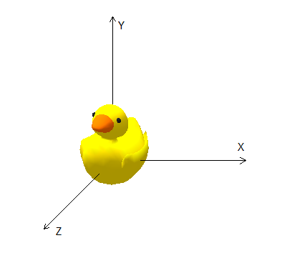
Object space

Slide 5
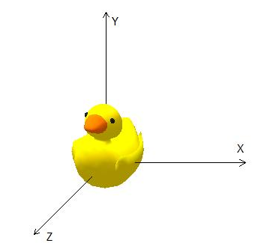
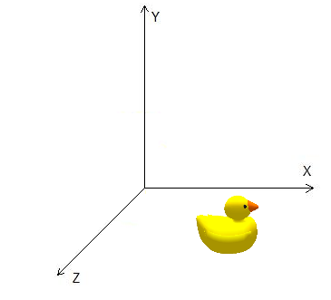
World space

Slide 6



View space
far plane
near plane
camera
view frustum

Slide 7
Clip space

Slide 8
Screen space

Slide 9
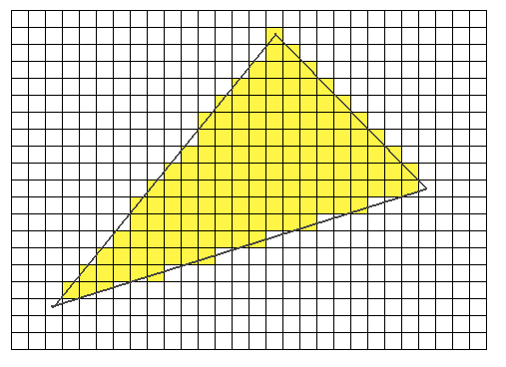
Rasterize

Slide 10
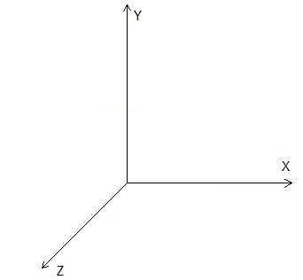
Summary

Slide 11
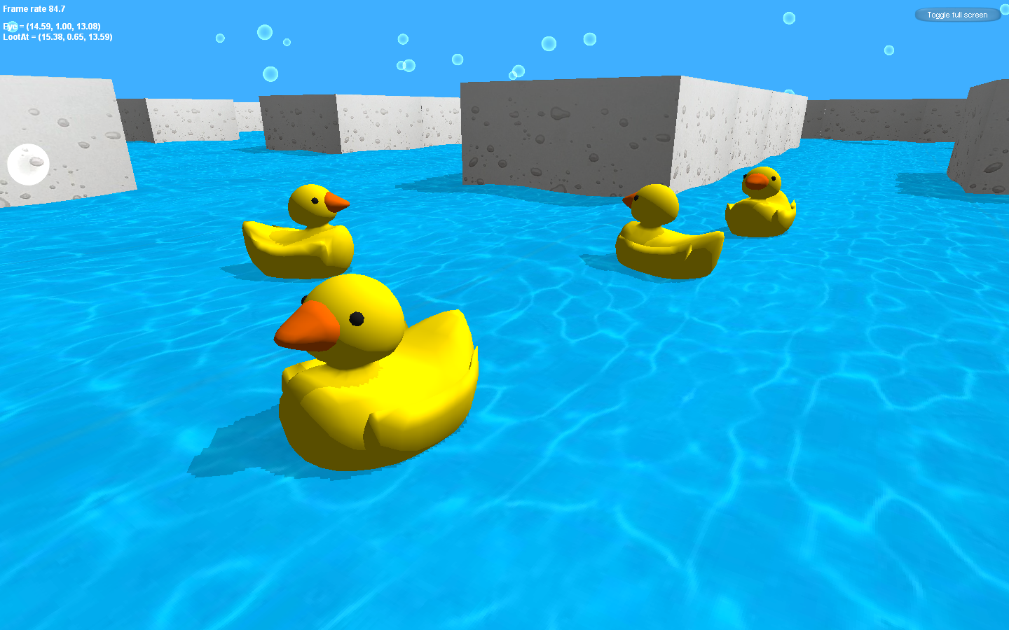

Slide 12

Without Lighting

Slide 13
Quack ?
Quack ?!?

Slide 14
What you see depends on…
The material of the object
The lighting

Slide 15
Colors
Color Value = [C_{r}, C_{g}, C_{b}]
  0 ≤ C_{i} ≤ 1
Scaling colors
  sC= [sC_{r}, sC_{g}, sC_{b}]
Adding colors
  C + D = [C_{r} + D_{r}, C_{g} + D_{g}, C_{b} + D_{b}]
Multiplying colors
  CD = [C_{r}D_{r}, C_{g}D_{g}, C_{b}D_{b}]

Slide 16
Duck colors
[0.00, 0.00, 0.00]
[0.80, 0.33, 0.00]
[0.82, 0.72, 0.00]

Slide 17


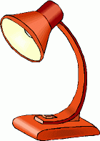

Light Sources
Point light
Directional light
Other…
Spotlight
Ambient light

Slide 18
Diffuse Light
Light is scattered in all directions equally
Depends on the material and the light hitting the object

Slide 19


Diffuse Light

Slide 20
Diffuse Light
Reflected light = DK max((cosθ), 0) = DK max((N ∙ L ), 0)
N = Surface normal
|| N|| = 1
L = Light vector
|| L || = 1
K = Light color
θ
D = diffuse color of material

Slide 21
Diffuse light examples
Reflected light = DK max((cosθ), 0) = DK max((N ∙ L ), 0)
D = [0.82, 0.72, 0.00]
D = [0.82, 0.72, 0.00]
K = [1.00, 1.00, 1.00]
K = [1.00, 1.00, 1.00]
N = [0.00, 1.00, 0.00]
N = [0.00, 1.00, 0.00]
L = [0.87, 0.50, 0.00]
L = [0.50, 0.87, 0.00]
R = [0.41, 0.36, 0.00]
R = [0.71, 0.63, 0.00]
N
L
N
30˚
60˚
L

Slide 22
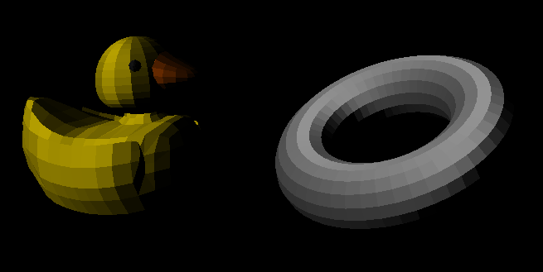
Diffuse Light
DK max((N ∙ L ), 0)

Slide 23
Vertex normals

Slide 24
Barycentric coordinates
v₃
p = λ₁v₁ + λ₂v₂ + λ₃v₃
λ₁+ λ₂+ λ₃ = 1
λ_{i} = A_{i} / A
A₂
A₁
p
A₃
v₁
area = A
v₂

Slide 25
Barycentric coordinates
v₃
A₂
A₁
p
A₃
v₁
area = A
v₂

Slide 26
Barycentric coordinates
If p is inside the triangle:
v₃
A₂
A₁
p
A₃
v₁
area = A
v₂

Slide 27
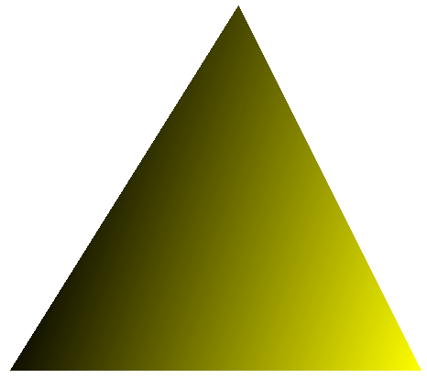
Shading
P_{r} = λ₁A_{r} + λ₂B_{r} + λ₃C_{r}
P_{g} = λ₁A_{g} + λ₂B_{g} + λ₃C_{g}
P_{b} = λ₁A_{b} + λ₂B_{b} + λ₃C_{b}
C
P
A
B

Slide 28
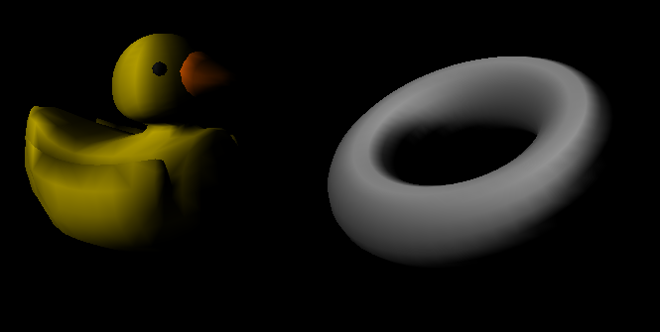
Diffuse Light (Gouraud shading)
DK max((N ∙ L ), 0)

Slide 29
Ambient Light
Reflects equally off all surfaces
Reflected light = BA
B = ambient color of the material
A = ambient light color

Slide 30
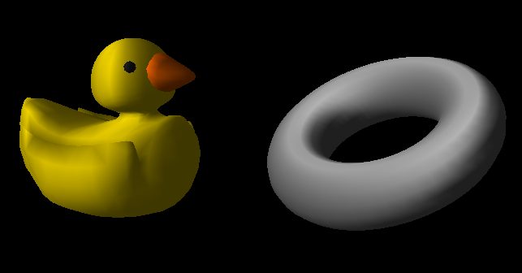
Ambient + Diffuse Light
AB + DK max((N ∙ L ), 0)

Slide 31
Specular Light
Highlight
Depends on
  The direction of the light
  The direction of the viewer
  The color of the light
  The material of the object

Slide 32
Specular Light
R = -L+2(N∙L)N
SK (max((V∙R), 0))^{n}
0
if N∙L > 0
if N∙L ≤ 0
Reflected light =
n = specular power
N = Surface normal
|| N|| = 1
R = Reflection
L = Light vector
|| L || = 1
K = Light color
V = View
θ
θ
S = specular color of material

Slide 33
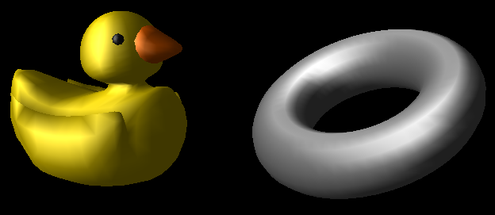
Ambient + Diffuse + Specular Light
SK (max((V∙R), 0))^{n}
0
if N∙L > 0
if N∙L ≤ 0
AB + DK max((N ∙ L ), 0) +

Slide 34
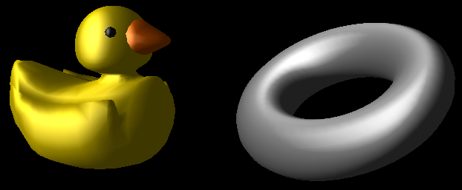
Phong shading

Slide 35
