Slide 1
Tracing Kepler’s path with Mathematica
Notes:
Introduce everyone
http://www.wallpaperpimper.com/wallpaper/download-wallpaper-Solar_System-size-1280x960-id-112377.htm

Slide 2
Heliocentrism
Notes:
Explain Heliocentrism is the idea that the planets revolve around the Sun and not Earth
http://www.astro.psu.edu/users/rbc/a1/lec4n.html

Slide 3
Nicolaus Copernicus (1473 - 1543)
Notes:
Nicolaus Copernicus came up with the idea of Heliocentrism
http://ircamera.as.arizona.edu/NatSci102/NatSci102/lectures/copernicus.htm

Slide 4
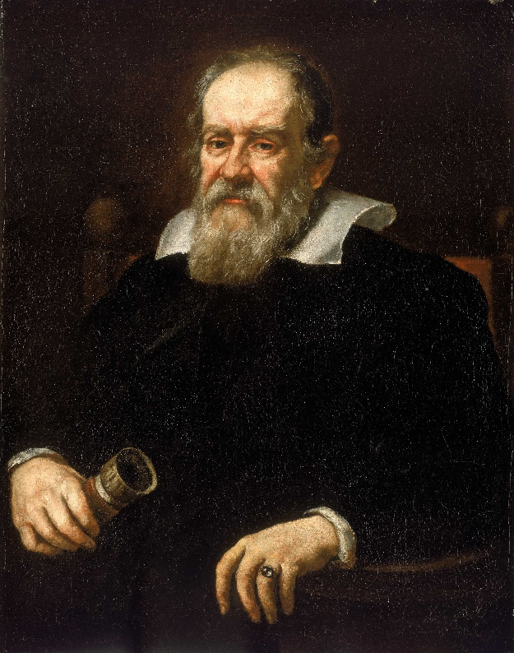
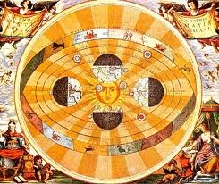
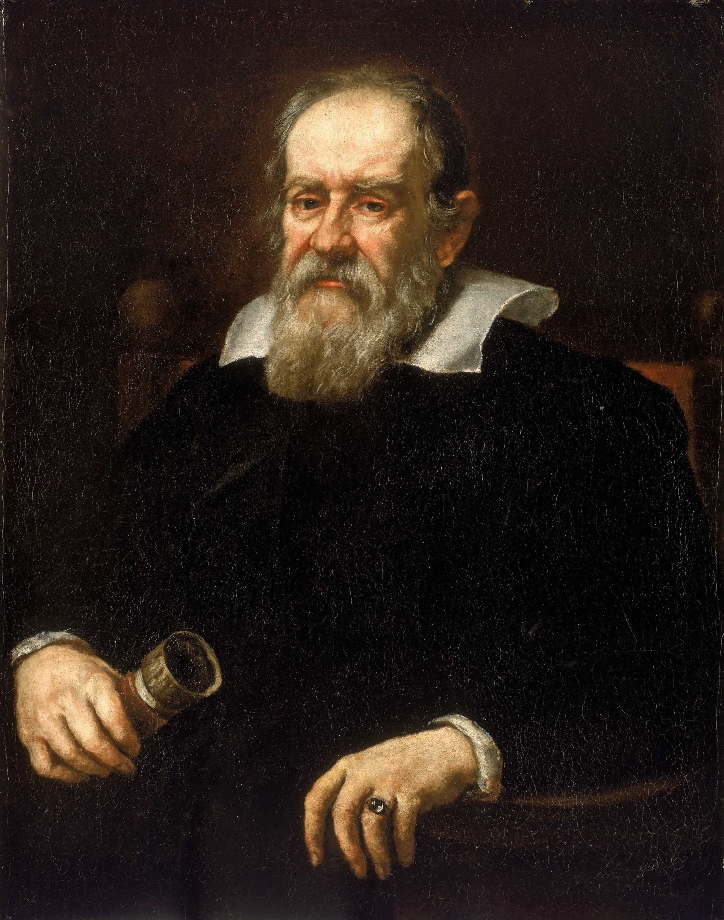
Galileo Galilei (1564 - 1642)
Confirmed Copernicus’ Idea of Heliocentrism
Notes:
Confirmed (verified) Copernicus’ Idea of Heliocentrism by observing the planets with his telescope. He saw phases on Venus.
http://en.wikipedia.org/wiki/Galileo_Galilei

Slide 5
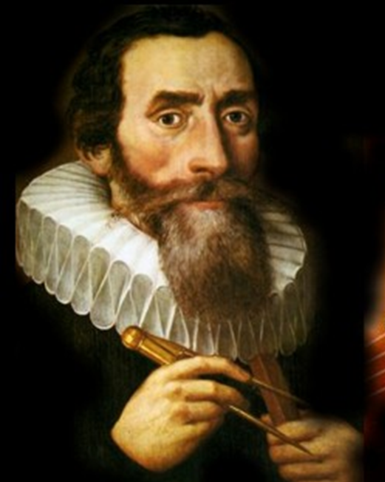
Johannes Kepler (1571 – 1630)
Laws of Planetary Motion
A planet’s orbit is elliptical
The line from sun to the planet sweeps out equal area in equal time
Notes:
Laws of Planetary Motion
1) A planet revolves around the sun in an elliptical orbit
2) The line joining the sun to a planet sweeps out equal areas in equal times
Ellipse: squished circle or

Slide 6
Sir Isaac Newton (1642-1727)
Proved Kepler’s Laws!
Notes:
– Proves Kepler’s Laws
http://commons.wikimedia.org/wiki/File:Sir_Isaac_Newton_by_Sir_Godfrey_Kneller,_Bt.jpg

Slide 7
Guiding Philosophy
Everything should
be made as simple
as possible, but
not simpler.
Albert Einstein

Slide 8
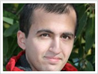
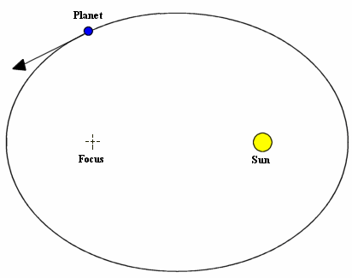
Kepler’s First Law
A planet revolves around the sun in an elliptical orbit with the sun at one focus

Slide 9
What do we need to prove?
Conic equation in
polar coordinates
r : the distance between the planet and the sun
e : the eccentricity of the orbit (related to ellipses)
d : the directrix (a constant of the ellipse)
Notes:
An applet illustration of the first law:
http://www.walter-fendt.de/ph14e/keplerlaw1.htm
Second law:
http://www.walter-fendt.de/ph14e/keplerlaw2.htm

Slide 10
The Physics
$$\overset{⃑}{F}=m. \overset{⃑}{a}$$
Newton's 1st Law
$$\overset{⃑}{F}=−\frac{GMm}{r^{3}}\overset{⃑}{r}$$
Newton’s Gravitational Law
$$\overset{⃑}{a}=−\frac{GM}{r^{3}}\overset{⃑}{r}$$
Acceleration of the planet

Slide 11
A Proof in Three Parts
Part I: Show the planet’s path lies in a plane
Part II: Nasty, nasty, nasty vector algebra and calculus
Part III: Coordinatize

Slide 12
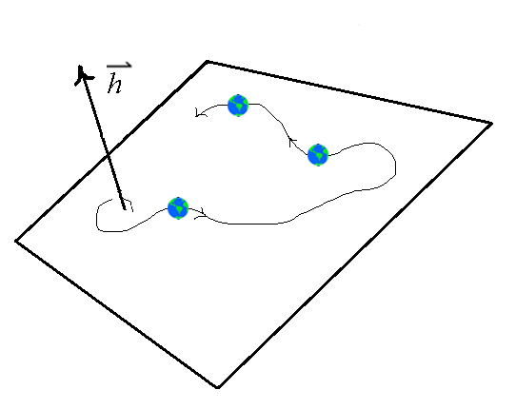
Part I Show the planet’s path lies in a plane
Let $\overset{⃑}{r}$ give the position of the planet at time t
Let $\overset{⃑}{v}$ give the velocity of the planet at time t

Slide 13
The relation between the position and velocity vectors
So, what is $\overset{⃑}{h}$ ?
Where does it come from?
How does it relate to $\overset{⃑}{r} and \overset{⃑}{v}$ ?
$$\overset{⃑}{v} × \overset{⃑}{v}= \overset{⃑}{0}$$
Note:
Notes:
a X a = |a|.|a|.sin(0)= 0
Note for later: v x v = 0

Slide 14
What is $\overset{⃑}{r } × \overset{⃑}{v}$ ?
$$\overset{⃑}{r} × \overset{⃑}{v}= ?$$
Take the derivative
of this expression

Slide 15
The Derivative of $\overset{⃑}{r } × \overset{⃑}{v}$

Slide 16
The Derivative of $\overset{⃑}{r } × \overset{⃑}{v}$

Slide 17
The Derivative of $\overset{⃑}{r } × \overset{⃑}{v}$

Slide 18
The Derivative of $\overset{⃑}{r } × \overset{⃑}{v}$

Slide 19
The Derivative of $\overset{⃑}{r } × \overset{⃑}{v}$

Slide 20
The Derivative of $\overset{⃑}{r } × \overset{⃑}{v}$

Slide 21
The Derivative of $\overset{⃑}{r } × \overset{⃑}{v}$

Slide 22
What have we just proved?
$\overset{⃑}{r} × \overset{⃑}{v}$ is a constant $\overset{⃑}{h}$.
Therefore the path of the planet is always perpendicular to a constant and thus lies on a plane
$\frac{d}{dt}( \overset{⃑}{r} × \overset{⃑}{v})$ = $\overset{⃑}{0}$
Notes:
Say the line with the integrals using words … not symbols (otherwise you end up having to justify integrating a vector)

Slide 23
Part II
Nasty, nasty, nasty, vector algebra
Play with the constant $\overset{⃑}{h}$
Introduce Newton’s acceleration $\overset{⃑}{a}$
Go back to the velocity $\overset{⃑}{v}$

Slide 24
Let’s express $\overset{⃑}{h}$ in a different form

Slide 25
Let’s express $\overset{⃑}{h}$ in a different form

Slide 26
Let’s express $\overset{⃑}{h}$ in a different form

Slide 27
Apply the product rule twice

Slide 28
Apply the product rule twice

Slide 29
Apply the product rule twice

Slide 30
Apply the product rule twice

Slide 31
Introducing Newton’s $\overset{⃑}{a}$

Slide 32
Introducing Newton’s $\overset{⃑}{a}$

Slide 33
Introducing Newton’s $\overset{⃑}{a}$
Notes:
This wouldn’t have been how Newton did it☺.

Slide 34
Use the vector triple product
Notes:
Vector triple product: $\overset{⃑}{a}×\left(\overset{⃑}{b}×\overset{⃑}{c}\right)=\left(\overset{⃑}{a}.\overset{⃑}{c}\right)\overset{⃑}{b}−(\overset{⃑}{a}.\overset{⃑}{b})\overset{⃑}{c}$

Slide 35
Use the vector triple product
Notes:
Vector triple product: $\overset{⃑}{a}×\left(\overset{⃑}{b}×\overset{⃑}{c}\right)=\left(\overset{⃑}{a}.\overset{⃑}{c}\right)\overset{⃑}{b}−(\overset{⃑}{a}.\overset{⃑}{b})\overset{⃑}{c}$

Slide 36
Use the vector triple product
Notes:
u is a unit vector
u.u’=0 since if |r|=c we know that r’ is orthogonal to r (see example 4 in section 13.2)

Slide 37
Use the vector triple product
Notes:
Vector triple product: $\overset{⃑}{a}×\left(\overset{⃑}{b}×\overset{⃑}{c}\right)=\left(\overset{⃑}{a}.\overset{⃑}{c}\right)\overset{⃑}{b}−(\overset{⃑}{a}.\overset{⃑}{b})\overset{⃑}{c}$

Slide 38
From Acceleration back to Velocity
We Know
We Conclude
Notes:
$({\overset{⃑}{v } × \overset{⃑}{h})}^{′}$= ($\overset{⃑}{v }$ $×$ $\overset{⃑}{h}′$) + ($\overset{⃑}{v′ }× \overset{⃑}{h}$)
= 0 + ($\overset{⃑}{a} × \overset{⃑}{h}$)
= $\overset{⃑}{a} × \overset{⃑}{h}$

Slide 39
From Acceleration back to Velocity
We Know
We Conclude

Slide 40
From Acceleration back to Velocity
We Know
We Conclude
Where $\overset{⃑}{c}$is a constant vector

Slide 41
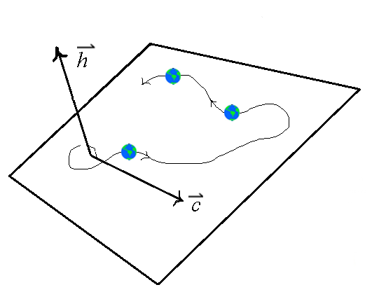
The Integration Constant $\overset{⃑}{c}$
The constant lies on the plane

Slide 42
Part III
Coordinatize
Introduce polar coordinates
Show that r has the form of an ellipse

Slide 43
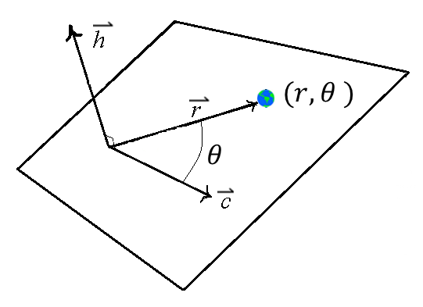
Polar Coordinates
Points in polar coordinates have the form $(r,θ )$
$\overset{⃑}{c}$ is our polar axis

Slide 44
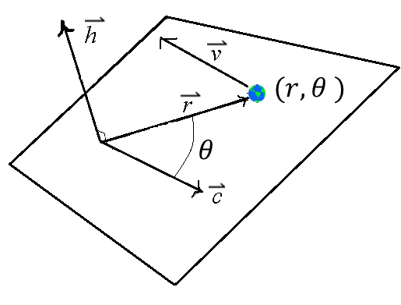
Relate the Big Three
$\overset{⃑}{r}$: position vector
$\overset{⃑}{v}$: velocity vector
$\overset{⃑}{h}$: normal to the plane
Notes:
This is an equation.

Slide 45
Solving for $\overset{⃑}{r}$ as a function of $θ$

Slide 46
Solving for $\overset{⃑}{r}$ as a function of $θ$

Slide 47
Solving for $\overset{⃑}{r}$ as a function of $θ$

Slide 48
Solving for $\overset{⃑}{r}$ as a function of $θ$

Slide 49
Almost there … 3

Slide 50
Almost there … 3

Slide 51
Almost there … 2

Slide 52
Almost there … 2

Slide 53
Almost there … 2

Slide 54
Almost there … 1

Slide 55
Almost there … 1

Slide 56
BLAST OFF

Slide 57
Q.E.D.
The position of the planet at an angle $θ$:
This is the equation of a conic section.
Planets orbit on a closed path.
The only closed conic is an ellipse.
Therefore planets follow elliptical orbits.
Notes:
Clearly state the conclusion that planets follow elliptical orbits.

Slide 58
Questions?

