Slide 1
Highline Class, BI 348
Basic Business Analytics using Excel
Chapter 03: Data Visualization: Tables & Charts

Slide 2
Topics
Data Visualization
Data Visualization Golden Rules: Low Data/Ink Ratio and “No Chart Junk”
Tables
Proper Data Sets
Cross Tabulation
PivotTables

Slide 3
Topics
Charts
Column and Bar Charts
Stacked Column or Bar Chart
Clustered column or Bar Chart
Line Charts
X-Y Scatter Charts
Bubble Charts
Conditional Formatting
Geographical Information System
Data Dashboards

Slide 4
Data Visualization
Tables:
Summarize data
See exact numbers
Help interpret, analyze, and learn from the data
Used when numbers are in different units or magnitudes
Make precise comparisons
Charts
Quick visual impression
See trends and patterns
Help interpret, analyze, and learn from the data
Make relative comparisons

Slide 5
Data Visualization
Conditional Formatting
Some examples:
Mark numbers over a hurdle
Heat Maps
Geographical Information System
Dashboards
Important metrics presented visually and connected to an updateable data source

Slide 6
Effective Data Visualization Allows You To Take Raw Data And:
See patterns and trends
Analyze data
Convey your analysis to others
Make your analysis easier for others to “see” and understand
Learn from data
Find errors

Slide 7
Visualization
Research shows that humans can process visual images (like charts) faster than they can process rows of numbers
Research shows that column and bar charts can convey differences more easily than pie charts

Slide 8
Edward R. Tufte
Edward R. Tufte on visually portraying quantitative data:
Data-Ink Ratio should be high:
All ink in the chart or table should help deliver the message or the meaning of the data
Ink that serves no useful purpose must be removed
“No Chart Junk”
All elements in a chart should help deliver the message
In every chart, ask: does the element help? If the message is no, click the Delete key.

Slide 9
Data Visualization Golden Rule:
Data Visualization Golden Rule:
No extraneous elements in your table or chart
Implementing this rule means:
All elements in the chart or table should help deliver the message
“No extraneous elements” leads to more effective tables and charts
Side note:
One of the hallmarks of great art is that great art has zero or near zero extraneous elements
Benefit of following this rule:
Effective tables and charts allows you to better communicate your analysis to others

Slide 10
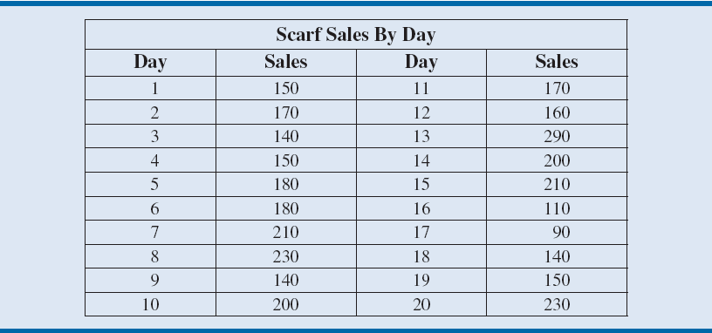
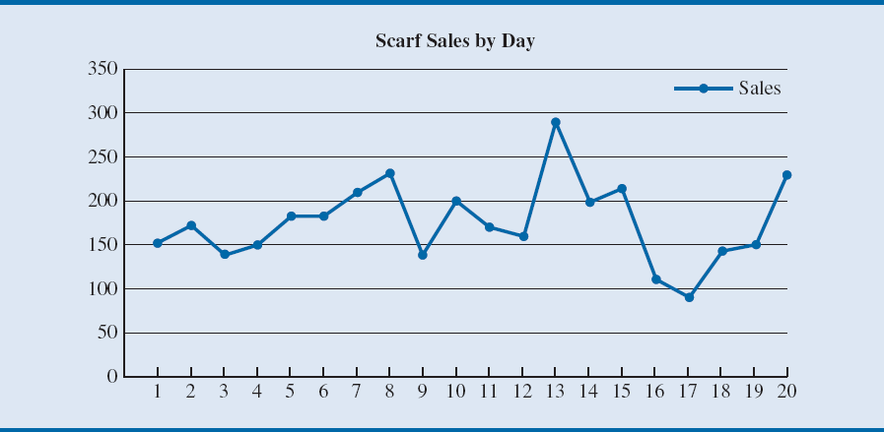
Low Data-Ink Ratio (Data/Ink)
From Essentials of Business Analytics textbook
Contains Chart Junk
Notes:
Let us consider the case of Gossamer Industries, a firm that produces fine silk clothing products.
Gossamer is interested in tracking the sales of one of its most popular items, a particular style of women’s scarf.
Table 3.1 and Figure 3.3 provide examples of a table and chart with low data-ink ratios used to display sales of this style of women’s scarf.
The data used in this table and figure represent product sales by day.

Slide 11
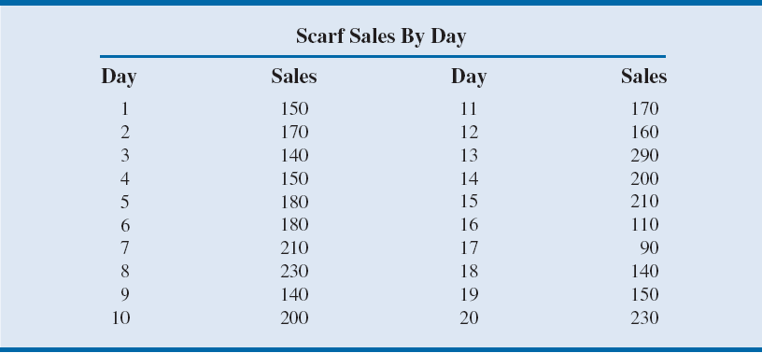
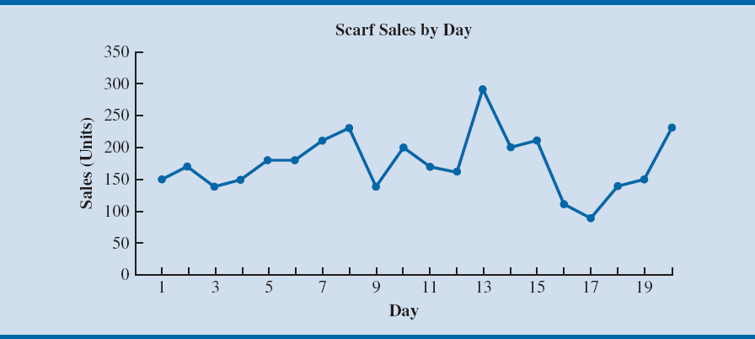
High Data-Ink Ratio (Data/Ink)
From Essentials of Business Analytics textbook
Does Not Contain Chart Junk
Notes:
Table 3.2 shows a modified table in which all grid lines have been deleted except for those around the title of the table.
Deleting the grid lines in Table 3.1 increases the data-ink ratio because a larger proportion of the ink used in the table is used to convey the information
(the actual numbers).
Similarly, deleting the unnecessary horizontal lines in Figure 3.4 increases the data-ink ratio.

Slide 12
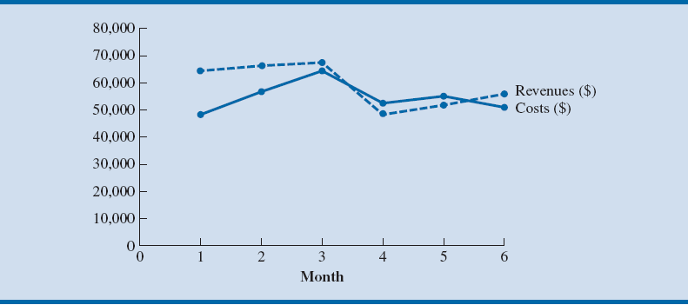
Exact Comparison Vs. Relative Comparision
Exact
From Essentials of Business Analytics textbook
Relative
Notes:
Consider when the accounting department of Gossamer Industries is summarizing the company’s annual data for completion of its federal tax forms.
In this case, the specific numbers corresponding to revenues and expenses are important and not just the relative values.
Therefore, these data should be presented in a table similar to Table 3.3.
Similarly, if it is important to know exactly by how much revenues exceed expenses each month, then this would also be better presented as a table rather than as a line chart, as seen in Figure 3.5.

Slide 13
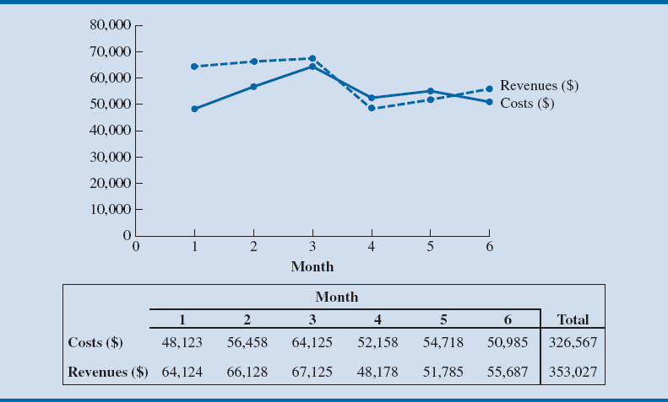
Both: Exact Comparison & Relative
From Essentials of Business Analytics textbook
Notes:
Figure 3.6 allows the reader to easily see the monthly changes in revenues and costs while also being able to refer to the exact numerical values.

Slide 14
Different Units: Use a Table
From Essentials of Business Analytics textbook
Notes:
Costs and revenues are measured in dollars ($), but head count is measured in number of employees.
Although all these values can be displayed on a line chart using multiple vertical axes, this is generally not recommended.
Because the values have widely different magnitudes (costs and revenues are in the tens of thousands, whereas headcount is approximately 10 each month), it would be difficult to interpret changes on a single chart.
Therefore, a table similar to Table 3.4 is recommended.

Slide 15
Tables
Proper Data Sets
Cross Tabulation
PivotTables

Slide 16
Tables Design Principles
Data-Ink Ratio should be high
Textbook suggests:
Avoid using vertical lines in a table unless they are necessary for clarity.
Horizontal lines are generally necessary only for separating column titles from data values or when indicating that a calculation has taken place.
In large tables, light shading can be used to differentiate columns
Numbers should be right aligned (Right is the visual cue that it is a number)
Text should be left aligned (Left is the visual cue that it is a text)
All numbers should have same number of digits
Units must be indicated either with Number Formatting or Labels
Large numbers may be rounded to dollar or thousands or millions and so on

Slide 17
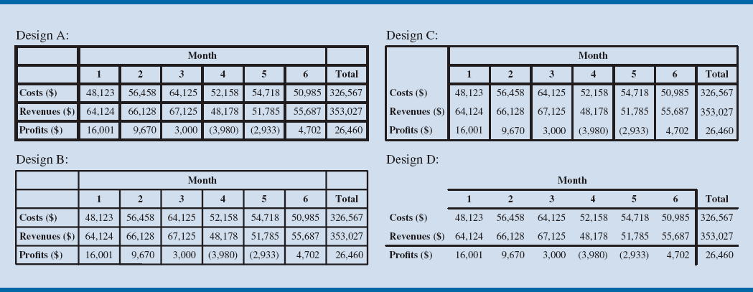
Table Design
Author states that most people prefer Design D
Notes:
Figure 3.7 compares several forms of a table displaying Gossamer’s costs and revenue data.
Most people find Design D, with the fewest grid lines, easiest to read.
In this table, grid lines are used only to separate the column headings from the data and to indicate that a calculation has occurred to generate the Profits row and the Total column.

Slide 18
Different Shades Sometimes Helps A Viewer To Read Table
Notes:
Table 3.5 breaks out the revenue data by location for nine cities and shows 12 months of revenue and cost data.
Every other column has been lightly shaded. This helps the reader quickly scan the table to see which values correspond with each month.
The horizontal line between the revenue for Academy and the Total row helps the reader differentiate the revenue data for each location and indicates that a calculation has taken place to generate the totals by month.
Columns of numerical values in a table should be right-aligned. This makes it easy to see differences in the magnitude of values.
If you are showing digits to the right of the decimal point, all values should include the same number of digits to the right of the decimal.
It is generally best to left-align text values within a column in a table, as in the Revenues by Location (the first) column of Table 3.5.
Column headings should either match the alignment of the data in the columns or be centered over the values, as in Table 3.5.

Slide 19
Table Example 1 from Video:
Before
After

Slide 20
Table Example 2 from Video:

Slide 21
Cross Tabulation
“Calculations with two or more criteria or conditions”
Allows you to compare two or more variables and shows relationship between variables (can be categorical or quantitative)
PivotTables are perfect for creating Crosstabulations
Variable/Field/Criteria/Condition as Row Header
Variable/Field/Criteria/Condition as Column Header
Intersection is a calculation done with two or more criteria/conditions
Sum
Count
"Show Values as" and then choose "% of Grand Total", "% of Row Total", "% of Column Total"
PivotTables and the PivotTable grouping feature were covered in chapter 02

Slide 22
Chart Types
Column and Bar Charts
Stacked Column or Bar Chart
Clustered column or Bar Chart
Line Charts
X-Y Scatter Charts
Bubble Charts
Heat Map
Graphical Information Systems
Textbook & Authors finally reflect the truth:
Pie charts are not as effective as column/bar charts
3-D charts (not bubble charts) are “Chart Junk”

Slide 23
What do Charts do?
Visually portray Quantitative data (number data).
Give a quick impression of the number data.
Create a picture that can communicate more quickly than just the numbers alone.
Charts allow you to see patterns or trends that you may not be able to see if you are looking at just the number data.
Allows you to make relative comparisons more quickly than if you are using a table

Slide 24
Effective charts:
Number data AND labels for the number data
No “Chart Junk”
Chart Junk:
Unnecessary Repetition
Chart elements that do not contribute to the message
Chart elements that make the chart look busy
Too many different colors
Patterns that are distracting
3-D effects that are not necessary or misleading

Slide 25
Charts Usually Come From Summarized Data Tables

Slide 26
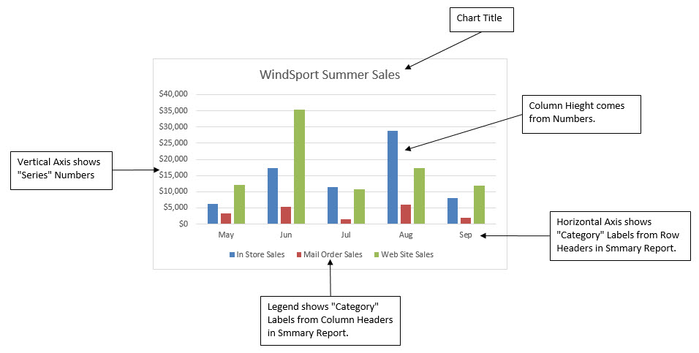
Excel Chart Terminology

Slide 27
Column and Bar Charts
Show differences (in numbers) across categories (labels)
Height of columns convey number
Good for Categorical Data:
Count (Frequency) by category
Used to show Frequency Distribution or Relative/Percent Frequency Distribution for Categorical Data
For categorical data, order of categories conveys no info
There are "gaps" between columns to indicate that the data is categorical or a discrete quantitative variable. Columns do not touch.
Research shows that Column or Bar Charts convey relative differences more effectively than Pie Charts
In recent years data analysis practitioners tend to use Column or Bar Charts rather than Pie Charts

Slide 28
Stacked Column or Bar Chart
Good for displaying crosstabulation.
Great chart for cross tabulated data from PivotTable
Emphasis is on comparing the categories listed in the horizontal axis
Excel:
If the number of row headers are equal or greater than to the number of column headers, row headers show up on horizontal axis and column headers in legend. If not, they are reversed. (You can switch this with the Switch button in the Chart Tools Design Ribbon Tab)

Slide 29
Clustered Column or Bar Chart
Good for displaying crosstabulation.
Great chart for cross tabulated data from PivotTable
Emphasis is on comparing the categories listed in the legend
Excel:
If the number of row headers are equal or greater than to the number of column headers, row headers show up on horizontal axis and column headers in legend. If not, they are reversed. (You can switch this with the Switch button in the Chart Tools Design Ribbon Tab)

Slide 30
Multiple Charts
An alternative to Stacked or Clustered Column/Bar Charts that breaks the variables in the legend into separate charts
Important to have consistent axes units and/or categories
May make the data less cluttered
Takes more space
When you have many variables or categories, multiple charts may be cleaner and easier to read
Both column/bar and scatter charts can be effective used for multiple charts
Scatter charts matrix
Useful or analyzing relationships among variables

Slide 31
Line Charts
One number on vertical axis, category on horizontal axis
Great for show trends over time

Slide 32
X-Y Scatter Charts
Chart that shows the relationship between two quantitative variables
One number on vertical axis, one number on horizontal axis
Horizontal Axis = Independent Variable = x.
Vertical Axis = Dependent Variable = f(x) = y
Always put X values in Left Most Column in the Table of Data
Add Regression Line and Equation and R Square:
Right-click plotted scatter markers
Add Trendline
Select Linear
Check check box for Show Equation
Check check box for R Square
Overcome a common mistake by Excel users:
Use X-Y Scatter Plot Chart, not Line Chart when plotting X-Y Scatter Data

Slide 33
Bubble Charts (3-D Graph)
Method of visualizing 3 variables in a 2-dimentional chart
First column of table = horizontal axis
Second column in table = vertical axis
Third column = size of bubble (marker of the intersection of the horizontal and vertical axis numbers.

Slide 34
Conditional Formatting
Examples:
Highlight value over a hurdle
Heat Map
Conditional Formatting to visualize data into thirds or quartiles by using a certain color for each section of the sorted data.
To create a Heat Map use: Conditional Formatting, “Color Scales”
Examples given in chapter 2 in the video at YouTube:
Basic Excel Business Analytics #14: Logical Formulas & Conditional Formatting to Visualizing Data

Slide 35
Geographical Information System
Maps that present data and statistics
Excel 2016: Insert Ribbon Tab, 3-D Maps

Slide 36
Data Dashboard
Data Dashboard
Data Visualization Tool that illustrates multiple metrics or KPIs (Key Performance Indicators) and automatically updates as new data becomes available
Effective Dashboards:
Presents timely summary data or metrics/KPIs
Metrics/KPIs should be useful for the user/decision maker
Dashboard should inform rather than overwhelm
Should call attention to unusual metrics/KPIs that require attention or are of interest

Slide 37
Histograms
Used to show frequency distribution of continuous quantitative data over a set of class intervals (lower and upper limit for each category)
Column or Bar Charts where columns are touching to indicate that the variable is continuous
Columns touch to indicate that no numbers can fit between classes. "No numbers can fit between columns - no gaps"
Height of columns convey count
Order of classes is important to help reveal shape of data, or distribution of data
Skew of Histograms
What does the distribution of Histogram Columns look like?
Skew Left or Negative means a few short Histogram Columns are on the low end (pull mean down)
Skew Right or Positive means a few short Histogram Columns are on the high end (pull mean up)
No Skew means the distribution is bell shaped or nearly bell shaped

Slide 38
Charts to show Distribution of Data:
Column/Bar/Pie: Used to show Frequency Distribution or Relative/Percent Frequency Distribution for Categorical Data or Discrete Quantitative Data
Dot Plot: Used to show distribution of quantitative data over entire range of data
Histogram: Used to show frequency distribution of continuous quantitative data over a set of class intervals (lower and upper limit categories)
Stem and Leaf: Allows you to see the shape of distribution for a quantitative variable without losing the identity of each value

Slide 39
Charts to show comparisons:
Clustered Colum: Emphasis is on comparing the categories listed in the legend
Stacked Column: Emphasis is on comparing the categories listed in the horizontal axis
100% Stacked Column: Each column is Similar to a pie chart. Emphasis is on comparing percentages for categories in Legend

