Slide 1
Highline Class, BI 348
Basic Business Analytics using Excel, Chapter 02
Descriptive Statistics

Slide 2
Topics
Data Types & Default Alignment in Excel
Raw Data, Data
Variable, Element, Observation
Proper Data Set: Proper Table of Data
Population and Sample
Categorical and Quantitative Data
Cross Sectional and Time Series Data
Sources of Data
Sort & Filter to Organize Data
Conditional Formatting to Visualizing Data

Slide 3
Topics
Frequency Distributions for Categorical Data, Charts: Column
Frequency Distributions for Quantitative Data, Charts: Histogram
Skew of Histograms
Cumulative Distributions

Slide 4
Topics
Measures of Location
  Mean
  Median
  Mode
  Geometric Mean
Measures of Variability
  Range
  Variance
  Standard Deviation
  Coefficient of Variation
  Z-score: Number of Standard Deviations

Slide 5
Topics
The Normal Distribution & the Empirical Rule
Identifying Outliers
Percentiles and Quartiles
Box Plots

Slide 6
Raw Data: Data stored in its smallest size
Why?
Because it is easier to analyze data when it is stored in its smallest parts

Slide 7
Data:
  Textbook: Facts or figures collected, analyzed and summarized for presentation and interpretation
  Data = all the unorganized raw data in a Proper Data Set

Slide 8
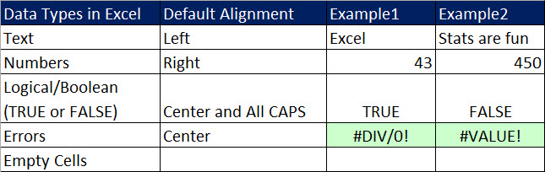
Data Types & Default Alignment in Excel
Empty Cells ➔ Not really a Data Type, but it is a "thing" in Excel that can sometimes cause problems.
  **Refer to Empty Cells as "Empty Cells", not blanks.
Why Default Alignment? Because Left means Excel thinks it is Text and Right means Excel thinks it is a Number. This is important when dealing with data because some systems will mistakenly import numbers as text. Numbers as text do not always behave like you expect (like not being added by the SUM function. The Default Alignment is a visual cue that informs us about how Excel “sees” the data.

Slide 9
Proper Data Set: Proper Table of Data
A structure for your data set necessary so that Excel Data Analysis features like Sort, Filter and PivotTables will work correctly:
Fields in first row (no empty cells)
Records or Observations in rows
Empty cells or Excel Row/Column Headers all the way around Data Set
Try not to have empty cells in data set

Slide 10
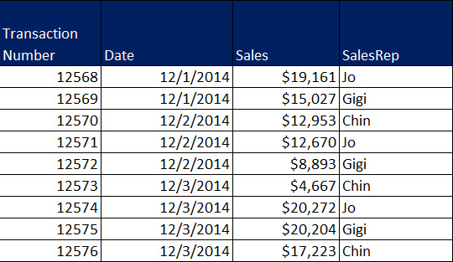
Terms for Proper Data Set
Primary Key /
List of Unique Elements
Variables
Element = Entities on which data are collected.
We are collecting data for each Transaction Number. Transaction Number is the Element.
Each row is a Record / Observation
All 4 are called Fields (Column Headers)

Slide 11
Variable, Element, Observation
Variable
  A characteristic or quantity of interest that can take on different values
  A Variable is also known as a “Field” or “Column Header” in Database terminology
  Example: Street address, City, State, Zip for a customer
Element
  Entities on which data are collected
    Like collecting data for an Employee or Invoice Number
Primary Key
  When the first column in a Proper Data Set contains a “Unique List” of Elements, it is called a “Primary Key”.
    “Primary Key”, “Unique List of Elements”, “List of Unique Identifiers”, “Distinct List” are all synonyms
  The “Primary Key” assure that data collected for a give element is stored in one and only one place.
Observation or Record
  A set of values corresponding to a set of Variables (Fields) for a set of Elements

Slide 12
Proper Data Set with a Primary Key / List of Unique Elements:
Proper Data Set:

Slide 13
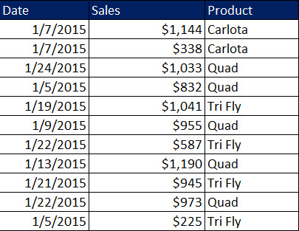
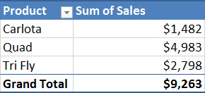
Proper Data Set with NO Primary Key / List of Unique Elements:
Proper Data Set:
Using the PivotTable feature we can create a
Proper Data Set with a Primary Key (Unique List of Products or Elements):

Slide 14
Variables
Variable (from previous slide)
  A characteristic or quantity of interest that can take on different values
Decision Variables
  Variables under the direct control of decision makers
  Example
    The “Quantity” Variable for a manufacturer. Managers can decide how many to make each day.
Random (uncertain variables) Variables:
  In general, variables that are outside of the decision makers control
  A quantity whose value is not known with certainty
  Example:
    Stock Price of Yahoo
    Number of units sold of a particular product

Slide 15
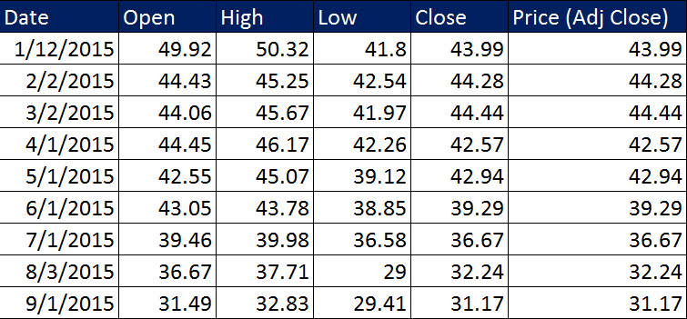
Variables and Variation
  If you own Yahoo Stock, you would be interested in the Variation in the Variable “Price (Adj Close)”.
Variation
  The difference in a variable measured over observations
    Differences over time
    Differences between customers or products
  **We will have a numerical measure for variation later…
Roll of Descriptive Statistics:
  Collect “Past Observed Values for Variables” or “Realizations of Variables” or “Raw Data” or “Data”
  Analyze Data to gain a better understanding of the variation and its impact on the business setting/situation

Slide 16
Population and Sample
Population
  All elements of interest
Sample
  Subset of the population
  Random sampling
    A sampling method to gather a representative sample of the population data.
      Each element comes from the same population (Target Population)
      Each element is selected independently (without bias)

Slide 17
Categorical and Quantitative Data
Quantitative Data
  “Number Data” on which numeric and arithmetic operations, such as addition, subtraction, multiplication, and division, can be performed.
  Discrete Quantitative Data: There are gaps between numbers, like counting: 1, 2, 3…
  Continuous Quantitative Data: There are no gaps between numbers, like weight, time, money. The number depends on the measurement instrument.
Categorical Data
    “Not Number Data”, like Product Names or “Yes” “No” Data on which arithmetic operations cannot be performed.

Slide 18
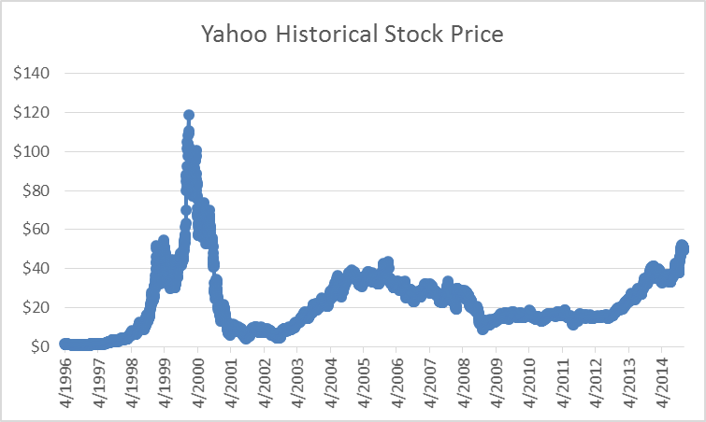
Data Terminology
Cross-sectional Data
Time Series Data
Cross-sectional Data
  Data collected from several elements/entities at the same, or approximately the same, point in time.
  Data collected over several time periods (Year, Month, Day, Hour…).
  Charts of time series data are common in business and economics.
  Help analysts understand what happened in the past, identify trends over time, and project future levels for the time series.

Slide 19
Sources of Data
Experimental study
  A variable of interest is first identified.
  Then one or more other variables are identified and controlled or manipulated so that data can be obtained about how they influence the variable of interest.
Nonexperimental study or observational study - Make no attempt to control the variables of interest.
  A survey is perhaps the most common type of observational study.
Existing Data Sets:
  Customer Lists
  Sales or Expense Lists
  Census Data
  Weather Data
  Government sources (data.gov)
  Purchase data from companies such as: Bloomberg, Dow Jones

Slide 20
Sort & Filter to Organize Data
Sort
Filter
Organize the Raw Data by sorting
  Example: Sort Sales biggest to smallest
Sort Buttons in Data Ribbon
  Sort columns one by one, with the “Major Sort” last.
Sort Dialog Box
  Make sure that “Major Sort” on top.
  Keyboard for Sort: Alt, D, S
Must have a Proper Data Set
Filter Button in Data Ribbon
Great for querying a data set (Extracting Observations / Records from a Proper Data Set) to get a sub-set of data based on a set of conditions or criteria

Slide 21
PivotTables
What does a PivotTable do?
  Makes calculations with criteria.
  PivotTables create reports that contain calculations with criteria.

Slide 22
How to create PivotTable:
Visualize the PivotTable 1st, see the row headers and column headers, see the values.
Must have Proper Data Set: 1) Field Names in first rows, 2) empty cells or row/column headers all around data set…
Click in one cell in Proper Data Set
Insert Ribbon Tab, Tables group, PivotTable button, make sure location has not data below it.
  Keyboard: Alt, N, V.
  Keyboard on new sheet: Alt, N, V, Enter
From Field List, drag field name (Criteria for calculations) to Row Header or Column Header
From Field List drag field you want to make a calculation upon to values area
Formatting:
  Design, Report Layout, Show in Tabular or Outline Form
  Right-Click: Number Formatting (so format follows the field if you Pivot)

Slide 23
Inside the PivotTable:
Pivot: drag and drop fields
Filter from dropdown arrows
Change calculation:
  Right-click Summarize Values As (Change Function)
  or
  Right-click Show Values As (New Calculation)
If you want more than one calculation, drop the field into the Values area more than one time and then change the calculation.
To Group, after dragging field to row area, Right-click, Group.
  When Grouping in a PivotTable, Numbers with Decimals trigger ambiguous labels.
  When Grouping in a PivotTable, Numbers with NO Decimals create unambiguous labels

Slide 24
Conditional Formatting to Visualizing Data
Each cell in the highlighted range must get a logical test that comes out TRUE (apply formatting) or FALSE (do NOT apply formatting)
Logical test can be created with built-in features or Logical Formulas
Great for visualizing data based on a set of conditions or criteria

Slide 25
Frequency Distributions and
Column/Bar Charts for Categorical Data
Frequency Distribution for Categorical Data is a tabular summary which:
  Shows the number of observations (count or frequency) in each of a set categories (unique list from data set)
  Categories must be Collectively Exhaustive Categories (enough categories so nothing is left out) and Mutually Exclusive Categories (no item can fit into more than one category)
  Goal is to is to provide information about frequencies (count)
Relative Frequency Distribution
  Shows decimal value that represents "parts compared to the whole" (used in chapter 4 for assigning probabilities)
Percent Frequency Distribution
  Formats Relative Frequencies with Percent Number Format

Slide 26
Frequency Distributions and
Column/Bar Charts for Categorical Data
Column/Bar Chart:
  Used to show Frequency Distribution or Relative/Percent Frequency Distribution for Categorical Data
  Counts across categories. Height of columns convey count. Order of categories conveys no info
  There are "gaps" between columns to indicate that the data is categorical or a discrete quantitative variable (not a continuous quantitative variable). Columns do not touch

Slide 27
Frequency Distributions and
Column/Bar Charts for Categorical Data

Slide 28
Frequency Distributions for Quantitative Data
Frequency Distribution is a tabular summary which:
  Shows the number of observations (count or frequency) in each of several nonoverlapping categories / classes / bins
    Categories, classes and bins are synonyms
  Categories must be Collectively Exhaustive Categories (enough categories so nothing is left out) and Mutually Exclusive Categories (no one item can fit into 2 or more categories)
  Goal is to is to provide information about frequencies (count) and reveal the shape of the quantitative data

Slide 29
Creating Classes for Quantitative Variables
The goal is to reveal the natural distribution or shape or variation of the data. This is the "art side of statistics". It takes practice to get the hang of it.
Determine the number of nonoverlapping classes. Goal is to have enough to show natural shape of data. One general guideline is: 2^k > n, where n = count and k = number of classes.
Determine the width of each class with something like: Approx. width = (Max-Min)/(Number of classes).
Determine the class limits: the key is to not create classes where you would double count.
  If you have a discrete variable (or a continuous variable that is shown as a whole number) it is just a matter of getting the lower and upper limit, like: 0-9, 10-19...
  If you have a continuous variable and you choose to use the upper limit from the previous class as the lower limit for the current class, be sure to include the equal sign on either the lower or upper, but not both. Create classes like: 0 <= Sales < 20, 20 <= Sales <40... or 0 up to 20, 20 up to 40...
  When we create a set of classes, we create a type of category for our continuous quantitative variable
  Making the classes all the same width helps to create tables & charts that are more easily interpreted
  Sometimes if there are a few large values or small values, it may be efficient to create an open ended class
Class midpoint is calculated as the halfway mark between the lower and upper limit

Slide 30
Relative Frequency Distributions for Quantitative Data
Relative Frequency Distribution:
  Shows decimal value that represents "parts compared to the whole“
  Often the basis for probability calculations (Relative Method)
Percent Frequency Distribution:
  Formats Relative Frequencies with Percent Number Format

Slide 31
Histograms for Quantitative Data
Histograms
  Used to show frequency distribution of continuous quantitative data over a set of class intervals (lower and upper limit for each category)
  Column or Bar Charts where columns are touching to indicate that the variable is continuous
  Columns touch to indicate that no numbers can fit between classes. "No numbers can fit between columns - no gaps"
  Height of columns convey count
  Order of classes is important to help reveal shape of data, or distribution of data.

Slide 32
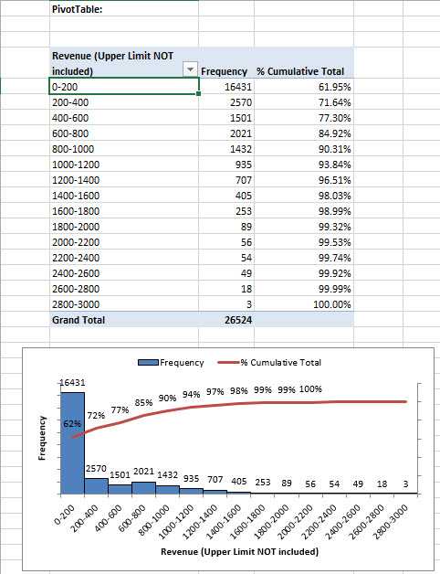
Cumulative Distributions
Example of Frequency Distribution & Cumulative Percent Frequency Distribution
Cumulative Frequency Distribution is a tabular summary which:
  Shows the cumulative number of observations (count or frequency) in each of the categories or classes. Count for "less than or equal to" upper limit of class. The last class will be equal to the count of all items in the data set
Cumulative Percent Frequency Distribution is a tabular summary which:
  Shows the percent cumulative frequency in each of the categories or classes. Calculation is based on Running Total divided by count of all items in the data set. The last class will be equal to 100%
  With any particular class you can say something like: "xx% of the occurrences are less than or equal to the upper limit of the class"

Slide 33
Excel Methods to Create Frequency Distribution
COUNTIFS Excel function with two criteria
  Count between the lower and upper limit
    Because you have control over the comparative operators, you can create any type of Upper and Lower Limit.
    This is different than with the PivotTable Grouping feature and the FREQUENCY Array Function.
PivotTables and the Grouping feature
  When Grouping in a PivotTable:
    Integer data yields unambiguous labels
    Decimal data yields ambiguous labels
    Remember: when you are counting between an upper and lower limit, the Upper Limit is NOT included and the Lower Limit IS included; unlike formulas we do not have control over how the upper and lower limits work when grouping.
FREQUENCY Array Function:
  Next slide has full details about this function➔
  One note here: For FRQUENCY Array Formula when you are counting between an upper and lower limit, the Upper Limit IS included and the Lower Limit is NOT included; unlike formulas we do not have control over how the upper and lower limits work when grouping.
  FREQUENCY Array Function and Data Analysis Tools, Histogram yield the same answer.
Data Analysis Tools, Histogram
  You must add this feature in: File tab, Options, Add-ins, Manage: Excel Ass-ins, Click Go, Check box for Analysis Toolpak, Click OK
  This feature will create the Frequency Table (just like the FREQUENCY Array Function), a Histogram and a Cumulative Distribution. If Gap Width in Chart is not zero, you must change it!!
  FREQUENCY Array Function and Data Analysis Tools, Histogram yield the same answer.

Slide 34
FREQUENCY Array Function
FREQUENCY counts how many numbers are in each category.
The bins_array argument contains the upper values for the categories—numbers only.
The data_array argument contains the values to count—numbers only.
Keep in mind the following about categories:
  Categories are automatically created. There is no visual indication of how the categories are organized.
  The first category counts all the values less than or equal to the first upper limit.
  The middle categories count between a lower limit and an upper limit. The lower limit is not included in the category. The upper limit is included in the category.
  The last category catches all the values that are greater than the last upper limit.
  There is always one more category than there are bins.
Because this is an array function, you must select the destination range before creating the formula and enter the formula with Ctrl+Shift+Enter.
  If you have n values in the bins_array argument, the selected destination range should contain n+ + 1 cells.

Slide 35
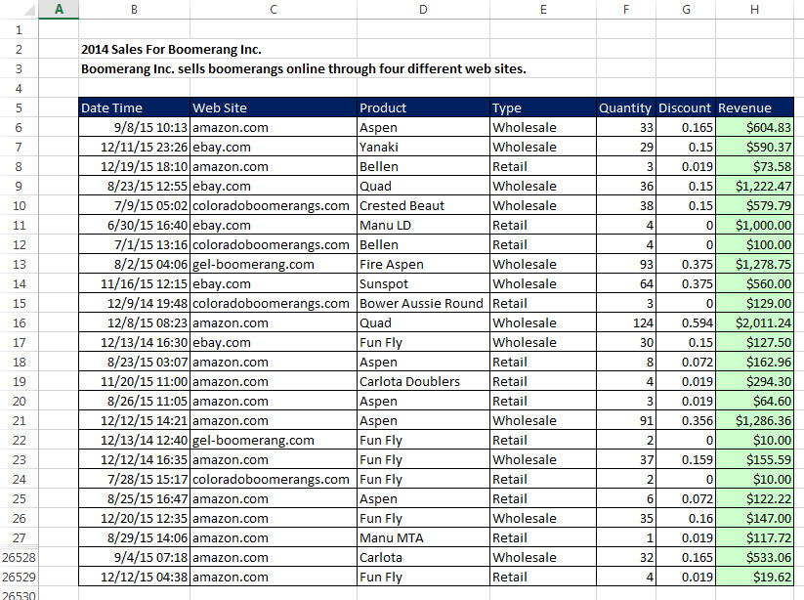
Sales Data

Slide 36
Frequency Distributions and
Histograms for Quantitative Data

Slide 37
Frequency Distribution and Histogram for Revenue with PivotTable:
When Grouping Decimal Quantitative Data in a PivotTable to create an upper and lower limit, Upper Limit is not included.!!!
When using the FREQUENCY Array Function or the Data Analysis

Slide 38
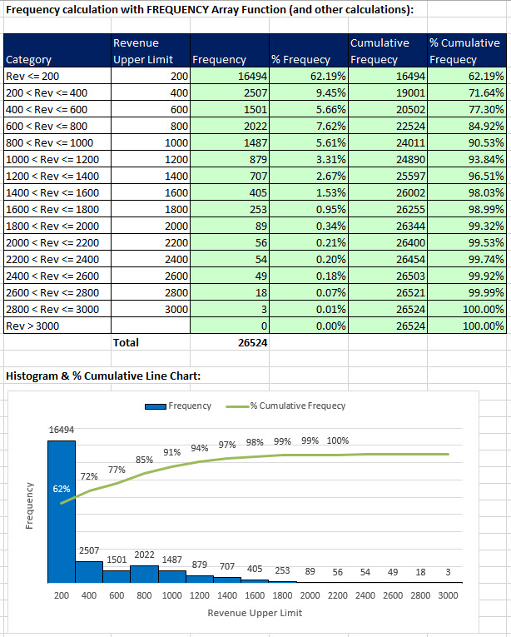
Frequency Distribution and Histogram for Revenue with FREQUENCY Array Function:
When using the FREQUENCY Array Function or the Data Analysis Histogram feature, for the upper and lower limit classes/categories, the Upper Limit IS Included

Slide 39
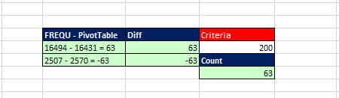
Check to see why the two methods yield different answers
When Grouping Decimal Quantitative Data in a PivotTable to create an upper and lower limit, Upper Limit is not included.!!!
When using the FREQUENCY Array Function or the Data Analysis Histogram feature, for the upper and lower limit classes/categories, the Upper Limit IS Included

Slide 40
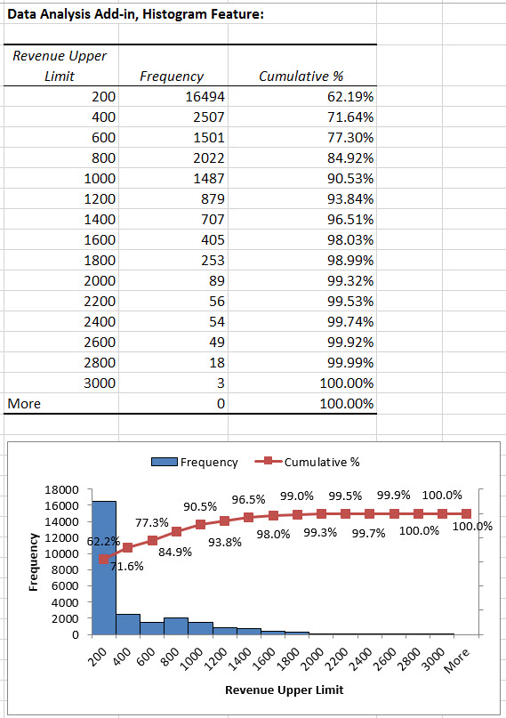
Frequency Distribution and Histogram for Revenue with Data Analysis Histogram Feature:
When using the FREQUENCY Array Function or the Data Analysis Histogram feature, for the upper and lower limit classes/categories, the Upper Limit IS Included

Slide 41
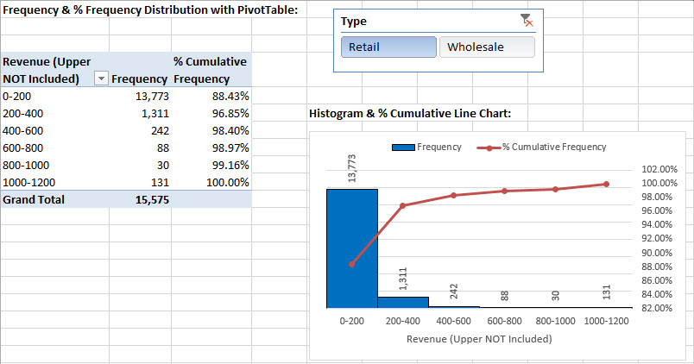
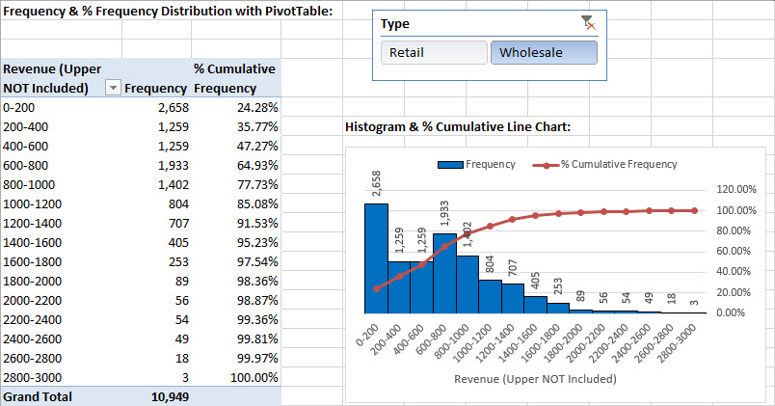
Why PivotTables Rule: Because you can add Criteria through a Slicer and Drill Down in the Data

Slide 42
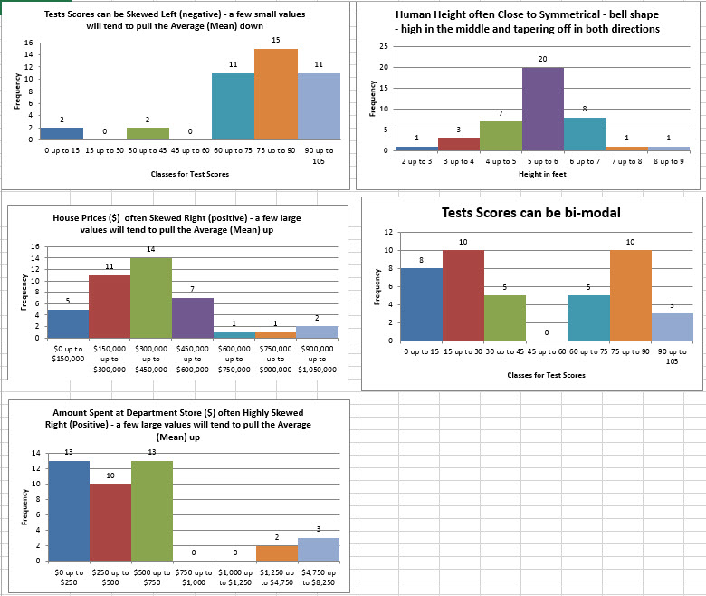
Skew of Histograms
What does the distribution of Histogram Columns look like?
Skew Left or Negative means a few short Histogram Columns are on the low end (pull mean down)
Skew Right or Positive means a few short Histogram Columns are on the high end (pull mean up)
No Skew means the distribution is bell shaped or nearly bell shaped
Perfect Bell Shape ➔ Mean = Median = Mode

Slide 43
Measures of Location
Measures of Location:
  Average = Typical Value = Measure of central location
  "Typical Values" calculated so that we have one value that can represent all the data points.
Examples:
  Mean
  Median
  Mode
  Geometric Mean

Slide 44
Mean, Median, Mode
Mean
  Arithmetic Mean: Add them up and divide by the count
  Good for quantitative data when there are not extreme values - extreme values can make the mean look too big or too small (Median more representative of a typical value in that case)
  Use AVERAGE function
Median
  Sort, then take the one in the middle. If count odd, take one in middle, if even, average middle two.
  Marks the point in the sorted list (an actual number) where 50% of the numbers are above and 50% of the numbers are below
  Good for quantitative data when there are extreme values (like house prices and salaries)
  Use MEDIAN function
Mode
  One that occurs most frequently (can be bimodal, multimodal)
  Good for Categorical Data (Nominal and Ordinal)
  Use MODE.SNGL for quantitative data and COUNTIF or PivotTable for Categorical or quantitative data. MODE.SNGL will only show 1 mode if the data set is bi-modal or multi-modal. MODE.MULT can be used for multiple modes.

Slide 45
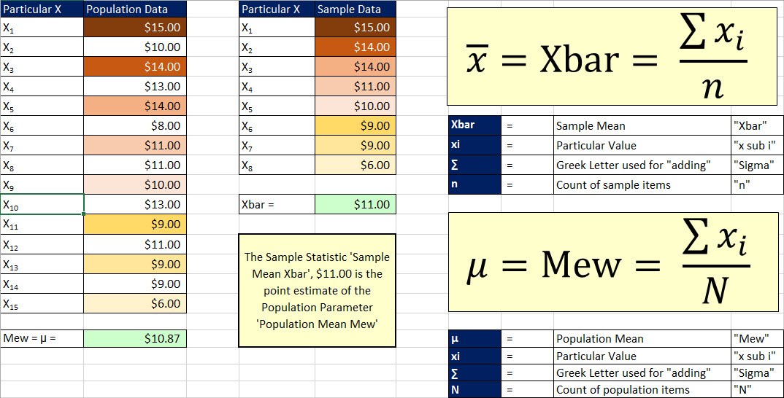
Mean

Slide 46
Geometric Mean
Use Geometric Mean when you have "Growth Rates" or "Rates of Change“ and you want:
  True "Average" Compounding Rate per Period
  You have a Begin Value and you want to calculate the End Value after a number of periods, like in Finance
    Arithmetic Mean overestimates
    Arithmetic Mean is for additive processes; Geometric Mean is for multiplicative processes
    Arithmetic mean is used in some situations like for Standard Deviation, Correlation, and other calculations that do not require True "Average" Compounding Rate per Period.
"Growth Rates" or "Rates of Change“ = % change from one period to the next
Growth Factor = Growth Rate + 1
  Growth Factor is value that you use when calculating End Value from Begin Value.
    Like: BeginValue*(1+GeometricMean)^NumberOfPeriods = EndValue
    In Finance: PV*(1+PeriodRate)^NumberOfPeriods = FV
  Growth Factor ALWAYS >= 0
  Growth Factor > 1 means positive growth
  Growth Factor < 1 means negative growth

Slide 47
Geometric Mean
Geometric Mean = Average Compounding Rate per Period
Geometric Mean Formula 1:
  Use when you are given all the "Growth Rates" or "Rates of Change“:
  Formulas:
    GEOMEAN(RangeOfGrowthRates+1) = Growth Factor
    GEOMEAN(RangeOfGrowthRates+1)-1 = Geometric Mean
Geometric Mean Formula 2:
  Use when you are given the Begin Value, End Value and the number of periods
  Formulas:
    (EndValue/BegValue)^(1/NumberOfPeriods)-1 1 = Geometric Mean
    RRI(NumberOfPeriods,BegValue, EndValue) or RRI(n,PV,FV) 1 = Geometric Mean

Slide 48
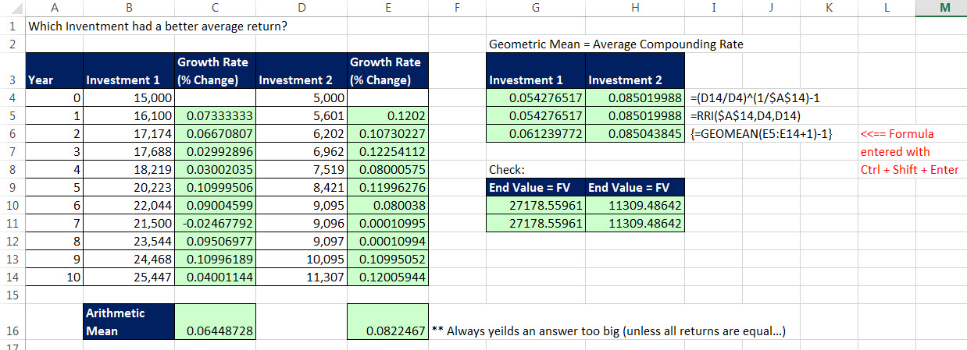
Geometric Mean = Average Compounding Rate:

Slide 49
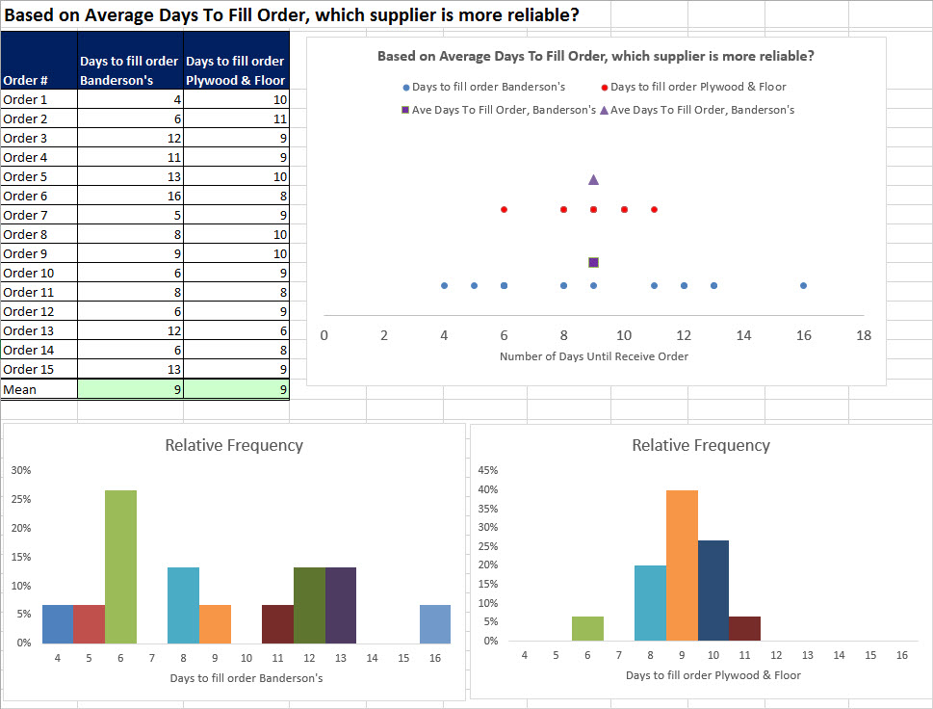
Variability

Slide 50
Variability
Synonyms for Variability:
  Variability
  Dispersion
  Spread In Data
  How Spread Out Is Data?
  Are the Data Points Clustered Around the Mean?
  Does the Mean Fairly Represent the Data Points?
Measures of Variability
  Range
  Variance
  Standard Deviation
  Coefficient of Variation
  Z-score

Slide 51
Range and Interquartile Range
Range
  Max - Min
  Simple to calculate. Sensitive to extreme values
Interquartile Range
  Quartile 3 - Quartile 1
  The range for the middle 50% of the data. It overcomes the sensitivity to extreme values

Slide 52
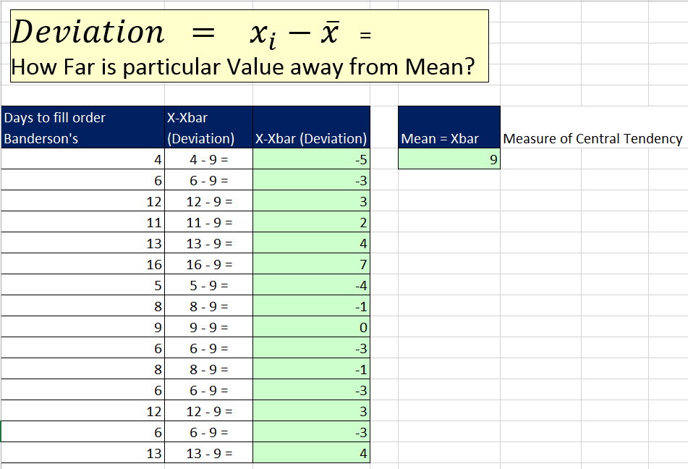
Deviation: X₁ – Xbar = Particular Value - Xbar
How far is the Particular Value from the Mean (Average)?
For any data set, the sum of the deviations is always zero!!!!
  This is why mathematically, we either square (Variance or Standard Deviation) or take the absolute value (Mean Absolute Value) for calculating our measures of variation.

Slide 53
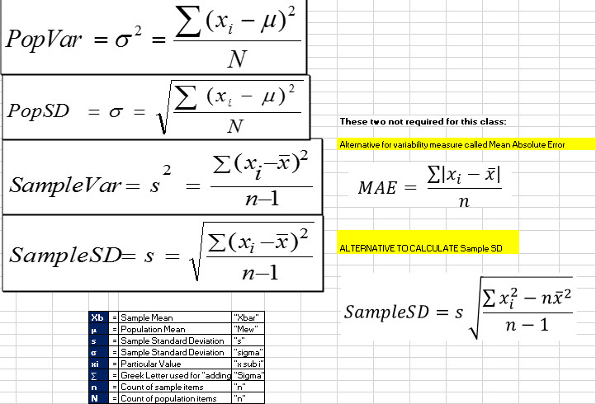
Formulas for Variance and Standard Deviation:

Slide 54
Proof that two formulas for Sample Standard Deviation are equal

Slide 55
Variance
A Numerical Measure that says how much variability there is in the data points
Variance uses all the data points, not just some like Range and Interquartile Range
Variance has squared units, which makes interpreting it difficult.
  Although Variance has squared units, it has many uses in statistics, especially with Regression Analysis (chapter 4) and Hypothesis Testing
  Standard Deviation undoes the squared units and is thus easier to interpret.
Use VAR.P function for population data
Use VAR.S function for sample data.

Slide 56

Standard Deviation = SD
Standard Deviation uses all the data points, not just some like Range and Interquartile Range
Standard Deviation does not have squared units (like Variance) and is thus easier to interpret
  Standard deviation has the same units as the data!!
The sample standard deviation is a point estimator of the population standard deviation
Interpretation of Standard Deviation:
  A Numerical Measure that says how much variability there is in the data points
  Standard Deviation Is Like An Average Of The Deviations
  Standard Deviation tells us how fairly the mean represents its data points
  Standard Deviation tells us how clustered the data points are around the mean
  For financial assets standard deviation is a measure of risk or fluctuation in asset value
  Use STDEV.P function for population data
  Use STDEV.S for sample data.
$$s= \sqrt{\frac{\sum{(x_{i}−\overline{x})^2}}{n−1}}$$

Slide 57
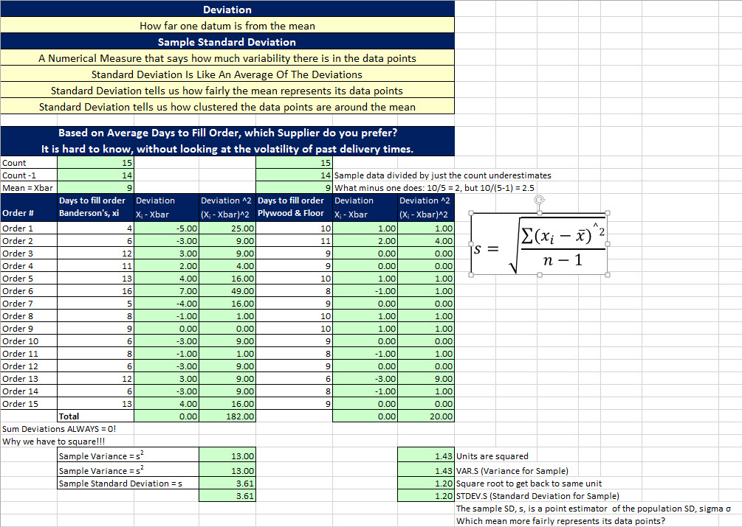
Standard Deviation: How Fairly Does Mean Represent Its Data Points?

Slide 58
Coefficient of Variation
Formula = SD/Mean
  Coefficient of Variation converts the SD to SD per unit of Mean
        For every one unit of mean, what is the SD?
  If you add Percent Number Formatting, it shows SD as a percentage of Mean
      What percentage is SD in relation to the Mean?
Use Coefficient Of Variation to compare:
      Data in different units.
      Data in the same units, but the means are far apart.

Slide 59
Z-score: Number of Standard Deviations
Formula for z-score = Deviation/SD = (X_{i} - Xbar)/SD
Excel Function: STANDARDIZE(X,Mean,SD)
z Score = How Many Standard Deviation is a particular value ways from the mean?
  z < 0, value below mean
  z > 0, value above mean
  z = 0, value is equal to mean
  Z score measures the relative location of a particular x in the data set (as compared to the mean), in units of standard deviation.
  Relative Location in terms of "Number of Standard Deviations
z Score = Standardized Value
Observations in 2 different data sets that have the same z-score are said to have the same relative location or the same number of standard deviations away from the mean.

Slide 60
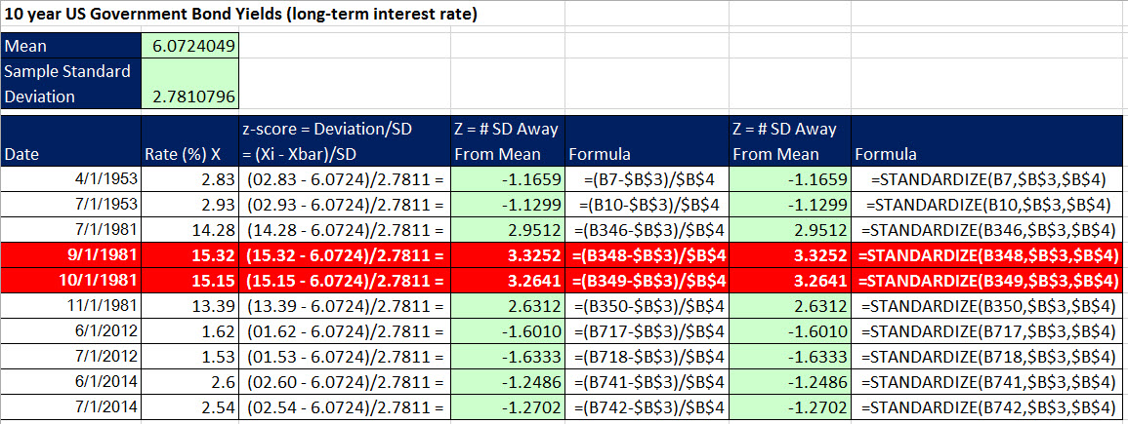
Uses of z-score:
Used in the Standard Normal Bell Curve or “Empirical Rule”
One way to measure Outliers (extreme values) is to consider any value that has z-score greater than 3 to be an Outlier

Slide 61
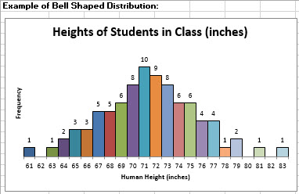
Example of Bell Shaped “Normal” Distribution:

Slide 62
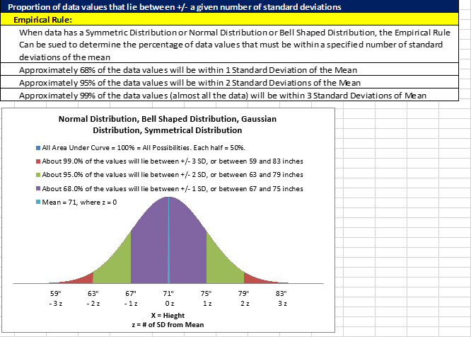
Empirical Rule

Slide 63
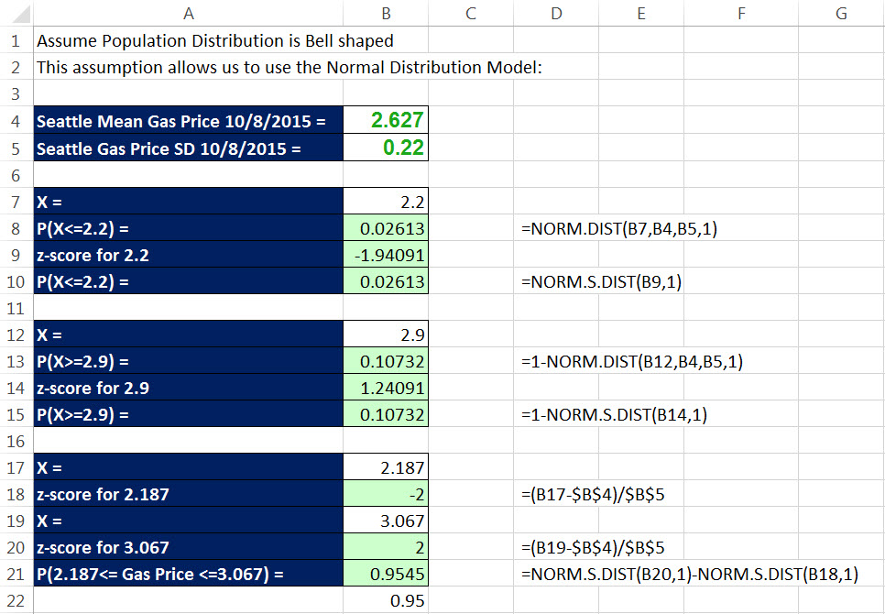
Example of Empirical Rule:

Slide 64
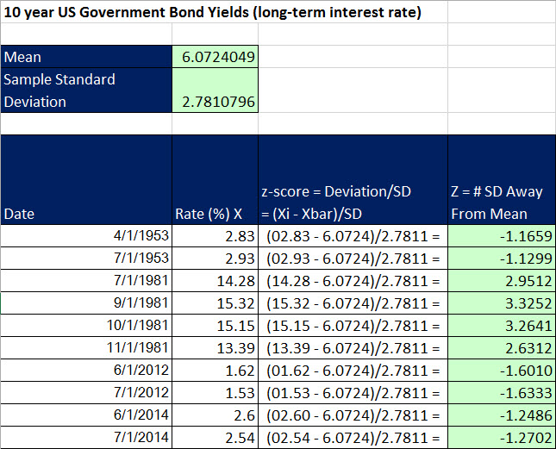
Identifying Outliers: 3 Z Rule
  One way to measure Outliers (extreme values) is to consider any value that has z-score greater than 3 to be an Outlier.
In Sep. and Oct. of 1981 the 10-year Government Bond Yield was above 15%.
  This was a value more than 3 standard deviations away from the mean and is therefore considered an outlier.

Slide 65
Measures for Location: Percentiles
Percentiles:
Excel Functions:
Percentile: Create Marker in sorted data set that divides set into 2 Parts with about P% Below the Marker and 1-P% Above
PERCENTILE.EXC
  .EXC = Exclusive: Excludes 0% & 100% = Min and Max values cannot be found -- 0% and 100% are not allowed
PERCENTILE.INC
  .INC = Inclusive: Includes 0% & 100% = Min and Max values CAN be found 0% = Min & 100% = Max
For Large Data Sets the two functions calculate similar answers

Slide 66
Measures for Location: Quartiles
Quartiles:
Excel Functions:
Create Marker in sorted data set that divides set into four equal parts:
  Each part contains approximately 25% of the observations.
  The three Markers are referred to as quartiles:
    𝑄₁ = first quartile, or 25th percentile
    𝑄₂ = second quartile, or 50th percentile (also the median)
    𝑄₃ = third quartile, or 75th percentile
QUARTILE.EXC
  .EXC = Exclusive: Min and Max values cannot be found -- can only enter 1, 2, 3 in second argument
QUARTILE.INC
  .INC = Inclusive: 0 = Min, 1 = Quartile 1, 2 = Quartile 2, 3 = Quartile 3, 4 = Max
For Large Data Sets the two functions calculate similar answers

Slide 67
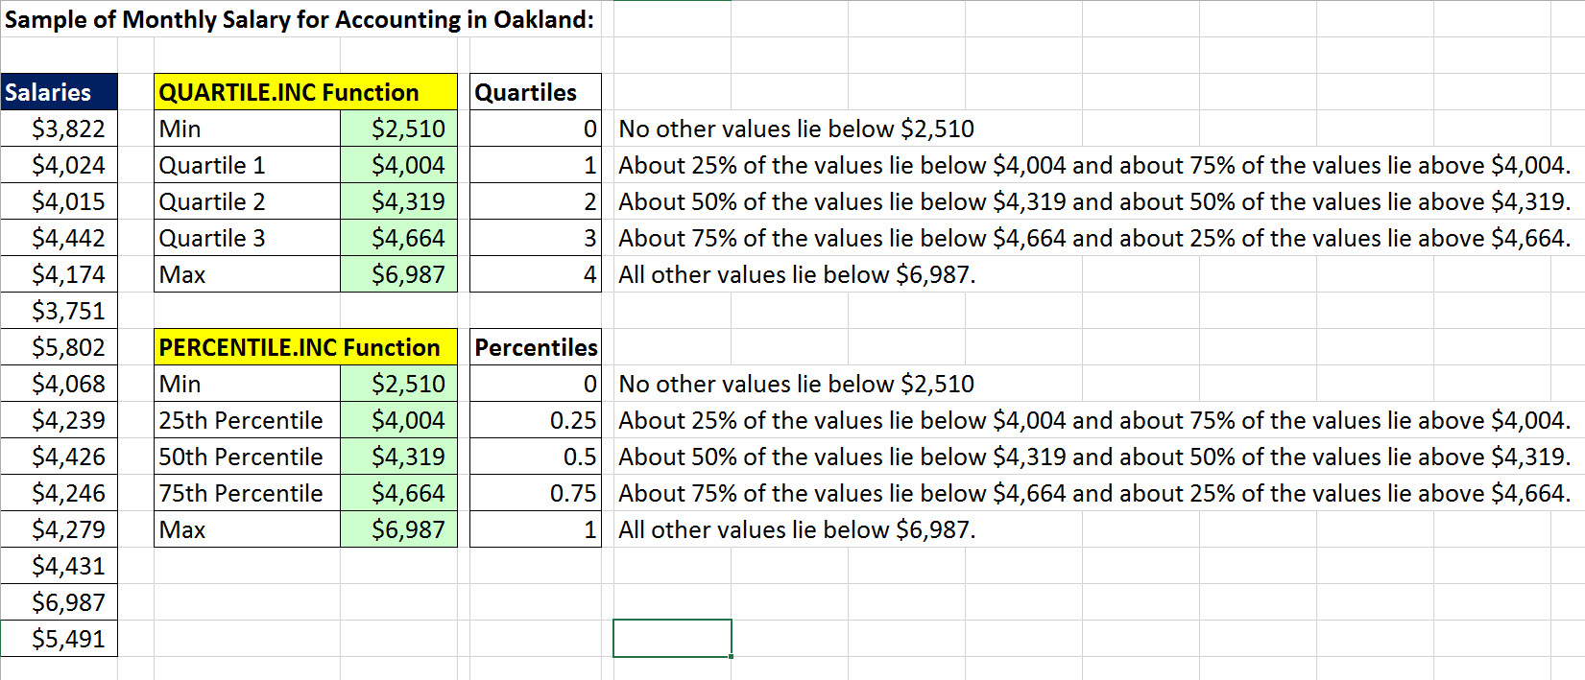
Percentile & Quartile Are Markers That Divide A Set Of Sorted Numbers Into Two Sets

Slide 68
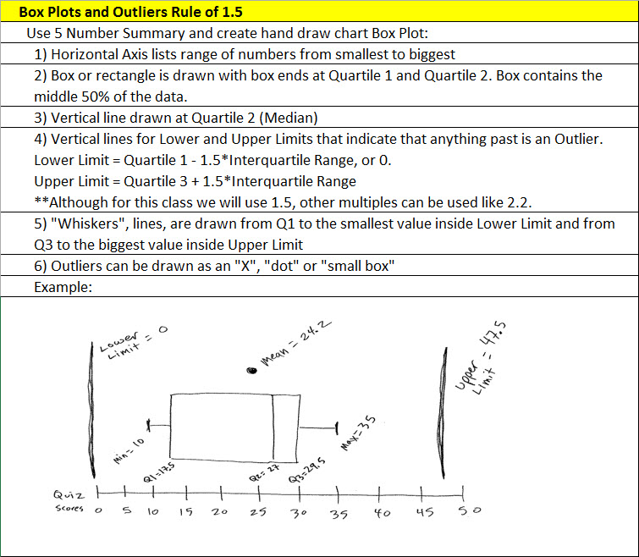
Box Plots by hand

Slide 69
Box Plots
No easy way to create Box Plots in Excel
Reference video for how to do it in Excel:
Excel 2010 Statistics #28: Box & Whisker Plot: Stacked Bar with Mean Point Plotted and Outlier Lines
https://www.youtube.com/watch?v=bgaN446TQXo
XL Minor Add-in makes it easy to create single and multiple variable data sets
  Must have a Proper Data Set.

Slide 70
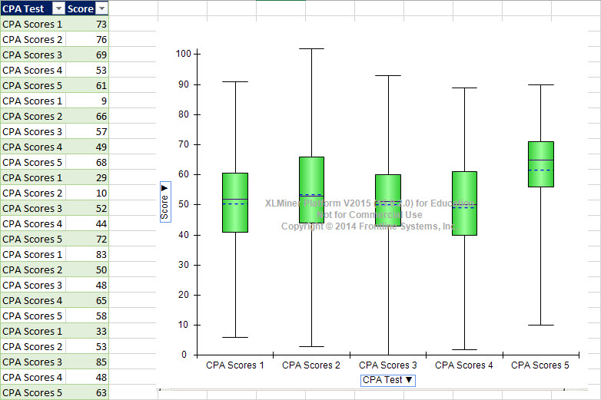
Box Plots in XL Minor

Slide 71
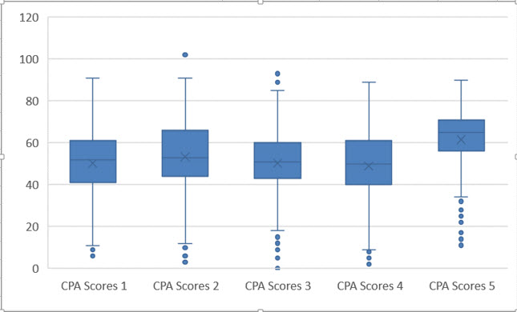
Box Plots in Excel 2016:

Slide 72
Don’t Forget:
Q: Why MUST we have a Proper Data Set?
  A: So we can ask questions of each Field (Variable)!!!!
    Like in a PivotTable when we drag a field like “Sales Rep” to ask the question: “What is the total sales for each Sales Rep?”
Q: Why do Histograms have “No Gap Width”?
  A: Continuous Quantitative Data that is grouped has no gaps between categories - so columns must touch (have no gap width) to visually indicate that no numbers can fit between the categories or columns.

