Slide 1
Highline Class, Busn 218
Excel 2016: Spreadsheet Construction
Charts

Slide 2
Topics
Charts
What do Charts do?
No “Chart Junk”
Types of Charts
Chart Elements

Slide 3
Charts
Charts = Graph = Picture of quantitative (number) data.
Charts can be found in Insert Ribbon Tab.
Charts Often Come from Summarized Tables, such as this Crosstabulated tables:

Slide 4
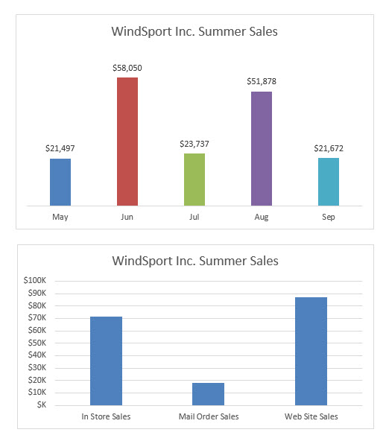
What do Charts do?
1) Visually portray Quantitative data (number data).
2) Give a quick impression of the number data.
3) Create a picture that can communicate more quickly than just the numbers alone.
4) Charts allow you to see patterns or trends that you may not be able to see if you are looking at just the number data.
5) Allows you to make relative comparisons more quickly than if you are using a table

Slide 5
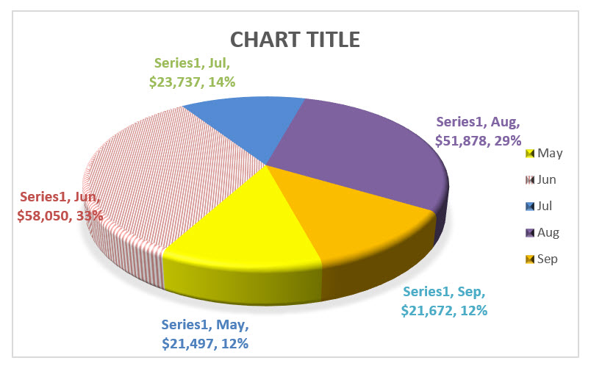
#1 Chart Rule = No “Chart Junk” Chart Junk = chart elements that does not contribute to the message

Slide 6
Types of Charts
Column: Use to compare differences across categories. Height of column conveys number.
Bar: Use to compare differences across categories. Length of bar conveys number.
Stacked Column/Bar: Good for displaying crosstabulation, emphasis on horizontal axis categories.
Clustered Column/Bar: Good for displaying crosstabulation, emphasis on legend categories.
Histogram: Chart used for counting numbers between a lower and upper limit. No gap between column indicates that there are no numbers between the upper and lower limit.
Line: Use to show trend for a number variable over a category such as time.
Combination Chart: Combine different chart types such as Column and Line.
X-Y Scatter: Used to show relationship between two number variables (x and y variables).
Break Even Chart: Specific type of X-Y Scatter Chart that shows the break-even cross over lines for Revenue and Costs.
Bubble Chart: Method of visualizing 3 variables in a 2-dimentional chart.

Slide 7
Column: Use to compare differences across categories. Height of column conveys number.

Slide 8
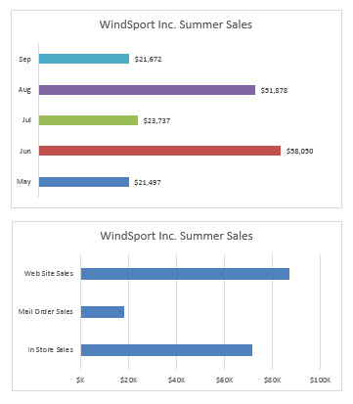
Bar: Use to compare differences across categories. Length of bar conveys number.

Slide 9
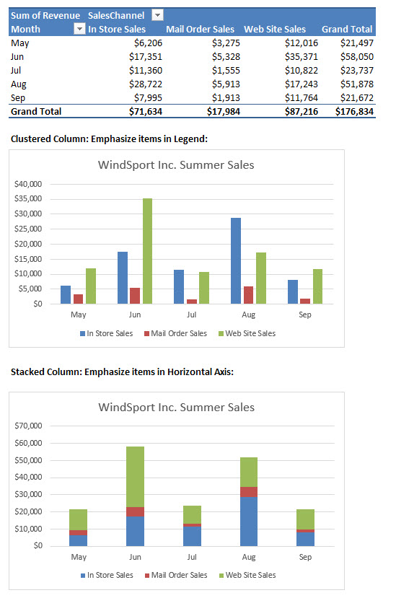
Clustered Column/Bar: Good for displaying crosstabulation, emphasis on legend categories. Stacked Column/Bar: Good for displaying crosstabulation, emphasis on horizontal axis categories.

Slide 10
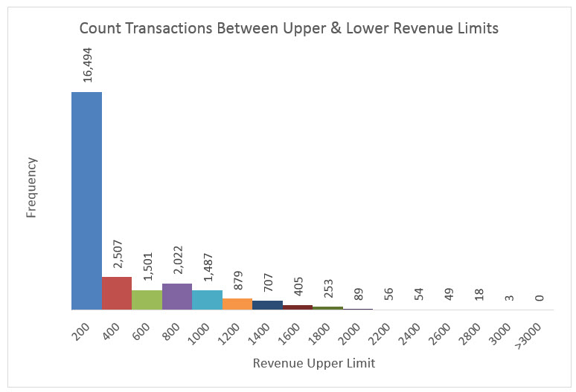
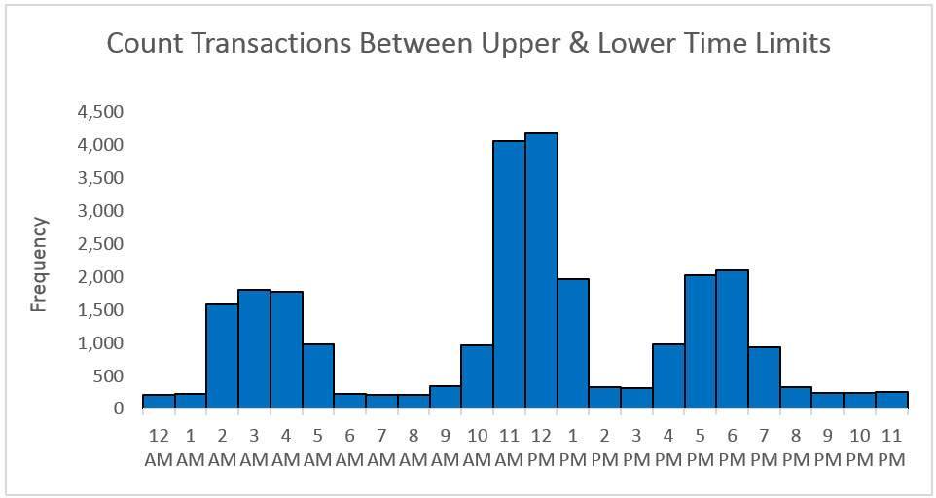
Histogram: Chart used for counting numbers between a lower and upper limit. No gap between column indicates that there are no numbers between the upper and lower limit.

Slide 11
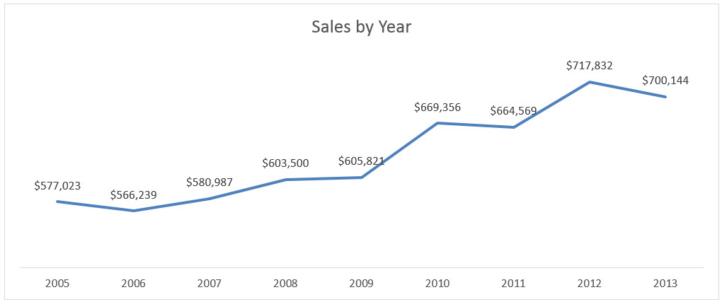
Line: Use to show trend for a number variable over a category such as time.

Slide 12
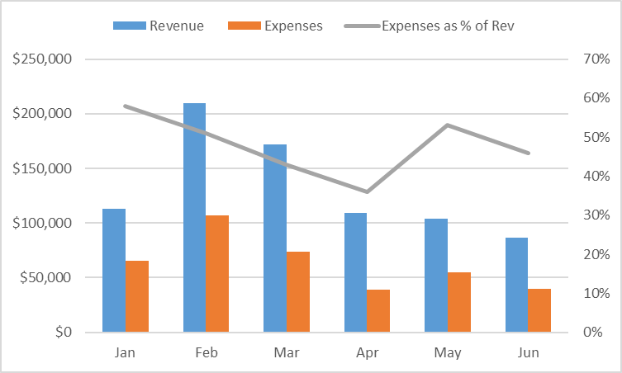
Combination Chart: Combine different chart types such as Column and Line.

Slide 13
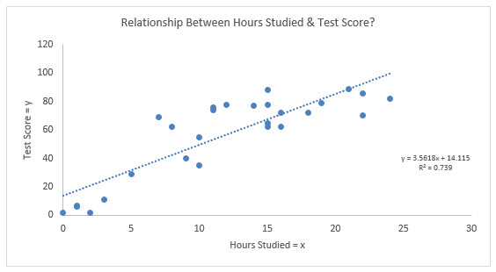
X-Y Scatter: Used to show relationship between two number variables (x and y variables).

Slide 14
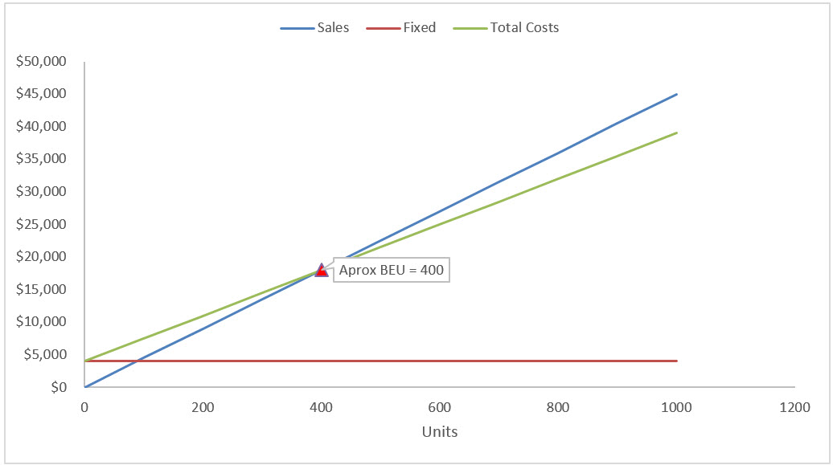
Break Even Chart: Specific type of X-Y Scatter Chart that shows the break-even cross over lines for Revenue and Costs.

Slide 15
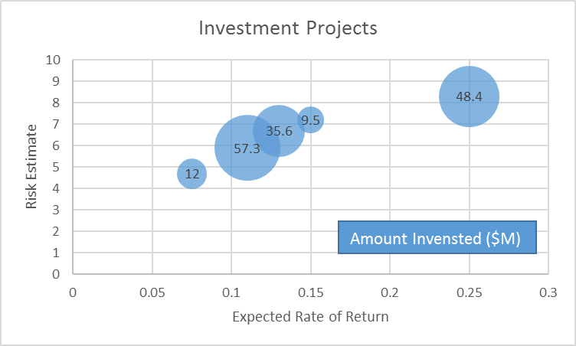
Bubble Chart: Method of visualizing 3 variables in a 2-dimentional chart.

Slide 16
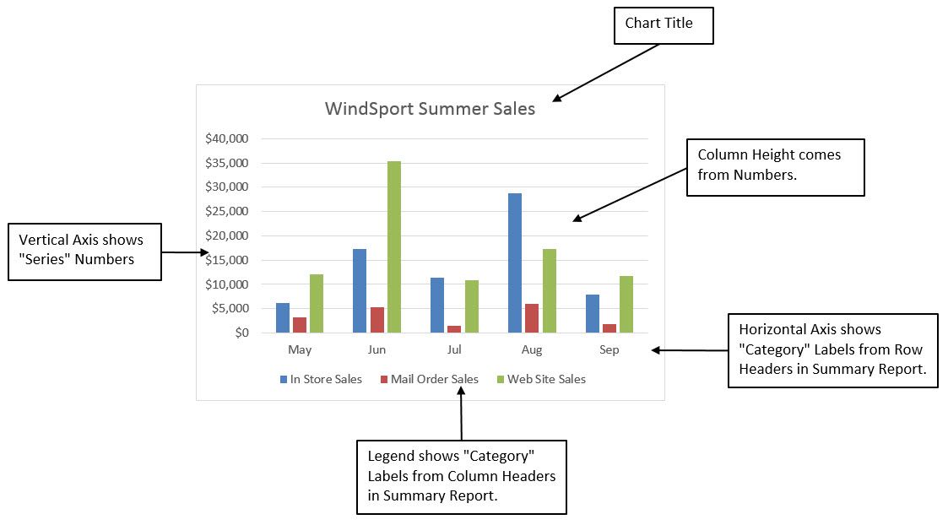
Chart Elements

Slide 17
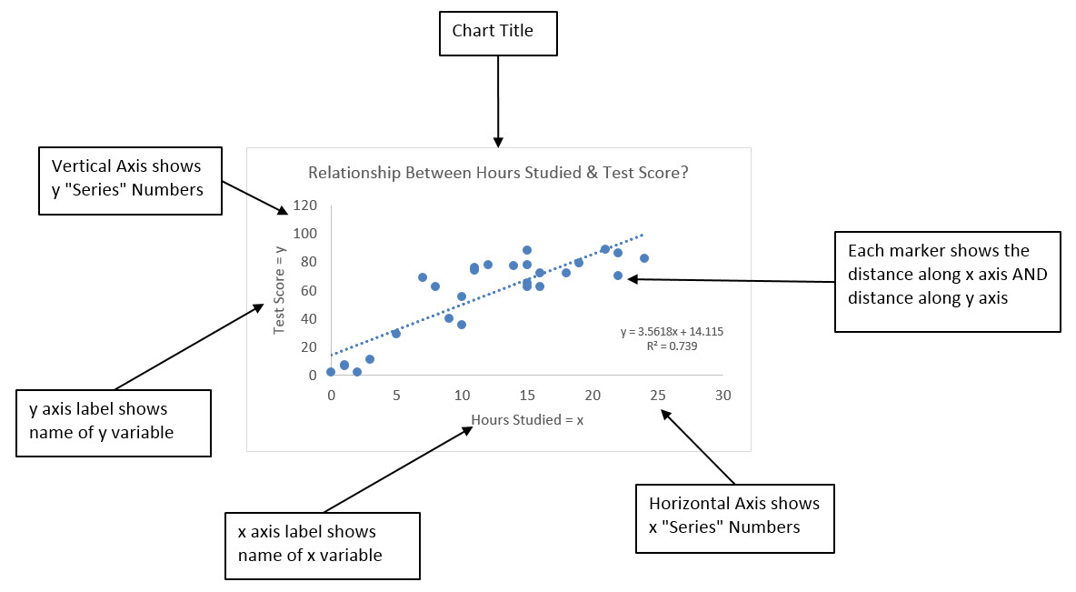
Chart Elements

