Slide 1
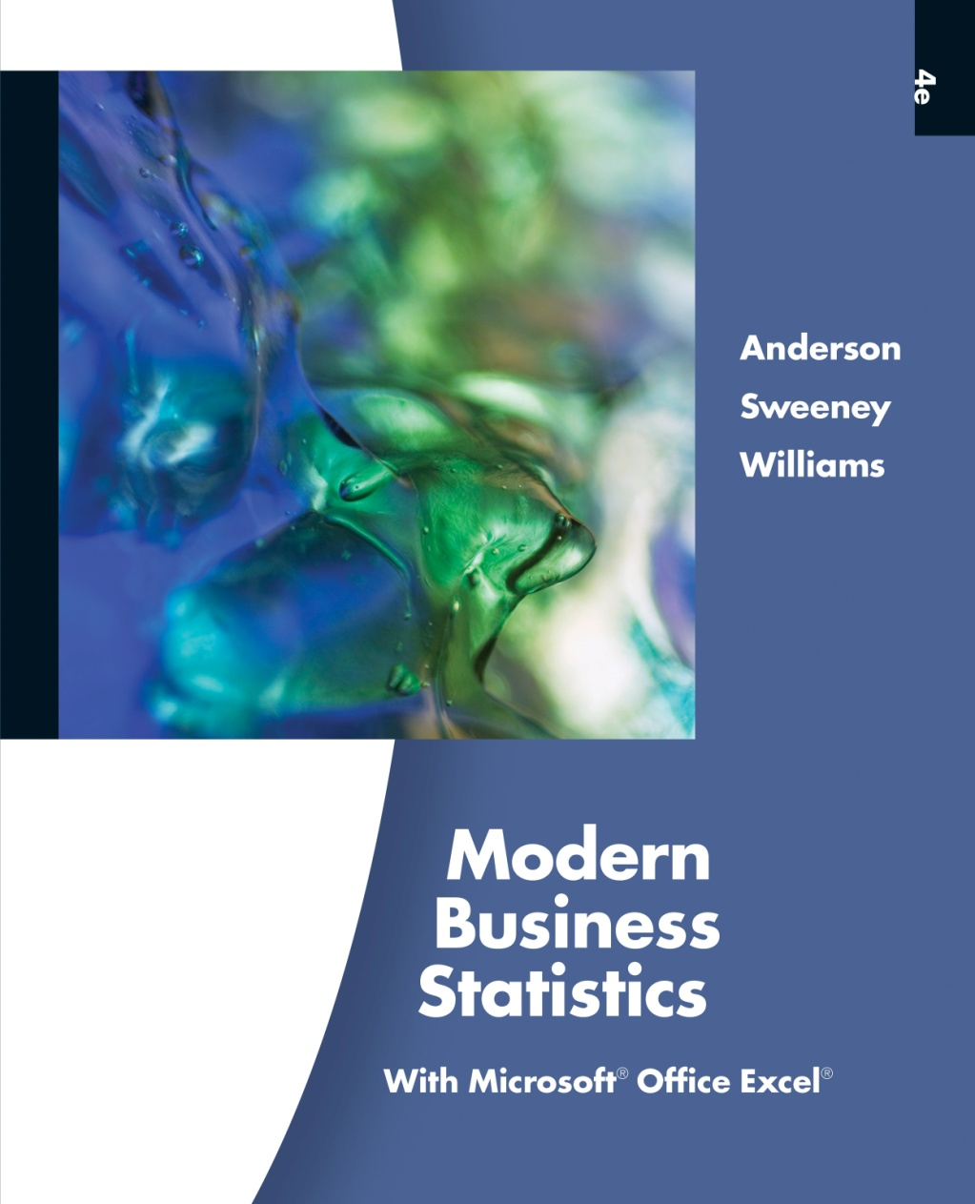
Slides by
John
Loucks
St. Edward’s
University

Slide 2
Chapter 2, Part A
Descriptive Statistics:
Tabular and Graphical Presentations
Summarizing Categorical Data
Summarizing Quantitative Data
Categorical data use labels or names
to identify categories of like items.
Quantitative data are numerical values
that indicate how much or how many.

Slide 3
Summarizing Categorical Data
Frequency Distribution
Relative Frequency Distribution
Percent Frequency Distribution
Bar Chart
Pie Chart

Slide 4
Frequency Distribution
A frequency distribution is a tabular summary of
data showing the frequency (or number) of items
in each of several non-overlapping classes.
The objective is to provide insights about the data
that cannot be quickly obtained by looking only at
the original data.

Slide 5
Frequency Distribution
Example: Marada Inn
Guests staying at Marada Inn were asked to rate the
quality of their accommodations as being excellent,
above average, average, below average, or poor. The
ratings provided by a sample of 20 guests are:
Below Average
Above Average
Above Average
Average
Above Average
Average
Above Average
Average
Above Average
Below Average
Poor
Excellent
Above Average
Average
Above Average
Above Average
Below Average
Poor
Above Average
Average

Slide 6
Frequency Distribution
Example: Marada Inn
Poor
Below Average
Average
Above Average
Excellent
2
3
5
9
1
Total 20
Rating
Frequency

Slide 7
Using Excel’s COUNTIF Function
to Construct a Frequency Distribution
Excel Formula Worksheet
Note: Rows 9-21 are not shown.

Slide 8
Using Excel’s COUNTIF Function
to Construct a Frequency Distribution
Excel Value Worksheet
Note: Rows 9-21 are not shown.

Slide 9
Relative Frequency Distribution
The relative frequency of a class is the fraction or
proportion of the total number of data items
belonging to the class.
A relative frequency distribution is a tabular
summary of a set of data showing the relative
frequency for each class.

Slide 10
Percent Frequency Distribution
The percent frequency of a class is the relative
frequency multiplied by 100.
A percent frequency distribution is a tabular
summary of a set of data showing the percent
frequency for each class.

Slide 11
Relative Frequency and
Percent Frequency Distributions
Example: Marada Inn
Relative
Frequency
Percent
Frequency
Rating
Poor
Below Average
Average
Above Average
Excellent
.10
.15
.25
.45
.05
Total 1.00
10
15
25
45
5
100
.10(100) = 10
1/20 = .05

Slide 12
Using Excel to Construct Relative Frequency and Percent Frequency Distributions
Excel Formula Worksheet
Note: Columns A-B and rows 9-21 and are not shown.

Slide 13
Using Excel to Construct Relative Frequency and Percent Frequency Distributions
Excel Value Worksheet
Note: Columns A-B and rows 9-21 and are not shown.

Slide 14
Bar Chart
A bar chart is a graphical device for depicting
qualitative data.
On one axis (usually the horizontal axis), we specify
the labels that are used for each of the classes.
A frequency, relative frequency, or percent frequency
scale can be used for the other axis (usually the
vertical axis).
Using a bar of fixed width drawn above each class
label, we extend the height appropriately.
  The bars are separated to emphasize the fact that each
  class is a separate category.

Slide 15
Bar Chart
Marada Inn Quality Ratings
10
9
8
7
6
Frequency
5
4
3
2
1
Rating
Poor
Below
Average
Average
Above
Average
Excellent

Slide 16
Using Excel’s Chart Tools
to Construct a Bar Chart
Step 1. Select cells C1:D6
Step 2. Click the Insert tab on the Ribbon
Step 3. In the Charts group, click Column
Step 4. When the list of column chart subtypes appears:
Go to the 2-D Column section
Click Clustered Column (the leftmost chart)
Step 5. In the Chart Layouts group, click the More button
(the downward pointing arrow with a line over it)
to display all the options
… continued

Slide 17
Using Excel’s Chart Tools
to Construct a Bar Chart
Step 6. Choose Layout 9
Step 7. Click the Chart Title and replace it with
Marada Inn Quality Ratings
Step 8. Click the Horizontal Axis (Category) Title and
replace it with Quality Rating
Step 9. Click the Vertical Axis (Value) Title and
replace it with Frequency
Step 10. Right click the Series 1 Legend Entry and choose
Delete from the list of options that appear
… continued

Slide 18
Using Excel’s Chart Tools
to Construct a Bar Chart
Step 11. Right click the vertical axis and choose
Format Axis from the options that appear
Step 12. When the Format Axis dialog box appears:
Go to the Axis Options section
Select Fixed for Major Unit and enter 2.0 in
the corresponding box
Click Close

Slide 19
Using Excel’s Chart Tools
to Construct a Bar Chart

Slide 20
Pareto Diagram
In quality control, bar charts are used to identify the
most important causes of problems.
When the bars are arranged in descending order of
height from left to right (with the most frequently
occurring cause appearing first) the bar chart is
called a Pareto diagram.
This diagram is named for its founder, Vilfredo
Pareto, an Italian economist.

Slide 21
Pie Chart
The pie chart is a commonly used graphical device
for presenting relative frequency and percent
frequency distributions for categorical data.
First draw a circle; then use the relative frequencies
to subdivide the circle into sectors that correspond to
the relative frequency for each class.
Since there are 360 degrees in a circle, a class with a
relative frequency of .25 would consume .25(360) = 90
degrees of the circle.

Slide 22
Pie Chart
Marada Inn Quality Ratings
Excellent
5%
Poor
10%
Below
Average
15%
Above
Average
45%
Average
25%

Slide 23
Example: Marada Inn
Insights Gained from the Preceding Pie Chart
One-half of the customers surveyed gave Marada
a quality rating of “above average” or “excellent”
(looking at the left side of the pie). This might
please the manager.
For each customer who gave an “excellent” rating,
there were two customers who gave a “poor”
rating (looking at the top of the pie). This should
displease the manager.

Slide 24
Using Excel’s Chart Tools
to Construct a Pie Chart
Excel’s chart tools can be used to develop a pie chart for
the Marada quality rating data in much the same way we
developed the bar chart.
The major difference is that in step 3 we would choose
Pie in the Charts group.

Slide 25
Using Excel’s Chart Tools
to Construct a Pie Chart

Slide 26
Excel’s PivotTable Report
and PivotChart Report
You have now seen how Excel’s COUNTIF function can
be used to develop a frequency distribution and Excel’s
Chart Tools can be used to create bar and pie charts.
But there is a more powerful set of Excel tools that can
be used for categorical data:
  PivotTable report
  PivotChart report

Slide 27
Summarizing Quantitative Data
Frequency Distribution
Relative Frequency and
Percent Frequency Distributions
Dot Plot
Histogram
Cumulative Distributions
Ogive

Slide 28
Frequency Distribution
Example: Hudson Auto Repair
The manager of Hudson Auto would like to gain a
better understanding of the cost of parts used in the
engine tune-ups performed in the shop. She examines
50 customer invoices for tune-ups. The costs of parts,
rounded to the nearest dollar, are listed on the next
slide.

Slide 29
Frequency Distribution
Example: Hudson Auto Repair
Sample of Parts Cost($) for 50 Tune-ups

Slide 30
Frequency Distribution
The three steps necessary to define the classes for a
frequency distribution with quantitative data are:
1. Determine the number of non-overlapping classes.
2. Determine the width of each class.
3. Determine the class limits.

Slide 31
Frequency Distribution
Guidelines for Determining the Number of Classes
Use between 5 and 20 classes.
Data sets with a larger number of elements
usually require a larger number of classes.
Smaller data sets usually require fewer classes.
The goal is to use enough classes to show the
variation in the data, but not so many classes
that some contain only a few data items.

Slide 32
Frequency Distribution
Guidelines for Determining the Width of Each Class
Use classes of equal width.
Approximate Class Width =
Making the classes the same
width reduces the chance of
inappropriate interpretations.

Slide 33
Frequency Distribution
Note on Number of Classes and Class Width
In practice, the number of classes and the
appropriate class width are determined by trial
and error.
Once a possible number of classes is chosen, the
appropriate class width is found.
The process can be repeated for a different
number of classes.
Ultimately, the analyst uses judgment to
determine the combination of the number of
classes and class width that provides the best
frequency distribution for summarizing the data.

Slide 34
Frequency Distribution
Guidelines for Determining the Class Limits
Class limits must be chosen so that each data
item belongs to one and only one class.
The lower class limit identifies the smallest
possible data value assigned to the class.
The upper class limit identifies the largest
possible data value assigned to the class.
The appropriate values for the class limits
depend on the level of accuracy of the data.
An open-end class requires only a
lower class limit or an upper class limit.

Slide 35
Frequency Distribution
Example: Hudson Auto Repair
If we choose six classes:
Approximate Class Width = (109 - 52)/6 = 9.5 ≅ 10
50-59
60-69
70-79
80-89
90-99
100-109
2
13
16
7
7
5
Total 50
Parts Cost ($)
Frequency

Slide 36
Using Excel’s PivotTable Report
to Construct a Frequency Distribution
Step 1 Click the Insert tab on the Ribbon
Step 2 In the Tables group, click the icon above the
word PivotTable
Step 3 When the Create PivotTable dialog box appears:
Choose Select a table or range
Enter A1:A51 in the Table/Range box
Choose Existing Worksheet as the location
for the PivotTable
Enter C1 in the Location box
Click OK
… continued

Slide 37
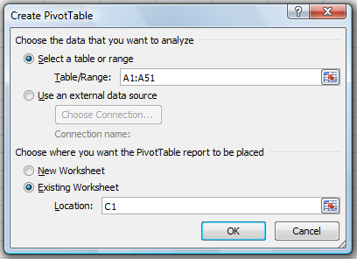
Using Excel’s PivotTable Report
to Construct a Frequency Distribution

Slide 38
Using Excel’s PivotTable Report
to Construct a Frequency Distribution
Step 4 In the PivotTable Field List, go to Choose Fields
to add to report:
Drag the Parts Cost field to the Row Labels area
Drag the Parts Cost field to the Values area
Step 5 Click on Count of Parts Cost in the Values area
Step 6 Click Value Field Settings from the list of options
that appear
Step 7 When the Value Field Settings dialog box appears:
Under Summarize value field by, choose Count
Click OK

Slide 39
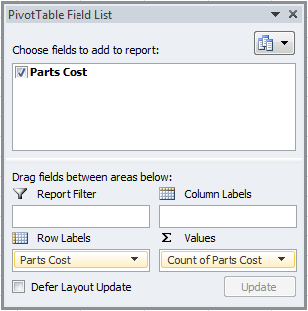
Using Excel’s PivotTable Report
to Construct a Frequency Distribution

Slide 40
Using Excel’s PivotTable Report
to Construct a Frequency Distribution
To construct the frequency distribution, we must group
the rows containing parts costs.
Step 1 Right click any cell in the PivotTable report
containing a parts cost.
Step 2 Choose Group from the list of options that appears
Step 3 When the Grouping dialog box appears:
Enter 50 in the Starting at box
Enter 109 in the Ending at box
Enter 10 in the By box
Click OK

Slide 41
Using Excel’s PivotTable Report
to Construct a Frequency Distribution
Excel PivotTable
A
B
C
D
1
Parts Cost
Row Labels
Count of Parts Cost
2
91
50-59
2
3
71
60-69
13
4
104
70-79
16
5
85
80-89
7
6
62
90-99
7
7
78
100-109
5
8
69
Grand Total
50
9
74
Note: Rows 10-51 are not shown.

Slide 42
Relative Frequency and
Percent Frequency Distributions
Example: Hudson Auto Repair
Parts
Cost ($)
Relative
Frequency
Percent
Frequency
50-59
60-69
70-79
80-89
90-99
100-109
.04
.26
.32
.14
.14
.10
Total 1.00
4
26
32
14
14
10
100
2/50
.04(100)
Percent
frequency is
the relative
frequency
multiplied
by 100.

Slide 43
Relative Frequency and
Percent Frequency Distributions
Example: Hudson Auto Repair
Insights Gained from the % Frequency Distribution:
Only 4% of the parts costs are in the $50-59 class.
30% of the parts costs are under $70.
The greatest percentage (32% or almost one-third)
of the parts costs are in the $70-79 class.
10% of the parts costs are $100 or more.

Slide 44
Dot Plot
One of the simplest graphical summaries of data is a dot plot.
A horizontal axis shows the range of data values.
Then each data value is represented by a dot placed above the axis.

Slide 45
Dot Plot
Example: Hudson Auto Repair
Tune-up Parts Cost
50 60 70 80 90 100 110
Cost ($)

Slide 46
Histogram
Another common graphical presentation of
quantitative data is a histogram.
The variable of interest is placed on the horizontal
axis.
A rectangle is drawn above each class interval with
its height corresponding to the interval’s frequency,
relative frequency, or percent frequency.
Unlike a bar graph, a histogram has no natural
separation between rectangles of adjacent classes.

Slide 47
Histogram
Example: Hudson Auto Repair
18
Tune-up Parts Cost
16
14
12
10
Frequency
8
6
4
2
Parts
Cost ($)
50−59 60−69 70−79 80−89 90−99 100-110

Slide 48
Using Excel’s Chart Tools
to Construct a Histogram
Step 1. Select cells C2:D7
Step 2. Click the Insert tab on the Ribbon
Step 3. In the Charts group, click Column
Step 4. When the list of column chart subtypes appears:
Go to the 2-D Column section
Click Clustered Column (the leftmost chart)
Step 5. In the Chart Layouts group, click the More
button (the downward pointing arrow with
a line over it) to display all the options
… continued

Slide 49
Using Excel’s Chart Tools
to Construct a Histogram
Step 6. Choose Layout 8
Step 7. Select the Chart Title and replace it with
Tune-up Parts Cost
Step 8. Select the Horizontal (Category) Axis Title and
replace it with Parts Cost ($)
Step 9. Select the Vertical (Value) Axis Title and replace
it with Frequency

Slide 50
Using Excel’s Chart Tools
to Construct a Histogram

Slide 51
Histograms Showing Skewness
Symmetric
  Left tail is the mirror image of the right tail
  Examples: heights and weights of people
.35
.30
.25
.20
Relative Frequency
.15
.10
.05
0

Slide 52
Histograms Showing Skewness
Moderately Skewed Left
  A longer tail to the left
  Example: exam scores
.35
.30
.25
.20
Relative Frequency
.15
.10
.05
0

Slide 53
Histograms Showing Skewness
Moderately Right Skewed
  A Longer tail to the right
  Example: housing values
.35
.30
.25
.20
Relative Frequency
.15
.10
.05
0

Slide 54
Histograms Showing Skewness
Highly Skewed Right
  A very long tail to the right
  Example: executive salaries
.35
.30
.25
.20
Relative Frequency
.15
.10
.05
0

Slide 55
Cumulative Distributions
Cumulative frequency distribution − shows the
number of items with values less than or equal to the
upper limit of each class..
Cumulative relative frequency distribution – shows
the proportion of items with values less than or
equal to the upper limit of each class.
Cumulative percent frequency distribution – shows
the percentage of items with values less than or
equal to the upper limit of each class.

Slide 56
Cumulative Distributions
The last entry in a cumulative frequency distribution
always equals the total number of observations.
The last entry in a cumulative relative frequency
distribution always equals 1.00.
The last entry in a cumulative percent frequency
distribution always equals 100.

Slide 57
Cumulative Distributions
Hudson Auto Repair
Cumulative
Relative
Frequency
Cumulative
Percent
Frequency
Cumulative
Frequency
< 59
< 69
< 79
< 89
< 99
< 109
Cost ($)
2
15
31
38
45
50
.04
.30
.62
.76
.90
1.00
4
30
62
76
90
100
2 + 13
15/50
.30(100)

Slide 58
Ogive
An ogive is a graph of a cumulative distribution.
The data values are shown on the horizontal axis.
Shown on the vertical axis are the:
  cumulative frequencies, or
  cumulative relative frequencies, or
  cumulative percent frequencies
The frequency (one of the above) of each class is plotted as a point.
The plotted points are connected by straight lines.

Slide 59
Ogive
  Because the class limits for the parts-cost data are 50-59, 60-69, and so on, there appear to be one-unit gaps from 59 to 60, 69 to 70, and so on.
Hudson Auto Repair
  These gaps are eliminated by plotting points halfway between the class limits.
  Thus, 59.5 is used for the 50-59 class, 69.5 is used for the 60-69 class, and so on.

Slide 60
Ogive with Cumulative Percent Frequencies
Example: Hudson Auto Repair
100
Tune-up Parts Cost
80
60
(89.5, 76)
Cumulative Percent Frequency
40
20
Parts
Cost ($)
50 60 70 80 90 100 110

Slide 61
End of Chapter 2, Part A

