Slide 1
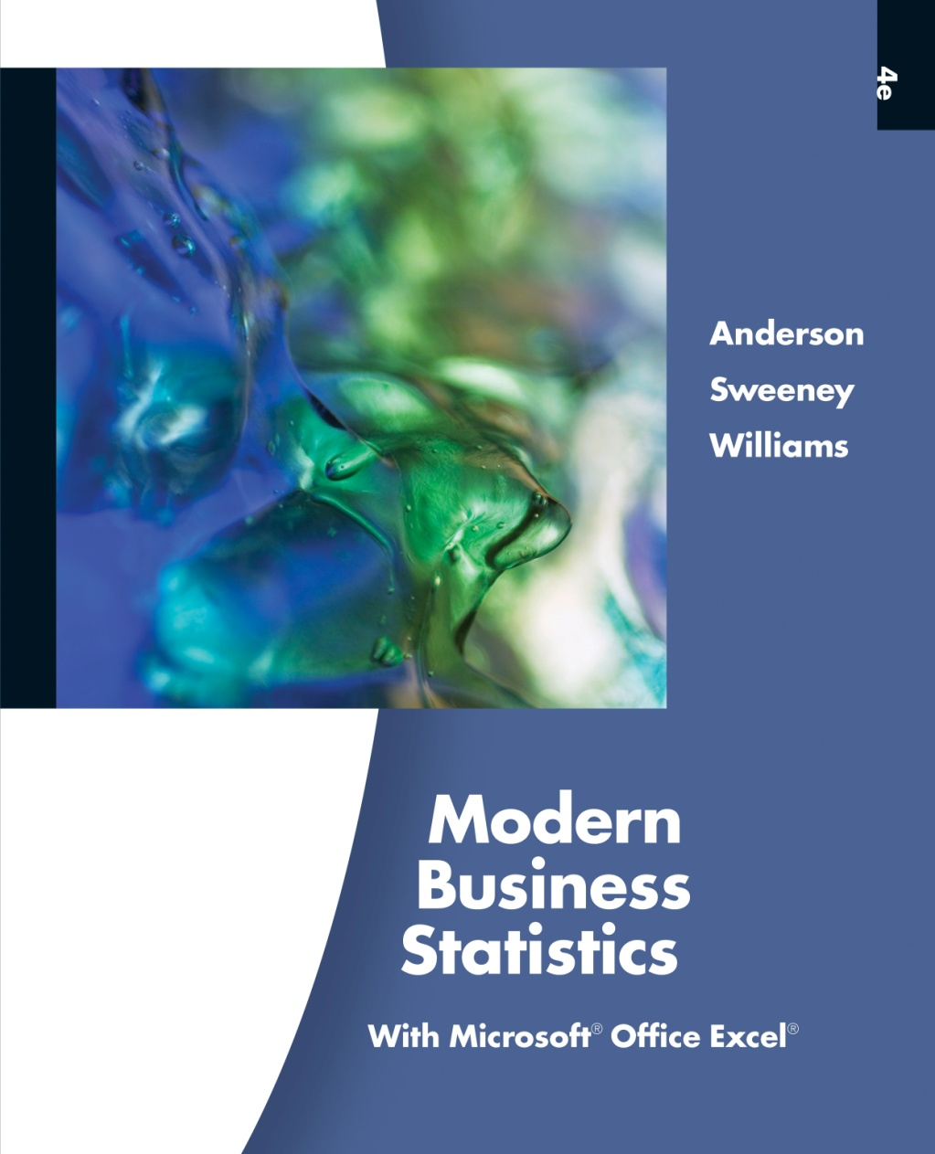
Slides by
John
Loucks
St. Edward’s
University

Slide 2
Chapter 1
Data and Statistics
Statistics
Applications in Business and Economics
Data
Data Sources
Descriptive Statistics
Statistical Inference
Computers and Statistical Analysis
Data Mining
Ethical Guidelines for Statistical Practice

Slide 3
Statistics
The term statistics can refer to numerical facts such as averages, medians, percents, and index numbers that help us understand a variety of business and economic situations.
Statistics can also refer to the art and science of collecting, analyzing, presenting, and interpreting data.

Slide 4
Applications in
Business and Economics
Accounting
Public accounting firms use statistical sampling
procedures when conducting audits for their clients.
Economics
Economists use statistical information in making
forecasts about the future of the economy or some
aspect of it.
Finance
Financial advisors use price-earnings ratios and
dividend yields to guide their investment advice.

Slide 5
Applications in
Business and Economics
Marketing
Electronic point-of-sale scanners at retail checkout
counters are used to collect data for a variety of
marketing research applications.
Production
A variety of statistical quality control charts are used
to monitor the output of a production process.

Slide 6
Data and Data Sets
Data are the facts and figures collected, analyzed,
and summarized for presentation and interpretation.
All the data collected in a particular study are referred
to as the data set for the study.

Slide 7
Elements, Variables, and Observations
Elements are the entities on which data are collected.
A variable is a characteristic of interest for the elements.
The set of measurements obtained for a particular
element is called an observation.
A data set with n elements contains n observations.
The total number of data values in a complete data
set is the number of elements multiplied by the
number of variables.

Slide 8
Data, Data Sets,
Elements, Variables, and Observations
Observation
Variables
Element
Names
Stock Annual Earn/
Exchange Sales($M) Share($)
Company
Dataram
EnergySouth
Keystone
LandCare
Psychemedics
NQ 73.10 0.86
N 74.00 1.67
N 365.70 0.86
NQ 111.40 0.33
N 17.60 0.13
Data Set

Slide 9
Scales of Measurement
Scales of measurement include:
Nominal
Interval
Ordinal
Ratio
The scale determines the amount of information
contained in the data.
The scale indicates the data summarization and
statistical analyses that are most appropriate.

Slide 10
Scales of Measurement
Nominal
Data are labels or names used to identify an
attribute of the element.
A nonnumeric label or numeric code may be used.

Slide 11
Scales of Measurement
Nominal
Example:
Students of a university are classified by the
school in which they are enrolled using a
nonnumeric label such as Business, Humanities,
Education, and so on.
Alternatively, a numeric code could be used for
the school variable (e.g. 1 denotes Business,
2 denotes Humanities, 3 denotes Education, and
so on).

Slide 12
Scales of Measurement
Ordinal
The data have the properties of nominal data and
the order or rank of the data is meaningful.
A nonnumeric label or numeric code may be used.

Slide 13
Scales of Measurement
Ordinal
Example:
Students of a university are classified by their
class standing using a nonnumeric label such as
Freshman, Sophomore, Junior, or Senior.
Alternatively, a numeric code could be used for
the class standing variable (e.g. 1 denotes
Freshman, 2 denotes Sophomore, and so on).

Slide 14
Scales of Measurement
Interval
The data have the properties of ordinal data, and
the interval between observations is expressed in
terms of a fixed unit of measure.
Interval data are always numeric.

Slide 15
Scales of Measurement
Interval
Example:
Melissa has an SAT score of 1885, while Kevin
has an SAT score of 1780. Melissa scored 105
points more than Kevin.

Slide 16
Scales of Measurement
Ratio
The data have all the properties of interval data
and the ratio of two values is meaningful.
Variables such as distance, height, weight, and time
use the ratio scale.
This scale must contain a zero value that indicates
that nothing exists for the variable at the zero point.

Slide 17
Scales of Measurement
Ratio
Example:
Melissa’s college record shows 36 credit hours
earned, while Kevin’s record shows 72 credit
hours earned. Kevin has twice as many credit
hours earned as Melissa.

Slide 18
Categorical and Quantitative Data
Data can be further classified as being categorical
or quantitative.
The statistical analysis that is appropriate depends
on whether the data for the variable are categorical
or quantitative.
In general, there are more alternatives for statistical
analysis when the data are quantitative.

Slide 19
Categorical Data
Labels or names used to identify an attribute of
each element
Often referred to as qualitative data
Use either the nominal or ordinal scale of
measurement
Can be either numeric or nonnumeric
Appropriate statistical analyses are rather limited

Slide 20
Quantitative Data
Quantitative data indicate how many or how much:
discrete, if measuring how many
continuous, if measuring how much
Quantitative data are always numeric.
Ordinary arithmetic operations are meaningful for
quantitative data.

Slide 21
Scales of Measurement
Data
Categorical
Quantitative
Numeric
Non-numeric
Numeric
Nominal
Ordinal
Nominal
Ordinal
Interval
Ratio

Slide 22
Cross-Sectional Data
Cross-sectional data are collected at the same or
approximately the same point in time.
Example: data detailing the number of building
permits issued in November 2010 in each of the
counties of Ohio

Slide 23
Time Series Data
Time series data are collected over several time
periods.
Example: data detailing the number of building
permits issued in Lucas County, Ohio in each of
the last 36 months
Graphs of time series help analysts understand
  what happened in the past,
  identify any trends over time, and
  project future levels for the time series

Slide 24
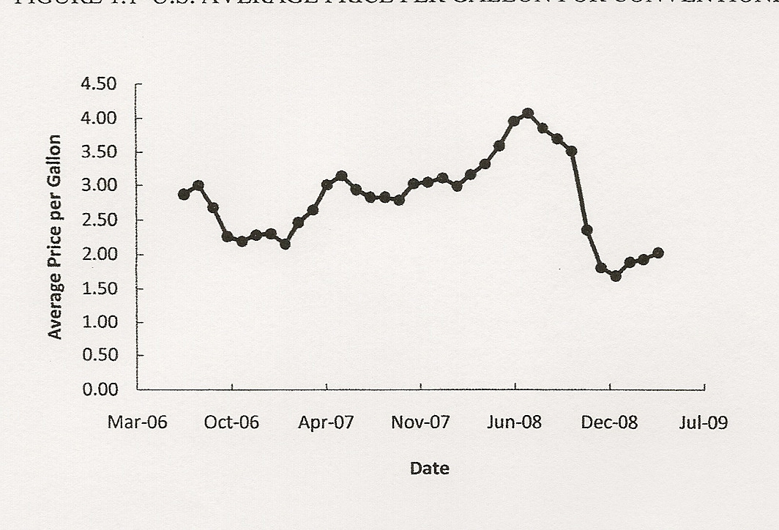
Time Series Data
Graph of Time Series Data
U.S. Average Price Per Gallon
For Conventional Regular Gasoline
Source: Energy Information Administration, U.S. Department of Energy, May 2009.

Slide 25
Data Sources
Existing Sources
Internal company records – almost any department
Business database services – Dow Jones & Co.
Government agencies - U.S. Department of Labor
Industry associations – Travel Industry Association
of America
Special-interest organizations – Graduate Management
Admission Council
Internet – more and more firms

Slide 26
Data Sources
Data Available From Internal Company Records
Record Some of the Data Available
Employee records
name, address, social security number
Production records
part number, quantity produced,
direct labor cost, material cost
Inventory records
part number, quantity in stock,
reorder level, economic order quantity
Sales records
product number, sales volume, sales
volume by region
Credit records
customer name, credit limit, accounts
receivable balance
Customer profile
age, gender, income, household size

Slide 27
Data Sources
Data Available From Selected Government Agencies
Government Agency Some of the Data Available
Census Bureau
www.census.gov
Population data, number of
households, household income
Federal Reserve Board
www.federalreserve.gov
Data on money supply, exchange
rates, discount rates
Office of Mgmt. & Budget
www.whitehouse.gov/omb
Data on revenue, expenditures, debt
of federal government
Department of Commerce
www.doc.gov
Data on business activity, value of
shipments, profit by industry
Bureau of Labor Statistics
www.bls.gov
Customer spending, unemployment
rate, hourly earnings, safety record

Slide 28
Data Sources
Statistical Studies - Experimental
  In experimental studies the variable of interest is
  first identified. Then one or more other variables
  are identified and controlled so that data can be
  obtained about how they influence the variable of
  interest.
The largest experimental study ever conducted is
believed to be the 1954 Public Health Service
experiment for the Salk polio vaccine. Nearly two
million U.S. children (grades 1- 3) were selected.

Slide 29
Data Sources
Statistical Studies - Observational
In observational (nonexperimental) studies no
attempt is made to control or influence the
variables of interest.
a survey is a good example
Studies of smokers and nonsmokers are
observational studies because researchers
do not determine or control
who will smoke and who will not smoke.

Slide 30
Data Acquisition Considerations
Time Requirement
Searching for information can be time consuming.
Information may no longer be useful by the time it
is available.
Cost of Acquisition
Organizations often charge for information even
when it is not their primary business activity.
Data Errors
Using any data that happen to be available or were
acquired with little care can lead to misleading
information.

Slide 31
Descriptive Statistics
Most of the statistical information in newspapers, magazines, company reports, and other publications consists of data that are summarized and presented in a form that is easy to understand.
Such summaries of data, which may be tabular, graphical, or numerical, are referred to as descriptive statistics.

Slide 32
Example: Hudson Auto Repair
The manager of Hudson Auto would like to have a
better understanding of the cost of parts used in the
engine tune-ups performed in her shop. She examines
50 customer invoices for tune-ups. The costs of parts,
rounded to the nearest dollar, are listed on the next
slide.

Slide 33
Example: Hudson Auto Repair
Sample of Parts Cost ($) for 50 Tune-ups

Slide 34
Tabular Summary:
Frequency and Percent Frequency
Example: Hudson Auto
Parts
Cost ($)
Frequency
Percent
Frequency
2
13
16
7
7
5
50
4
26
32
14
14
10
100
50-59
60-69
70-79
80-89
90-99
100-109
(2/50)100

Slide 35
Graphical Summary: Histogram
Example: Hudson Auto
18
Tune-up Parts Cost
16
14
12
10
Frequency
8
6
4
2
Parts
Cost ($)
50−59 60−69 70−79 80−89 90−99 100-110

Slide 36
Numerical Descriptive Statistics
The most common numerical descriptive statistic
is the average (or mean).
The average demonstrates a measure of the central
tendency, or central location, of the data for a variable.
Hudson’s average cost of parts, based on the 50
tune-ups studied, is $79 (found by summing the
50 cost values and then dividing by 50).

Slide 37
Statistical Inference
Population
− the set of all elements of interest in a
particular study
Sample
− a subset of the population
Statistical inference
− the process of using data obtained
from a sample to make estimates
and test hypotheses about the
characteristics of a population
Census
− collecting data for the entire population
Sample survey
− collecting data for a sample

Slide 38
Process of Statistical Inference
1. Population
consists of all tune-
ups. Average cost of
parts is unknown.
2. A sample of 50
engine tune-ups
is examined.
4. The sample average
is used to estimate the
population average.
The sample data
provide a sample
average parts cost
of $79 per tune-up.

Slide 39
Statistical Analysis Using Microsoft Excel
Statisticians often use computer software to perform
the statistical computations required with large
amounts of data.
Often the data to be analyzed reside in a spreadsheet.
In your textbook you are shown how statistical
analysis can be performed using Microsoft Excel.
Chapter appendices show how to use StatTools, an
Excel add-in, that provides an extended range of
statistical and graphical options.

Slide 40
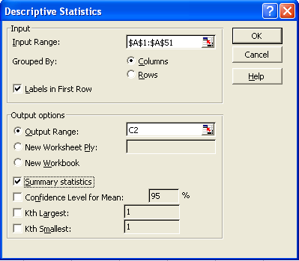
Statistical Analysis Using Microsoft Excel
3 tasks might be needed:
Enter Data
Enter Functions and Formulas
Apply Tools
D
E
Mean
=AVERAGE(A2:A71)
Median
=MEDIAN(A2:A71)
Mode
=MODE.SNGL(A2:A71)
Range
=MAX(A2:A71)-MIN(A2:A71)

Slide 41
Statistical Analysis Using Microsoft Excel
Excel Worksheet (showing data)
Note: Rows 10-51 are not shown.

Slide 42
Statistical Analysis Using Microsoft Excel
Excel Formula Worksheet
Note: Columns A-B and rows 10-51 are not shown.

Slide 43
Statistical Analysis Using Microsoft Excel
Excel Value Worksheet
Note: Columns A-B and rows 10-51 are not shown.

Slide 44
Data Warehousing
Organizations obtain large amounts of data on a
daily basis by means of magnetic card readers, bar
code scanners, point of sale terminals, and touch
screen monitors.
Wal-Mart captures data on 20-30 million transactions
per day.
Visa processes 6,800 payment transactions per second.
Capturing, storing, and maintaining the data, referred
to as data warehousing, is a significant undertaking.

Slide 45
Data Mining
Analysis of the data in the warehouse might aid in
decisions that will lead to new strategies and higher
profits for the organization.
Using a combination of procedures from statistics,
mathematics, and computer science, analysts “mine
the data” to convert it into useful information.
The most effective data mining systems use automated
procedures to discover relationships in the data and
predict future outcomes, … prompted by only general,
even vague, queries by the user.

Slide 46
Data Mining Applications
The major applications of data mining have been
made by companies with a strong consumer focus
such as retail, financial, and communication firms.
Data mining is used to identify related products that
customers who have already purchased a specific
product are also likely to purchase (and then pop-ups
are used to draw attention to those related products).
As another example, data mining is used to identify
customers who should receive special discount offers
based on their past purchasing volumes.

Slide 47
Data Mining Requirements
Statistical methodology such as multiple regression,
logistic regression, and correlation are heavily used.
Also needed are computer science technologies
involving artificial intelligence and machine learning.
A significant investment in time and money is
required as well.

Slide 48
Data Mining Model Reliability
Finding a statistical model that works well for a
particular sample of data does not necessarily mean
that it can be reliably applied to other data.
With the enormous amount of data available, the
data set can be partitioned into a training set (for
model development) and a test set (for validating
the model).
There is, however, a danger of over fitting the model
to the point that misleading associations and
conclusions appear to exist.
Careful interpretation of results and extensive testing
is important.

Slide 49
Ethical Guidelines for Statistical Practice
In a statistical study, unethical behavior can take a
variety of forms including:
Improper sampling
Inappropriate analysis of the data
Development of misleading graphs
Use of inappropriate summary statistics
Biased interpretation of the statistical results
You should strive to be fair, thorough, objective, and
neutral as you collect, analyze, and present data.
As a consumer of statistics, you should also be aware
of the possibility of unethical behavior by others.

Slide 50
Ethical Guidelines for Statistical Practice
The American Statistical Association developed the
report “Ethical Guidelines for Statistical Practice”.
The report contains 67 guidelines organized into
eight topic areas:
Professionalism
Responsibilities to Funders, Clients, Employers
Responsibilities in Publications and Testimony
Responsibilities to Research Subjects
Responsibilities to Research Team Colleagues
Responsibilities to Other Statisticians/Practitioners
Responsibilities Regarding Allegations of Misconduct
Responsibilities of Employers Including Organizations,
Individuals, Attorneys, or Other Clients

Slide 51
End of Chapter 1

